Slide 1
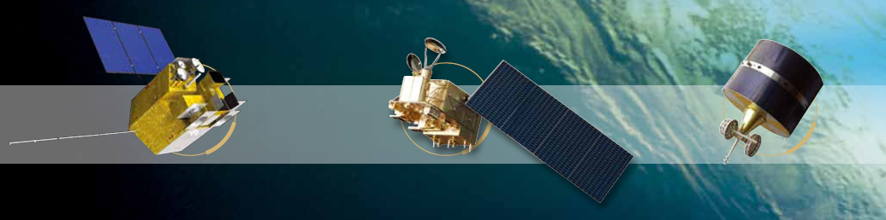
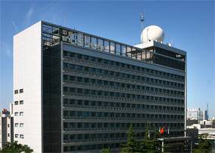


FENGYUN Meteorological Satellite Data Service
WU Xuebao
National Satellite Meteorology Center （NSMC）
China Meteorological Administration （CMA）
AOMSUC-10, Melbourne, Australia
Dec. 2-7, 2019

Slide 2
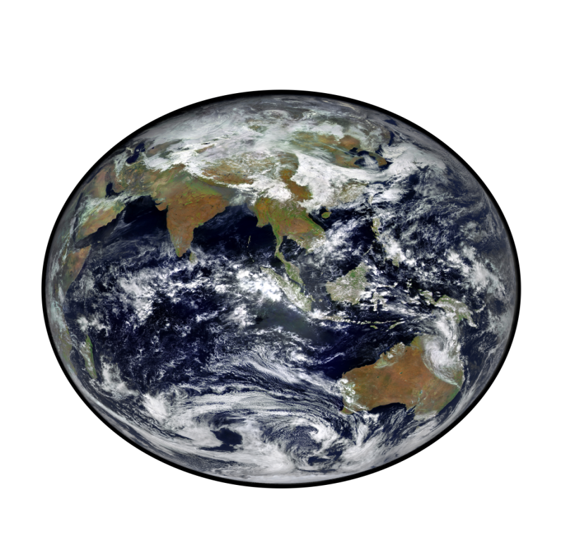
Outline
What we have?
How to access these data and products?

Slide 3
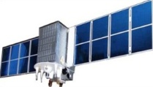
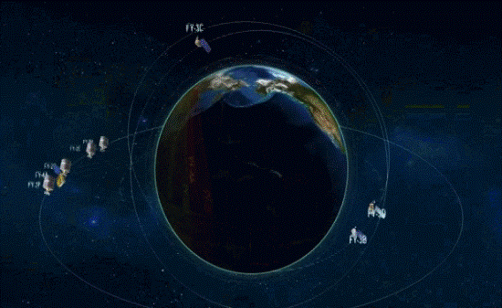
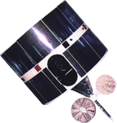
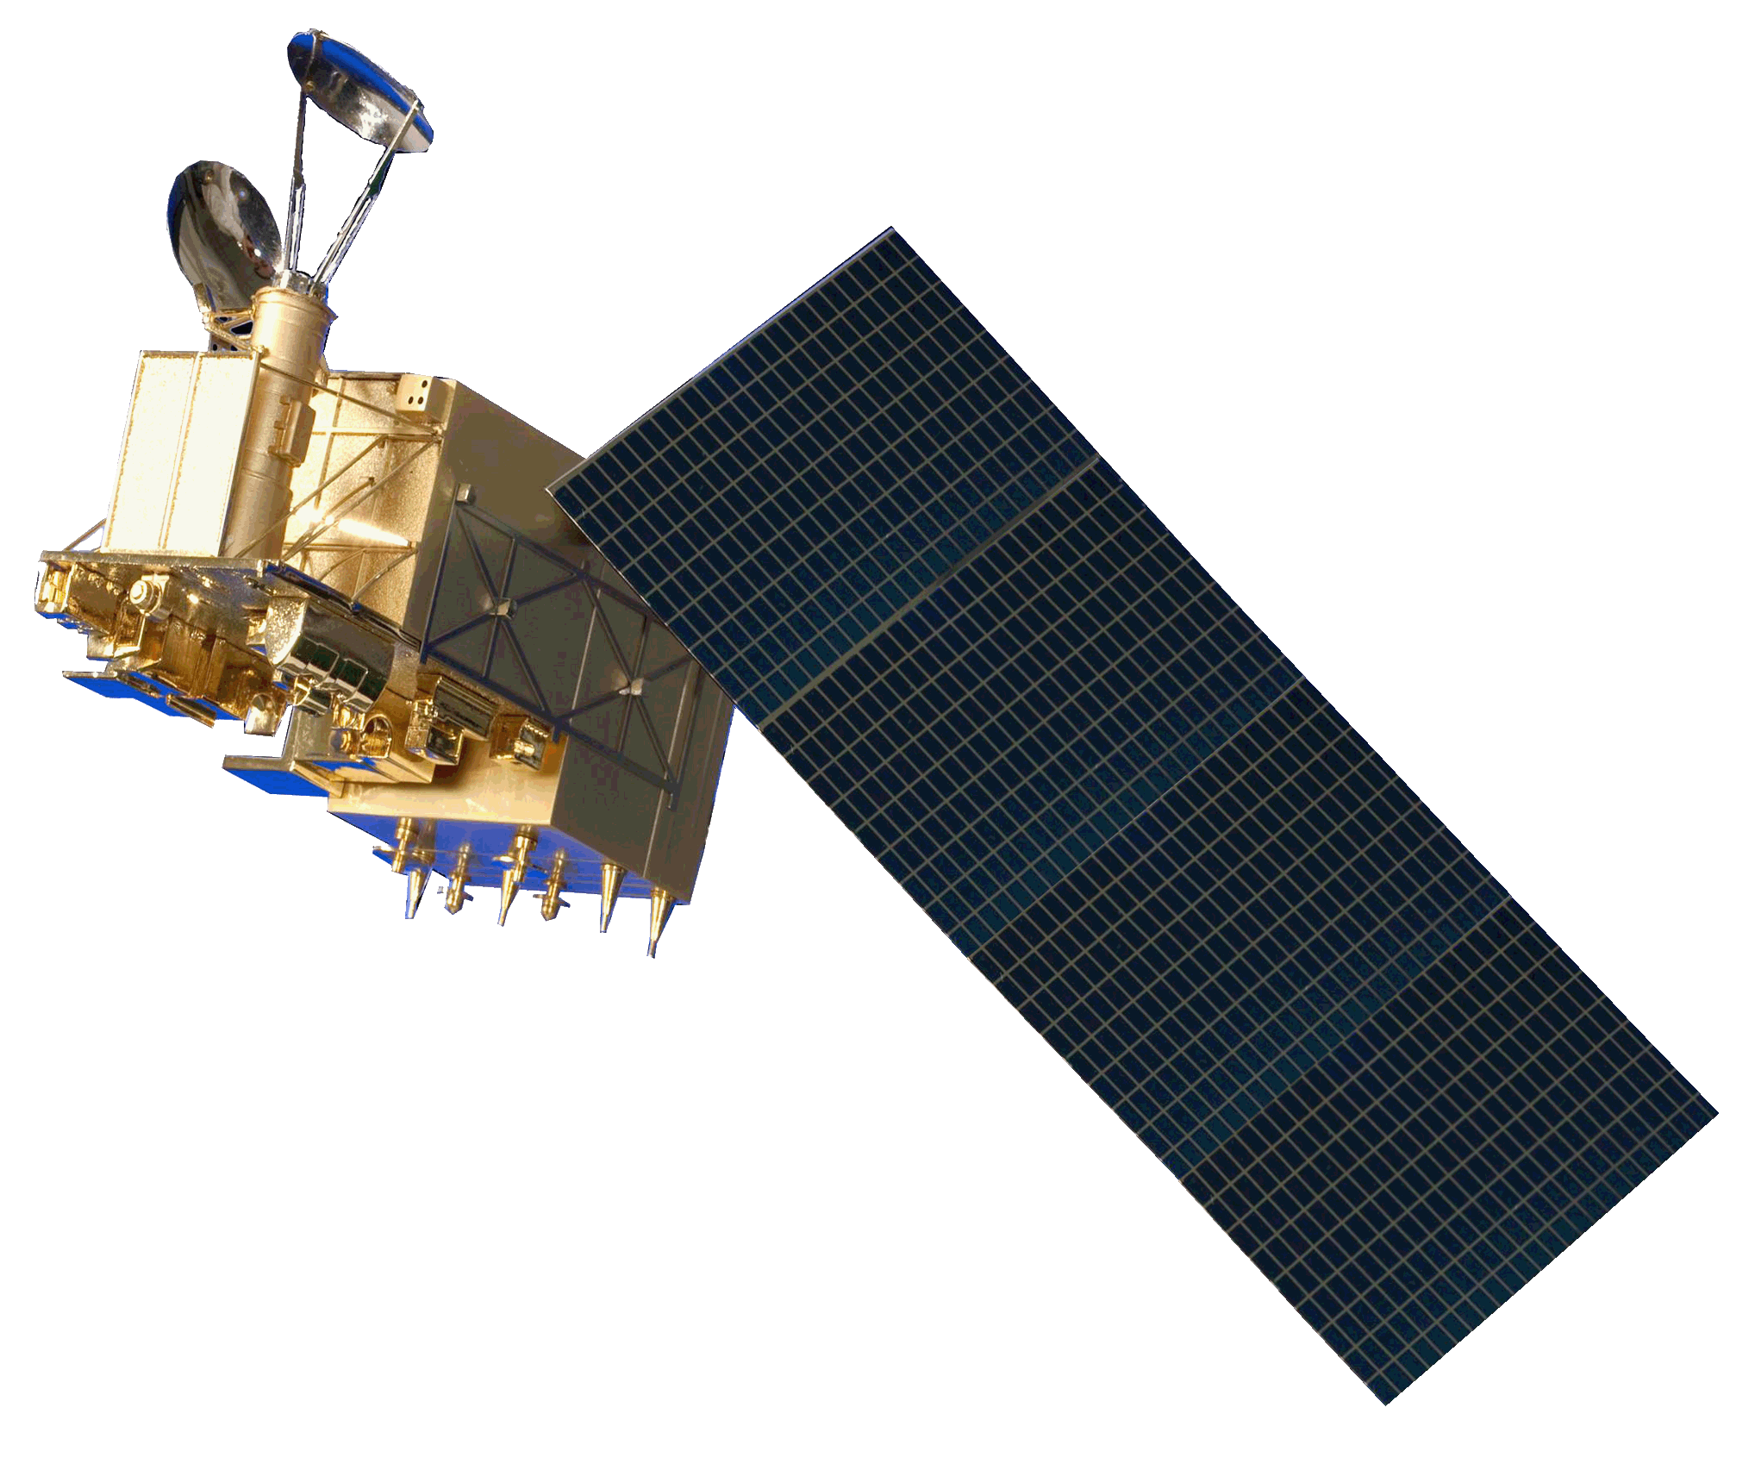
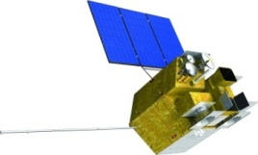
FENGYUN Meteorological Satellites
Polar-orbiting System
Geostationary System
First Generation
FY-1 A, B, C, D
First Generation
FY-2 A, B, C, D, E,
F, G, H
Second Generation
FY-3 A, B, C, D
Second Generation
FY-4 A
FY-3E,F, G planned until 2025
FY-4B,C,D planned until 2025

Slide 4
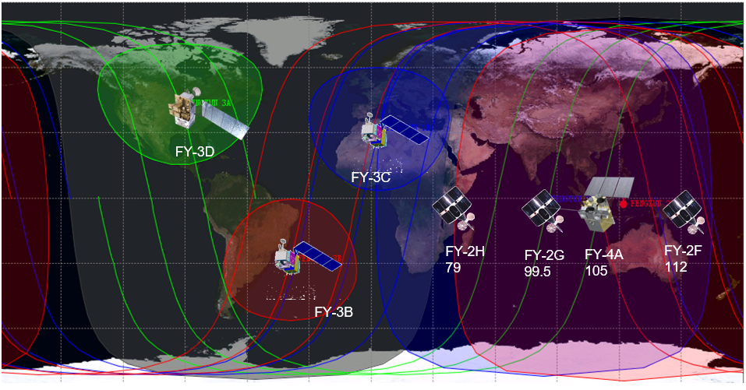
FENGYUN Meteorological Satellites
7 FengYun Satellites in operational service
  FY LEO:
    FY3B/3C/D
  FY GEO:
    FY2F/2G/2H
    FY4A
Notes:
This satellite observation network in the morning and afternoon watches the earth seamlessly six times a day. Geostationary satellites are operating from 4ºE to 173ºW, providing continuous observations of areas ranging from Africa to the central Pacific at an interval of up to 5 minutes.

Slide 5
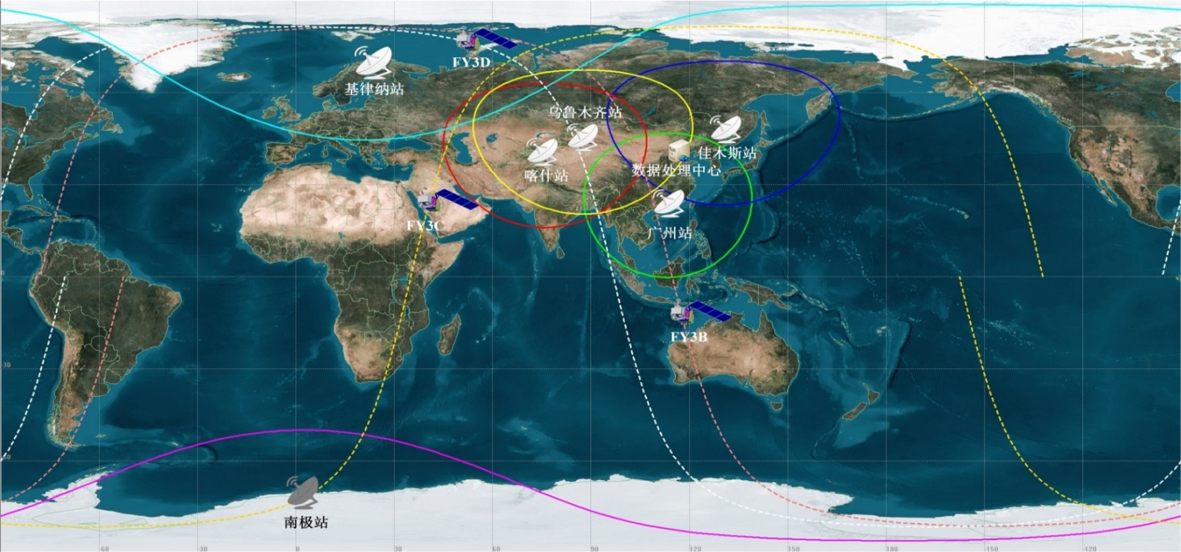
FengYun LEO Constellation
FY-3C + FY-3D, global coverage 4 times per day
FY-3B
FY-3C LTC 10:30 AM
FY-3D LTC 13:40 PM
Notes:
This satellite observation network in the morning and afternoon watches the earth seamlessly six times a day.

Slide 6
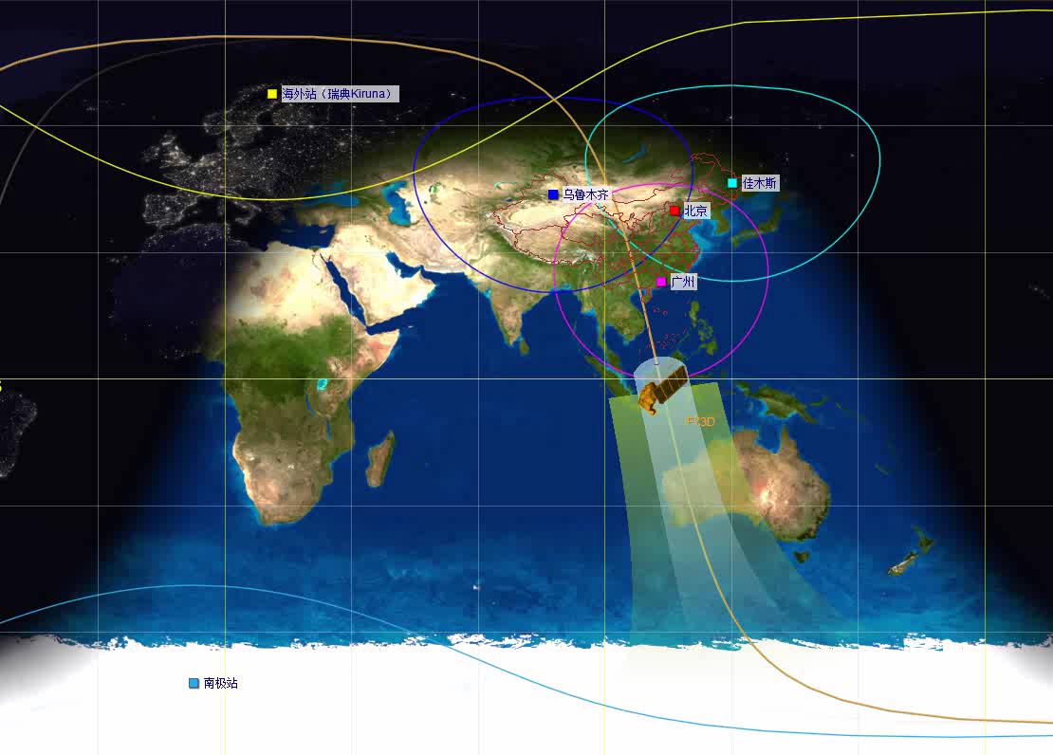
FY-3D: Launched on 15 Nov, 2017
10 instruments on board FY-3D:
5 Successive instruments:
MWTS-II: Microwave Temperature sounder
MWHS-II: Microwave Humidity sounder
MWRI: Microwave Radiation Imager
GNOS: Global Navigation Occultation Sounder
SEM: Space Environment Monitor
2 Improved instruments：
MERSI-II：Improved from MERSI
HiRAS: Upgraded from filter-type spectrometer IRAS
3 New Instruments:
GAS: Greenhouse gases Absorption Spectrometer
WAI: Wide-angle Aurora Imager
IPM: Ionospheric Photometer

Slide 7
FY-3D Baseline products
Cloud & Radiation | Atmosphere | Land Surface | Sea Surface | Space Weather
Cloud mask, Cloud amount, Cloud type, Cloud phase, Cloud top temperature, Cloud top height, Cloud optical depth, Cloud physical parameters, Cloud water content, Cloud liquid water, Ice water path, Outgoing longwave radiation | Atmospheric total precipitable water, Dust storm index, Aerosol optical depth, Rain detection, Atmospheric humidity profile (GNOS,VASS), Atmospheric temperature profile (GNOS,VASS), Precipitation, Microwave rain rate, Fog detection | Global fire detection, Land cover, Land surface reflectance, Land surface temperature, Soil moisture, NDVI, Snow cover, Snow cover fraction, LAI, FPAR, NPP, Albedo, Snow depth, Snow water equivalent | SST, Sea-Ice cover, Ocean color, Chlorophyll, Sea surface wind speed | radiation flux of high energy particles, surface electric potential radiation dose, GNOS Electron Density Profile, Ionospheric O/N2 Column Ratio, Aurora Mapping Products

Slide 8
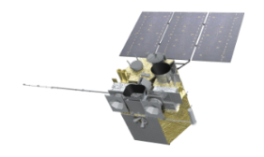
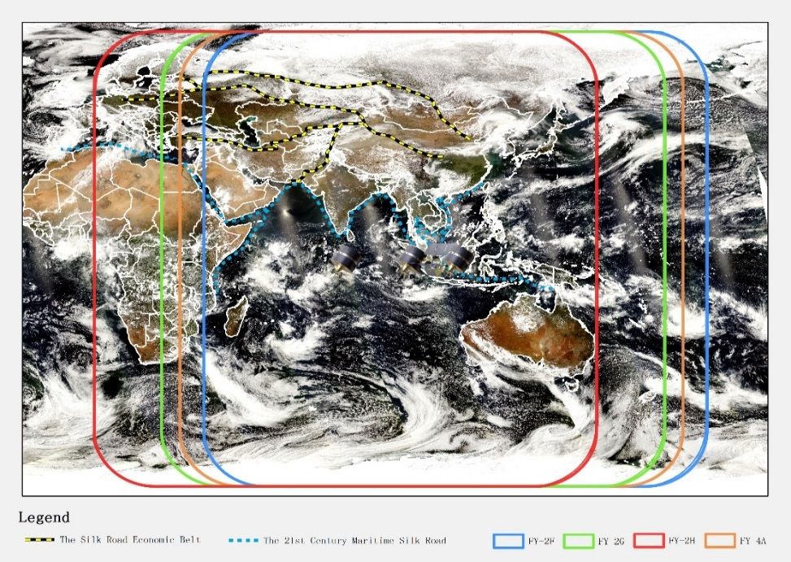
FengYun GEO Constellation
FDS
FDS
FDS+RRS
RRS
4 in operation
  FY-2G: Full Disk (99.5°E)
  FY-2F: Regional (112°E)
  FY-2H：Full Disk (79°E)
  FY-4A: Full Disk + Regional Rapid (105°E)
FY-2H
FY-2G
FY-4A
FY-2F

Slide 9
FY-4A & FY2 Baseline products
 | FY-4A | FY-2
Cloud | Cloud Mask Cloud Top Temperature Cloud Top Height Cloud Top Pressure Cloud Type Cloud Phase Daytime cloud optical and microphysical properties Nighttime cloud optical and microphysical properties | Cloud Mask Cloud Top Temperature Cloud Classification Cloud Cover Ratio Cloud Total Amount
Atmosphere | Quantitative Precipitation Estimate Layer Precipitable Water Atmosphere Motion Vector Atmospheric Temperature Profile Atmospheric Humidity Profile Cloudy Vertical Temperature Profile Cloudy Vertical Moisture Profile Aerosol Detection Atmosphere Instability Index Convective Initiation Tropopause Folding Turbulence Prediction Total Ozone Amout Ozone Profile | Precipitation Index Quantitative Precipitation Estimate Clear sky Total Precipitable Water Atmosphere Motion Vector Cloudy Vertical Moisture Profile Upper Tropopause Humidity
Radiation | Outgoing Long wave Radiation Surface Solar Irradiance Downward Longwave Radiation Upward Longwave Radiation Reflected Shortwave Radiation | Outgoing Long wave Radiation Surface Solar Irradiance
Surface | Sea Surface Temperature (Skin) Land Surface Temperature Snow Cover Land Surface Albedo Land Surface Emissivity Evapotranspiration products | Sea Surface Temperature (Skin) Land Surface Temperature Snow Cover
Environment | Dust Smoke Detection Fire/Hot Spot Characterization Fog Detection | Dust Index Fire/Hot Spot Characterization Heavy Fog Detection
Lightning | One Minute Lightning Quantitative Product (including flash group event) Lightning Jump Identification Product Flash Daily Density
Space | High-energy particle distribution Magnetic Field Intensity Space Environment Effect

Slide 10
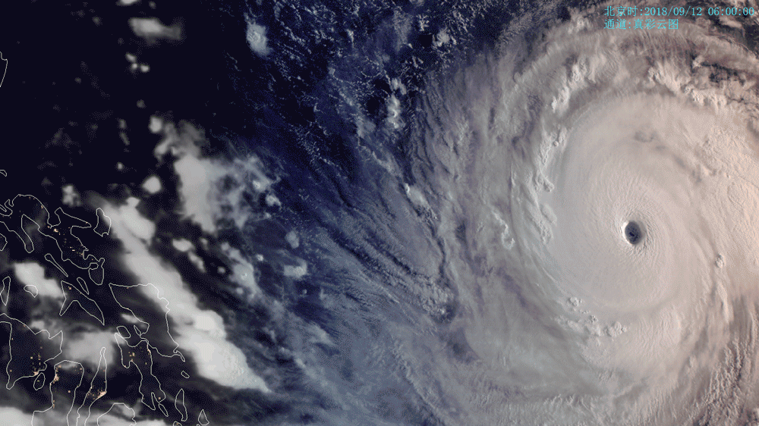
AGRI Typhon Monitoring

Slide 11
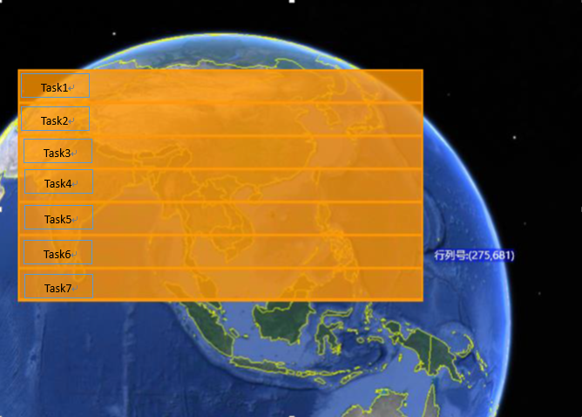
FY4A GIIRS Schedule
Daily Schedule:
  Every 2 hour: Full Observation region, will be scheduled to 7 tasks
  Every task costs 10 minutes. One task contains ca 60 dwells.
  16—18UTC: Maintenance, data unavailable
Observation region:
  3N-55N, 60E-137E

Slide 12
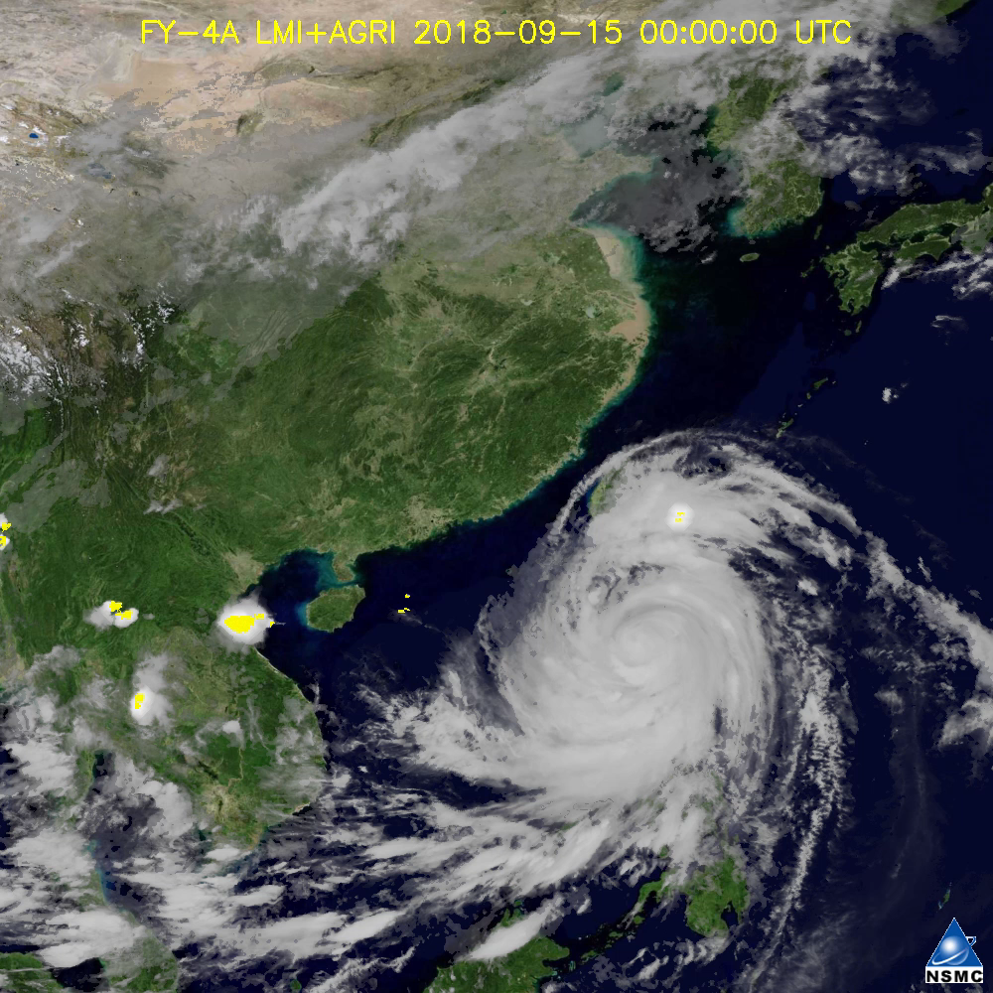
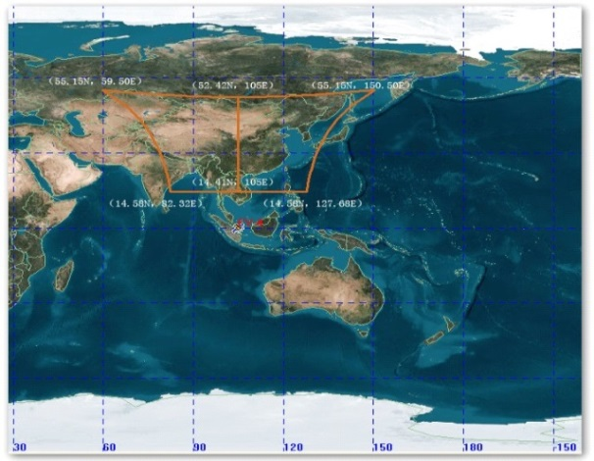
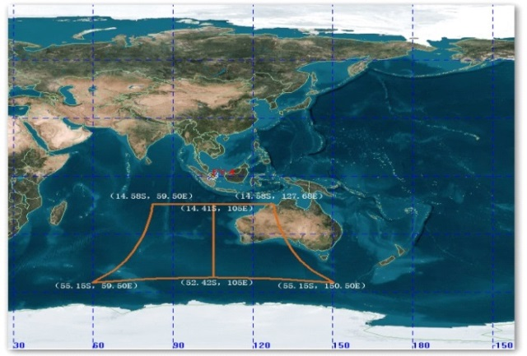
LMI—Continuous Capture
Daily Schedule:
  500 frames per second
  21 Mar.-22 Sep: Northern Hemisphere
  22.Sep-Next 21 Mar: Southern Hemisphere

Slide 13


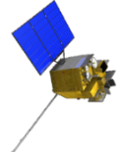
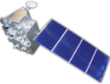

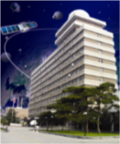

Data Archive
Data resource: Chinese Atmosphere, Land, Ocean Observation satellites data and Foreign satellites data
Archive: 25 Satellites, 122 Datasets
1988-2018, 30 Yeas Total Archive: 12 PB
12PB
Data Exchange
DB System
FengYun
Satellites
Land： CRESDA
Ocean：NSOAS
EU: EUMETSAT
FY-1
FY-2
FY-3
FY-4
EOS/MODIS
NOAA
NPP
MetOp
25Satellites
122Datasets
National Satellite Meteorological Center ,CMA

Slide 14
Atmosphere（33）
Fengyun Products
Aerosol
Aerosol optical thickness
Aerosol over Land Surface
Atmospheric humidity
profile (GNOS)
Atmospheric temperature profile(MWTS-III、MWRI、GNOS)
Atmospheric temperature and humidity Profile(MWHS-II)
Atmospheric temperature and humidity Profile(HIRAS/MWHS-II/MWTS-III)
Atmospheric temperature and humidity Profile(MWHS-III/HIRAS)
Atmospheric temperature and humidity Profile(MWTS-III/HIRAS)
Atmospheric temperature and humidity Profile(MWHS-II/MWTS-III/MWRI)
Total oxygen column
Carbon dioxide mixing ratio
Methane mixing ratio
total ozone column
Nadir Ozone vertical profile
Limb Ozone vertical profile
Space Weather（13）
zeta potential
Radiation dose
Magnetic field
particle(Medium and high energy proton、Electronic three-directional flow、Particle throw angle）
scan imaging
Push-broom scan imaging
Aurora egg morphology
Particle sedimentation
IPM night product
IPM daytime product
IPM multi-angle product
Solar extreme ultraviolet imager
solar x ray imager
Total Precipitable Water
Precipitation
Rain Type
Rain Phase
Radar Rain Rate
Atmospheric bending angle
Atmospheric refractive index
Atmospheric density
Electron density profile
Cloud & Radiation（17）
Equivalent emission radiation for clear sky
OLR of HIRAS
Cloud Top Parameters
Top-up Radiation and Clouds
Surface radiation budget
Total solar irradiance downward from the atmospheric top
solar band irradiance at the top of the atmosphere
Cloud Mask
Cloud Amount
CLoud Classification
Cloud Top Temperature/Cloud Top Pressure
Cloud Optical Depth
the Effective Radius of Cloud
Outgoing Longwave Radiation
Polar Winds
Water leaving Reflectance
Cloud Liquid Water Content
total sulfur dioxide column
Total Nitrogen Dioxide column
Aerosol over Ocean
Total Precipitable Water over Ocean
Land（12）
Land Reflectance Factor
Land Surface Temperature
Land Surface Bidirectional Reflection/ Albedo
Land Cover
Dust Product
Near-Constant Contrast Image
City Light/Urban low-light background mosaic
Land Surface Temperature
Soil moisture content
Surface pressure
surface reflectance
Ocean（7）
Ice&Snow（4）
Biology（4）
MERSI Sea Surface Temperature
MWRI Sea Surface Temperature
MWRI Sea surface wind direction
GNOS Sea surface wind Speed
PR Sea surface wind Speed
PR Sea surface wind direction
Sea ice
Snow Cover
Snow Depth
SWE
Polar Sea Ice Cover
Vegetation Index
Leaf area index
Fraction of Photosynthetically Active Radiation
Net Primary Production
Chlorophyll fluorescence
Operational Product
Research product

Slide 15
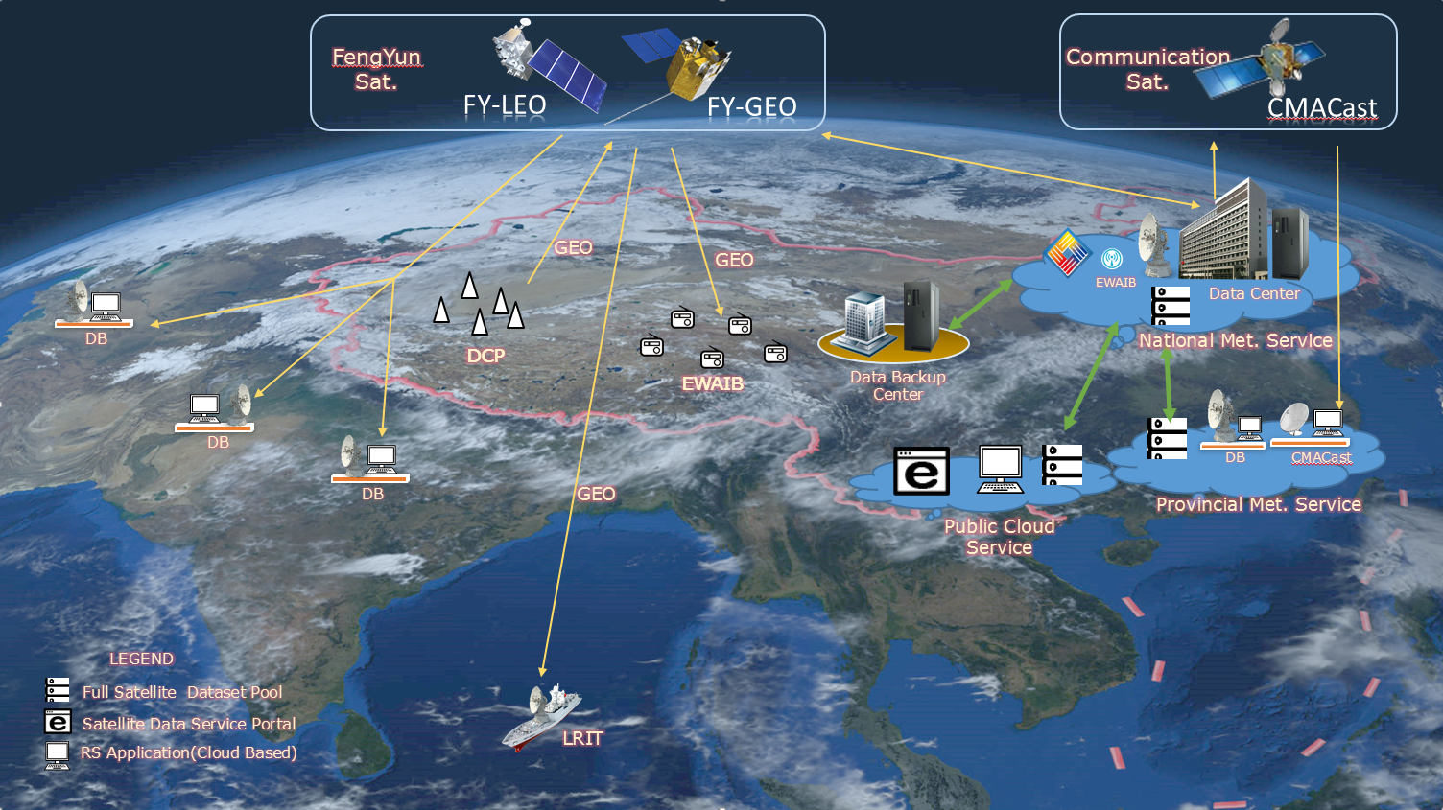
How to access?
Real time
  Direct Broadcast
  CMACast
Non-Real Time
  Website
  Cloud Service
  FTP Service
  Manual Service

Slide 16
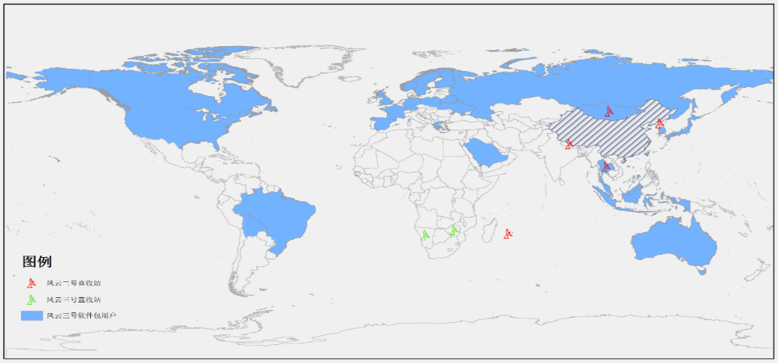
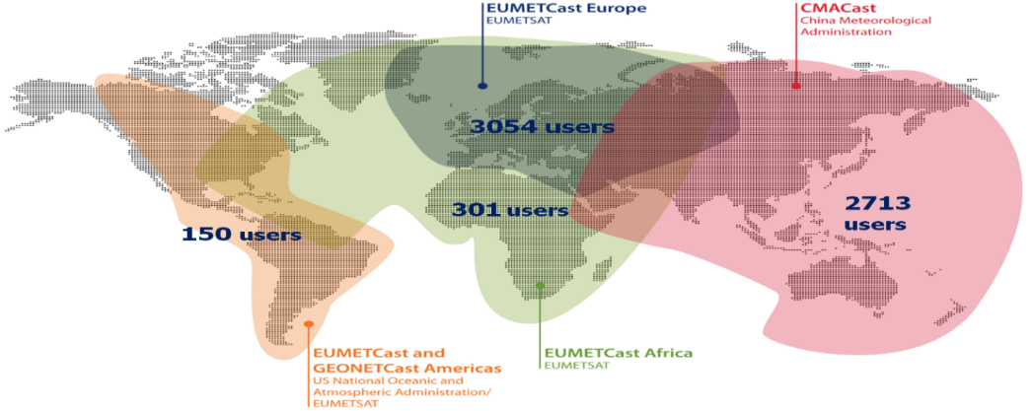
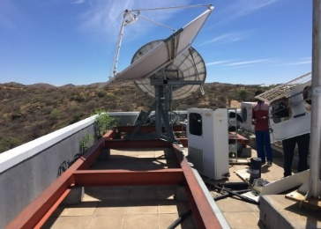
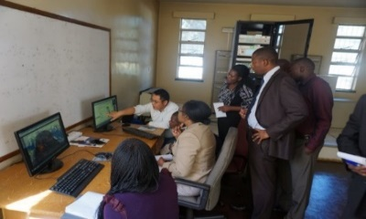
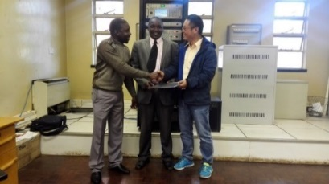
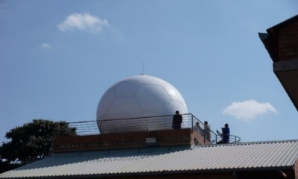
Space based services
FENGYUN satellite Direct Broadcasting System (FY-DBS)
CMA satellite data broadcasting system (CMACast)
FY-2 DB Station: 5 countries
FY-3 DB Station: 2 countries
FY-3 Data Preprocessing Software packages: 24 countries, 47 users
CMACast has been deployed in 19 countries

Slide 17
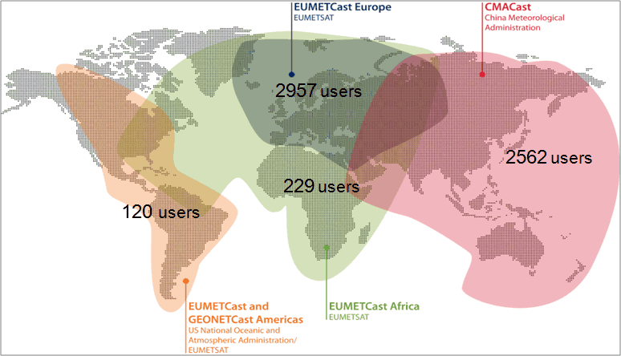
CMACast Coverage
International CMACast Stations in operation
  Laos, Iran, Bengal, Indonesia, Maldives, Nepal, Mongolia, Malaysia, Pakistan, Thailand, Philippines, Uzbekistan, Kyrgyzstan, Sri Lanka, Korea, Vietnam, Myanmar, Australia, Kazakhstan
Notes:
CMACast is also a major component of GEONETCast

Slide 18
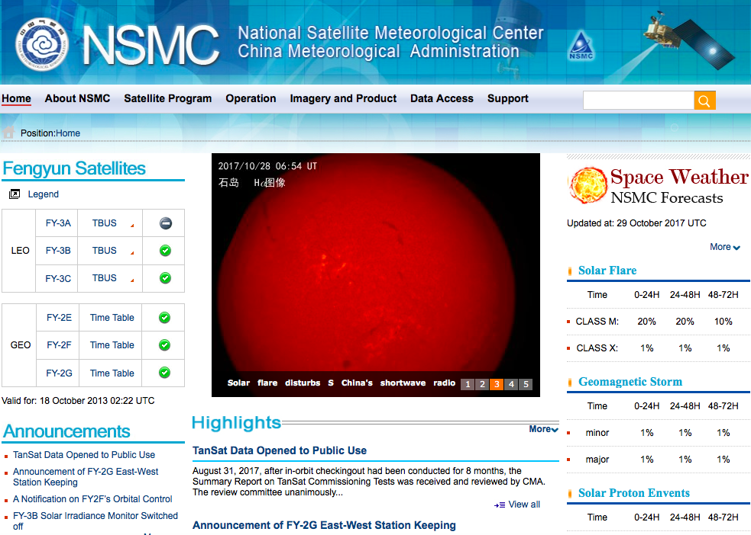
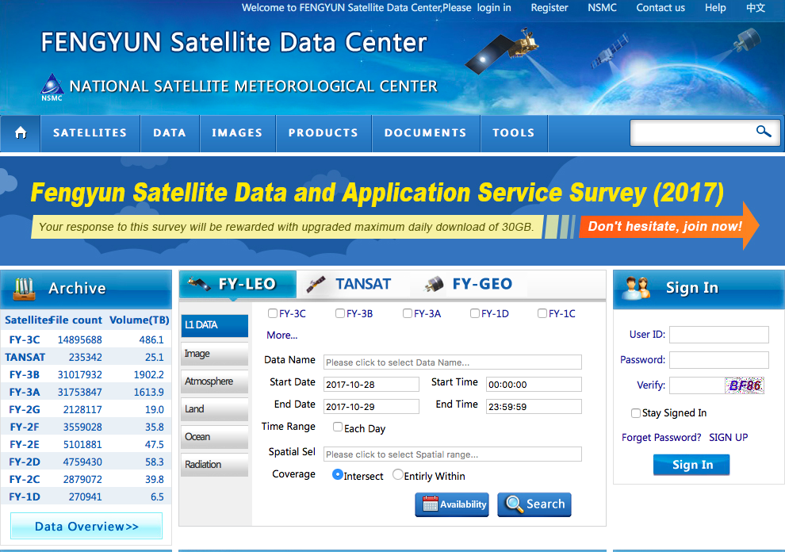
Ground based services
http://www.nsmc.org.cn
http://data.nsmc.org.cn

Slide 19
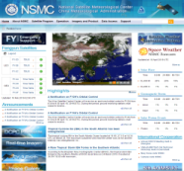
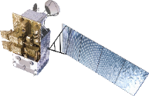


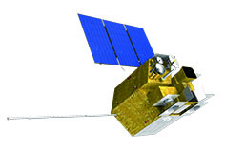
Public cloud
Users
Public Cloud
Data Center
No | Country | No | Country | No | Country
1 | Laos | 11 | Oman | 21 | New Zealand
2 | Myanmar | 12 | Mozambique | 22 | Kazakhstan
3 | Iran | 13 | Kyrgyzstan | 23 | Armenia
4 | Maldives | 14 | Lesotho | 24 | Tajikistan
5 | Thailand | 15 | Mauritius | 25 | Mongolia
6 | Philippines | 16 | Nigeria | 26 | Nepal
7 | Algeria | 17 | Portugal | 27 | Benin
8 | Malaysia | 18 | Ghana | 28 | Ethiopia
9 | Uzbekistan | 19 | Malawi | 29 | Russia
10 | Tunisia | 20 | Guinea
Notes:
开通基于公有云的国际用户数据服务绿色通道
CMA is taking various measures to help international users to prevent and mitigate their meteorological disasters through the application of Fengyun meteorological satellites.
The Fengyun satellite data and products will be available through the Direct Broadcast Receiving System,
Internet, public cloud, WMO Information System and other ways.

Slide 20
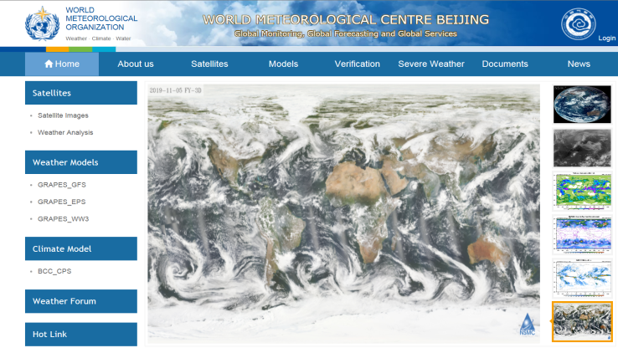
WMC-Beijing Website
Officially launched on 6 Jun 2018 and operated by WMC-Beijing office
— Contribution to WMC-Beijing’s functions
— Platform of CMA for Global Monitoring, Global Forecasting, Global Serving
Real-time graphical products
— Daily FY-4A FY-3D images
— Daily GRAPES_GFS NWP
— Daily GRAPES_EPS NWP
— Monthly and seasonal prediction
www.wmc-bj.net

Slide 21
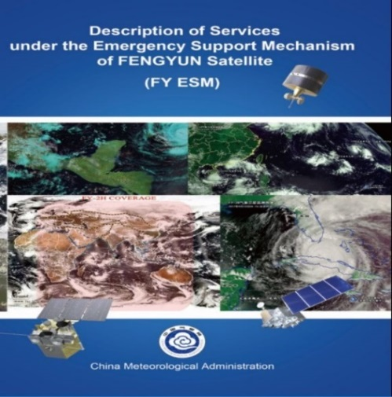
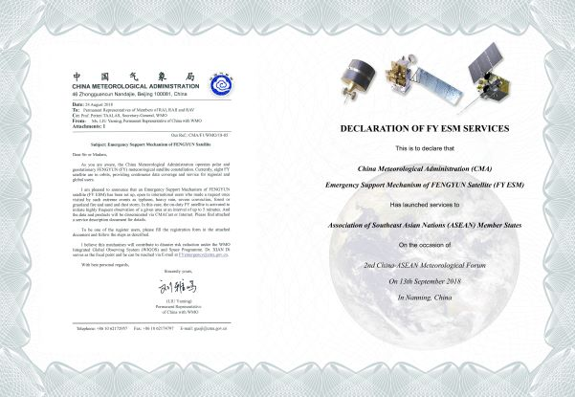
FY_ESM
Establishment of the Emergency Support Mechanism of FENGYUN Satellite (FY_ESM)
China provides timely and efficient observation of extreme weather, climate and environmental events regionally and globally by operating both geostationary and polar-orbiting meteorological satellites. China Meteorological Administration (CMA) issued the Emergency Support Mechanism of FENGYUN (FY) Satellite (FY ESM) in 2018.
Open to all WMO members.

Slide 22

For more information：http://rsapp.nsmc.org.cn/geofy
http://satellite.nsmc.org.cn

Slide 23

谢 谢！
Thanks for your attention!

