Slide 1
Ways to share GEO-KOMPSAT-2A(GK2A) Data and training materials
03 Dec. 2019
Hyesook Park
(hyesookpark@korea.kr)
Satellite Analysis Division
NMSC/KMA

Slide 2

Data Service : Geo-KOMPSAT-2A
The L1B data is releasing via internet as well as broadcast since 25 July 2019.
Via GK2A broadcast (< 3 minutes data latency)
Broadcast all 16 channels data (UHRIT, full resolution) of meteorological observations
Maintain HRIT broadcast corresponding to COMS five channels
LRIT broadcast will be replaced by meteorological service for ship-board small antenna
Via Landline
To disseminate L1B data via real-time cloud service similar to HimawariCloud (< 5 min data latency)
Currently 11 countries are registered (India, Japan, Bangladeshi, Malaysia, Singapore, Nepal, Vietnam, Australia, and Hong Kong, Taiwan, Germany)
GK2A data is also available in NMSC website & DCPC-NMSC (http://dcpc.nmsc.kma.go.kr)
L1/L2 Data Format
netCDF4(for each channels), with GSICS information / netCDF4(for each products)
Notes:
Next is the Geo-KOMPSAT-2A data service plan.
First of all, the GK-2A level 1B data is disseminating since 25 July 2019. Level 2 data will be provided to users after verification.
KMA broadcasts all 16 channels of AMI in full resolution via Geo-KOMPSAT-2A, we named it as Ultra HRIT and maintain HRIT broadcast corresponding to COMS five channels.
And also land-line based real-time FTP data service similar to Himawaricloud is also available.
Real-Time FTP Service (registration 9 countries; 2019. 8. )
The both of level 1 and level 2 data are generated in NetCDF4 format according to the CGMS recommendation

Slide 3
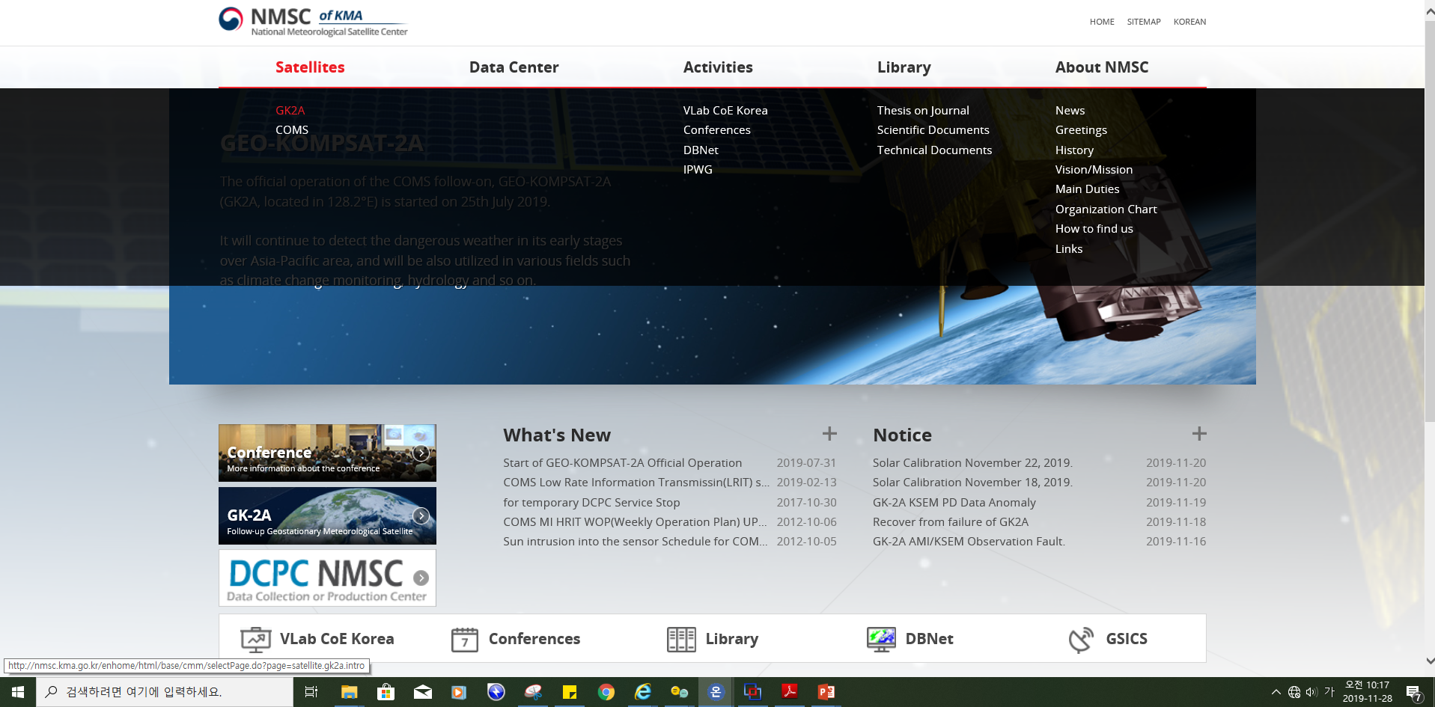
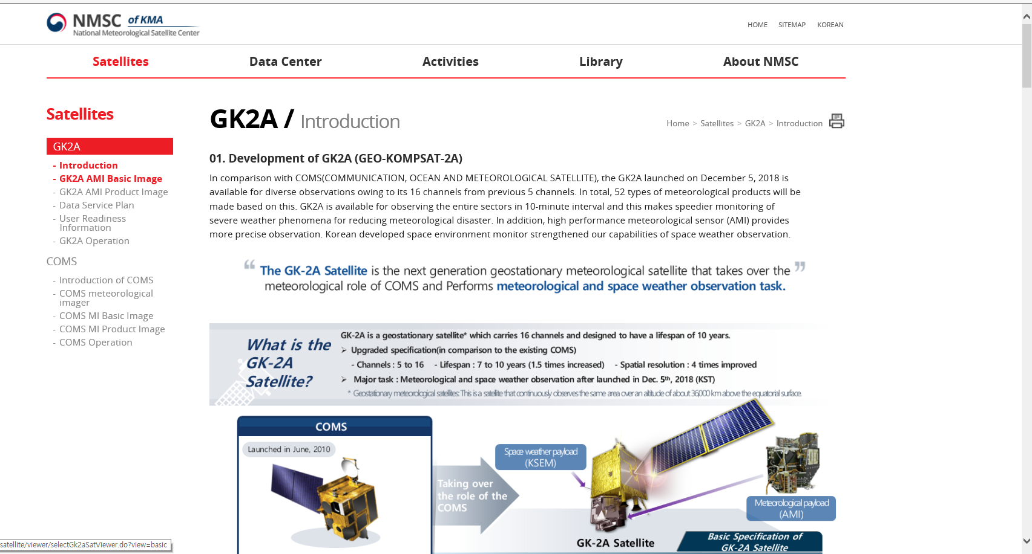
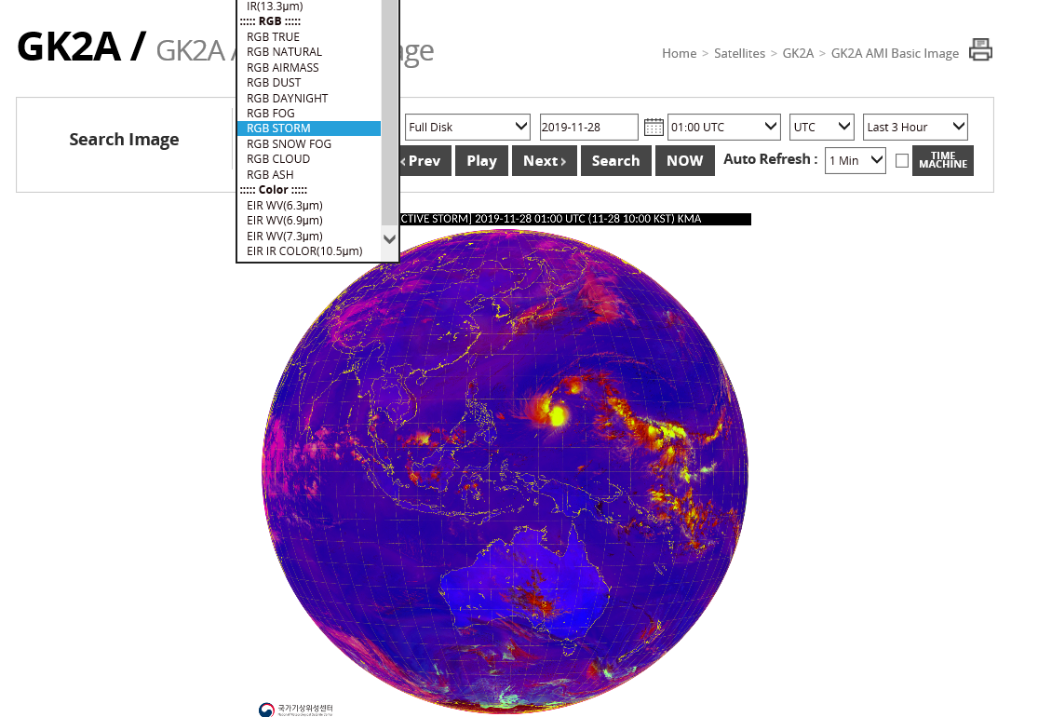
How to access the GK2A image (1)
All spectral band images are released via NMSC website in real time
- Region : Full Disk /East Asia/ Korea
- Images : 16 bands, 10 RGB composites, 4 (1IR, 3 WV) enhanced images
NMSC website : http://nmsc.kma.go.kr/enhome/html/main/main.do

Slide 4
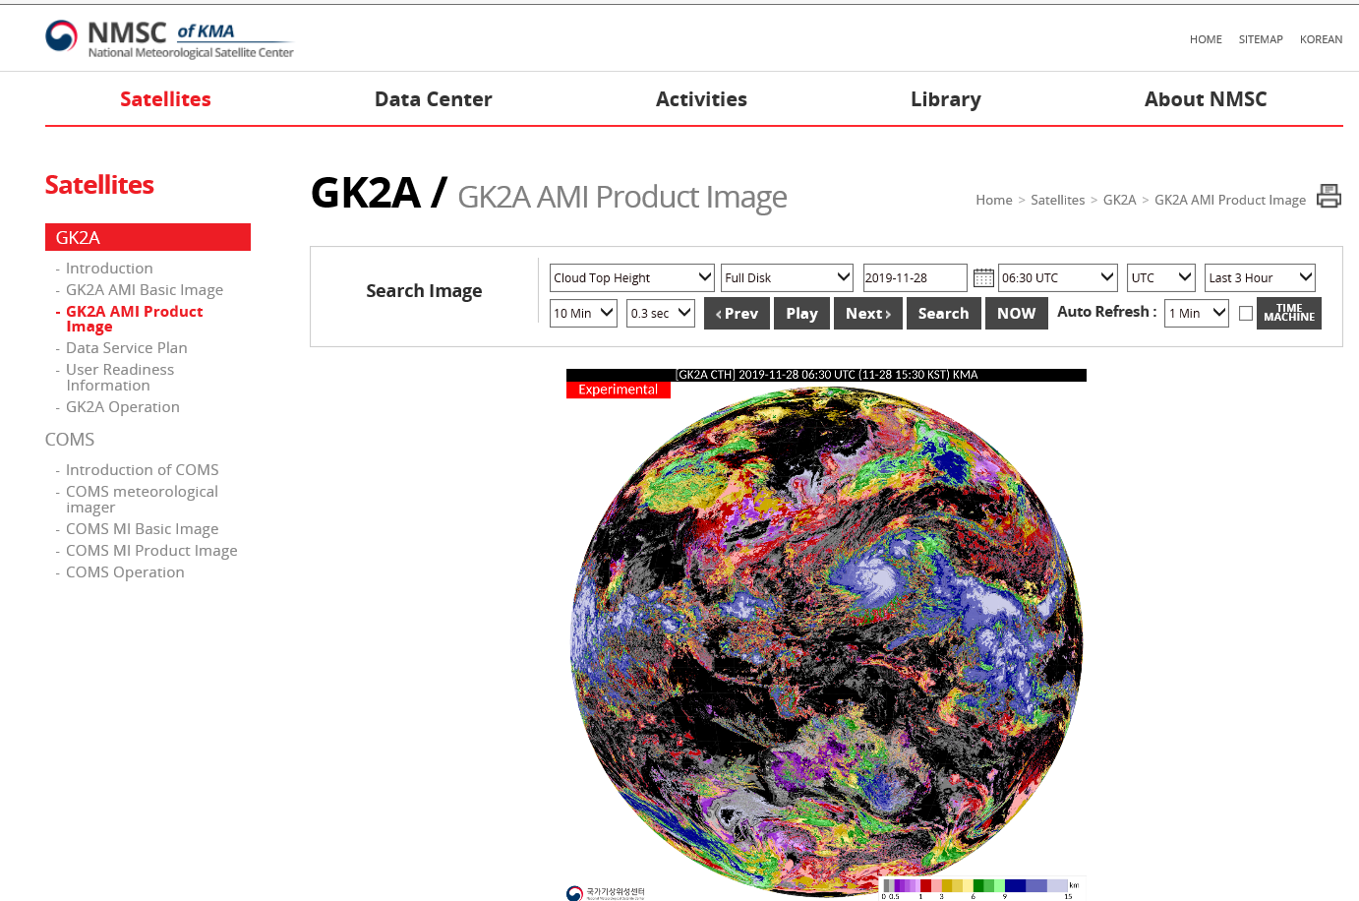
How to access the GK2A image(1)
52kinds of Level 2 products are also released via NMSC website
- Region : Full Disk /East Asia/ Korea
- Products : stability/rainfall(21), clouds(15), Land/Sea surface(20),
Aerosol/winds(17), Aviation(3), radiation (6)
NMSC website : http://nmsc.kma.go.kr/enhome/html/main/main.do

Slide 5
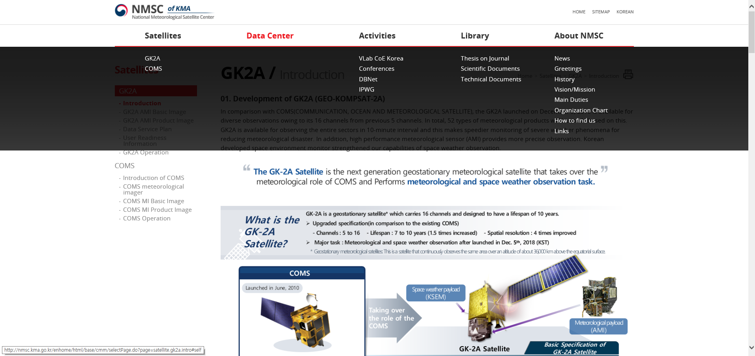
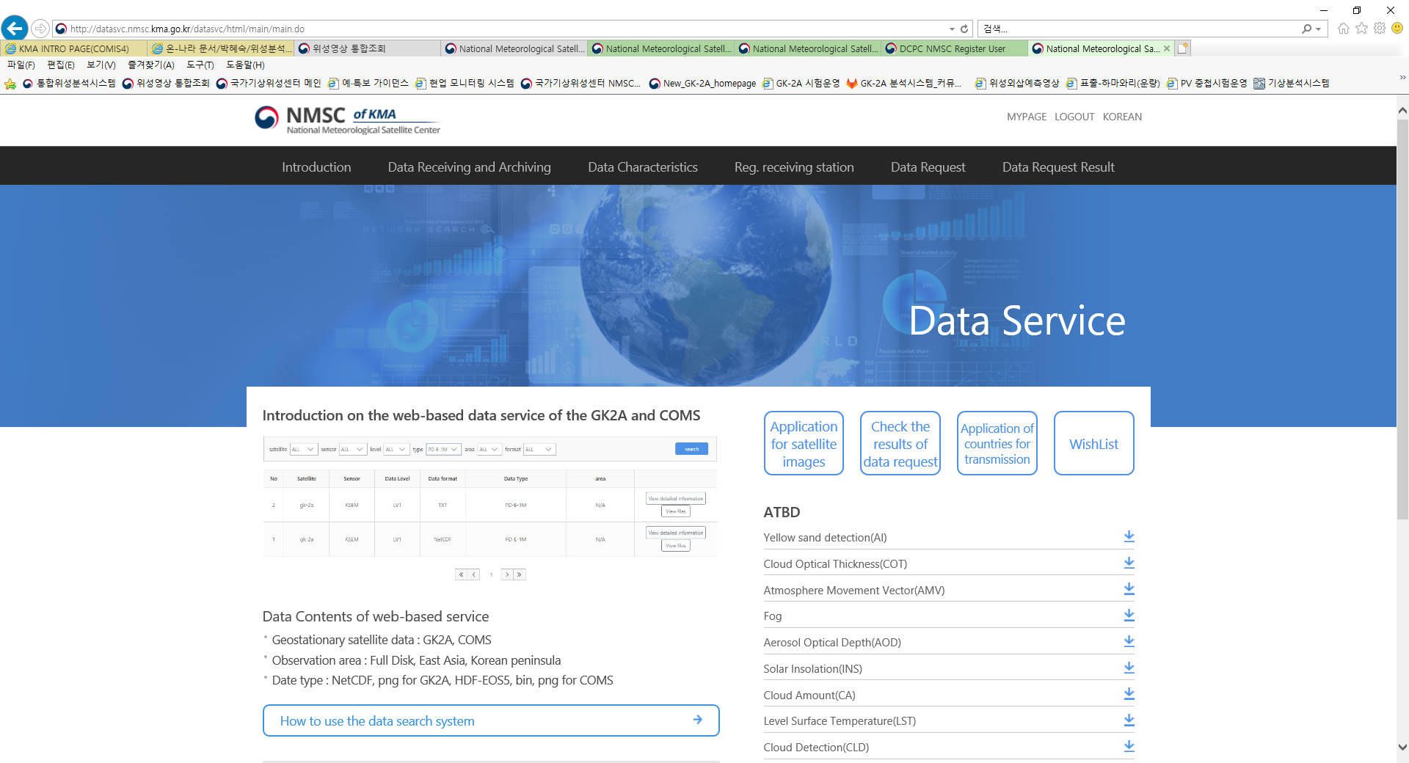
How to access the GK2A data (2)
GK2A data are downloaded in Bin, netCDF, PNG format at the NMSC website after login
http://datasvc.nmsc.kma.go.kr/datasvc/html/main/main.do
Quick guide

Slide 6
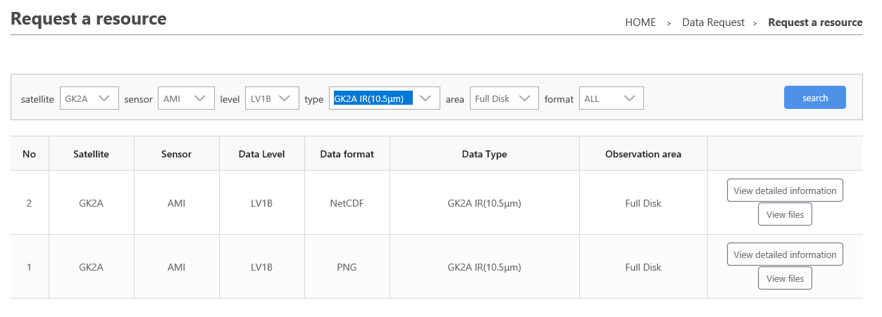
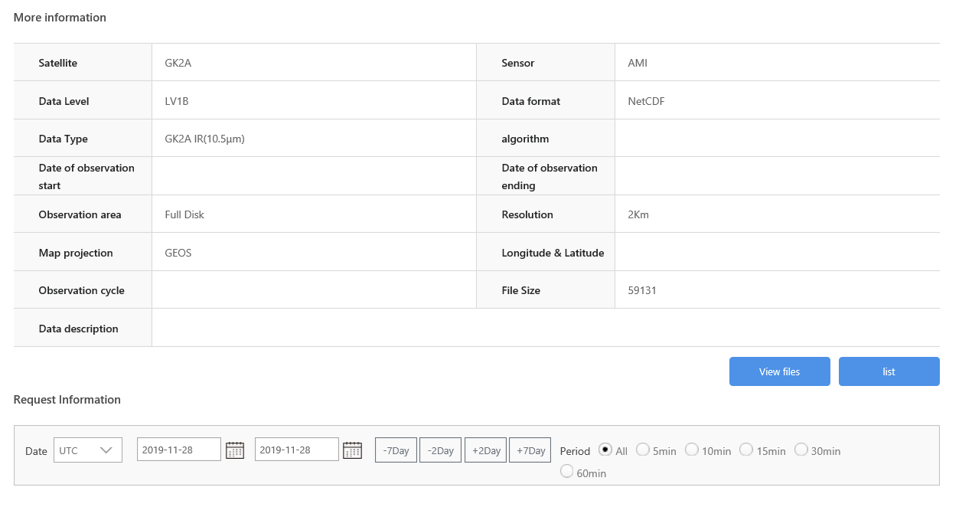
How to access the GK2A data (2)
GK2A LV1B data are downloaded in Bin, netCDF, PNG format at the NMSC website after login
① Display search lists of satellite meteorological data
② Select Satellite, area, data type, and format
③Add data to wish list, after select period
Select period ➔ Add wishlist

Slide 7
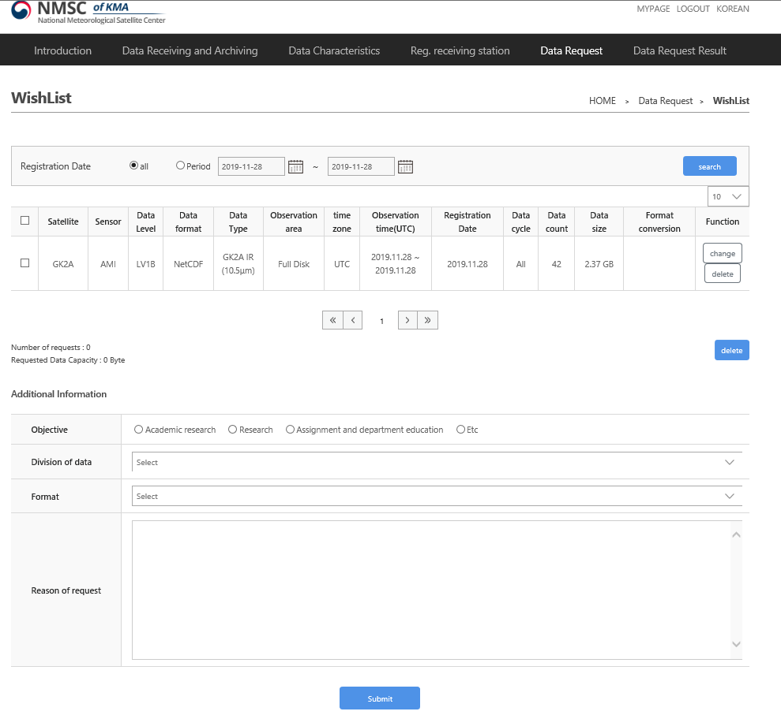

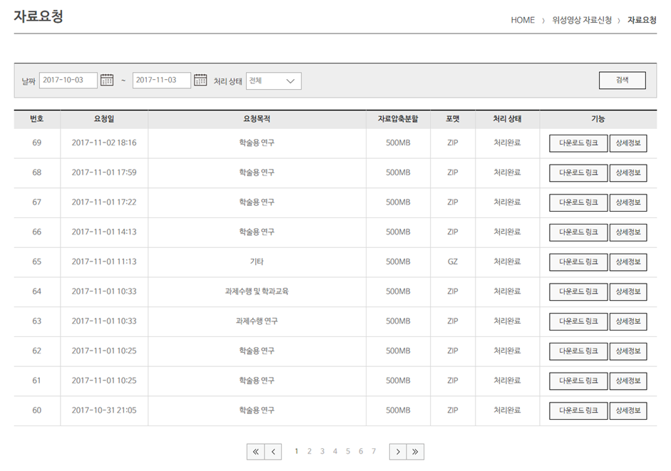
How to access the GK2A data (2)
④ Status is displayed, such as “Being Prepared” , or “Download Possible”
⑤ Download of Satellite meteorological data
To obtain login and password please contact Mr. Hyunjong Oh, National Meteorological Satellite Centre KMA hyunjong.oh@korea.kr

Slide 8
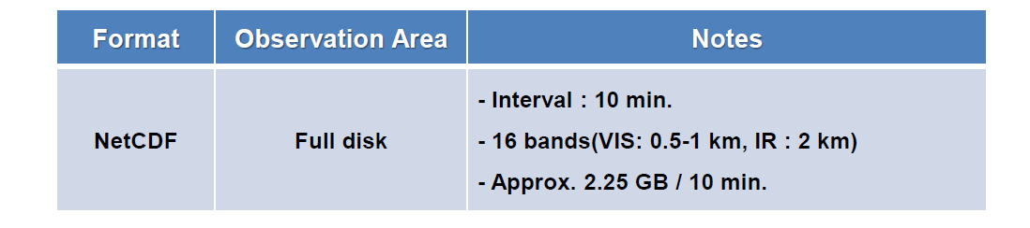
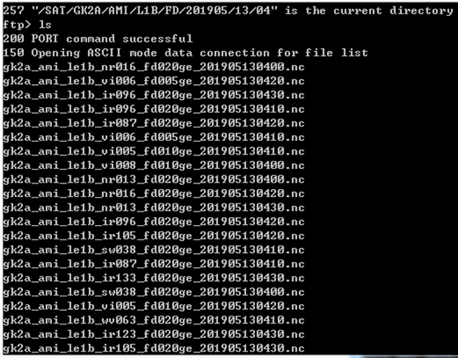
How to access the GK2A meteorological data in real-time (3)
GK2A LV1B data can be obtained via FTP in real-time, very similar to Himawari Cloud
- Basically one download per one nation after account registration
- High speed internet access(31Mbps) is required
Accessing information to GK2A real time FTP Service
1) Protocol: FTP
2) URL: IP(210.125.45.78) or domain PORT 21
3) Authentication method:
- Login with ID and password which are issued by KMA
- Multiple accesses with one account are not allowed
- Currently, 11 countries are registered.
(Australia, Japan, Malaysis, Nepal, India, Singapore, Vietnam,
Bangladesh, Hong Kong, Taiwan, Germany)
4) Hierarchical Structure of the top page
- Home directory : /SAT
- Data directory : /SAT/GK2A/AMI/L1B/FD/YYYYMM/DD/HH
- The latest 7 days data are available on RFS, so files uploaded 7 days(168 hours) ago are removed at every 00:00 UTC.

Slide 9
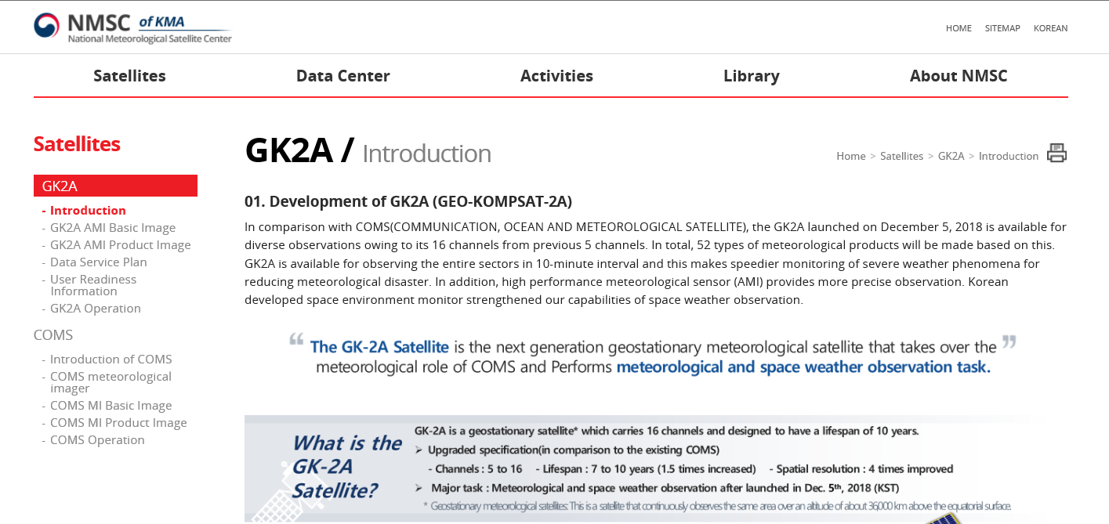
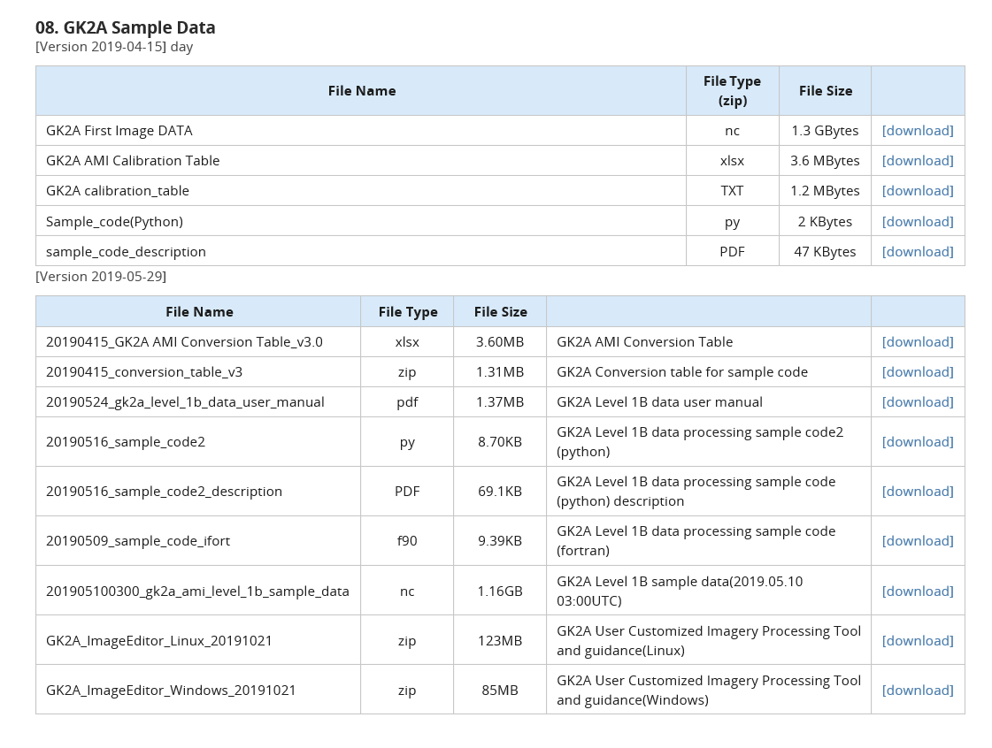
How to read and display GK2A data
Sample data and sample codes to read GK2A data are available on NMSC website
“Customized image processing tool” is provided
-Display, analysis of GK2A data

Slide 10
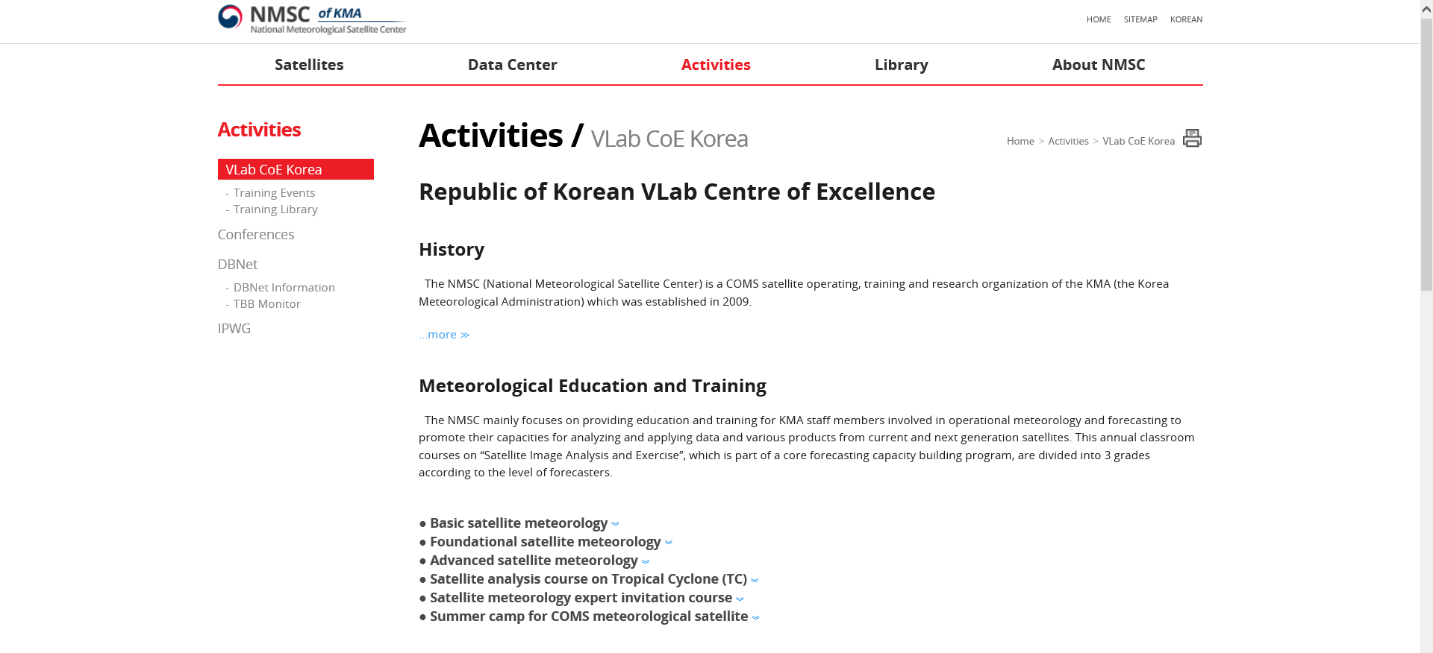
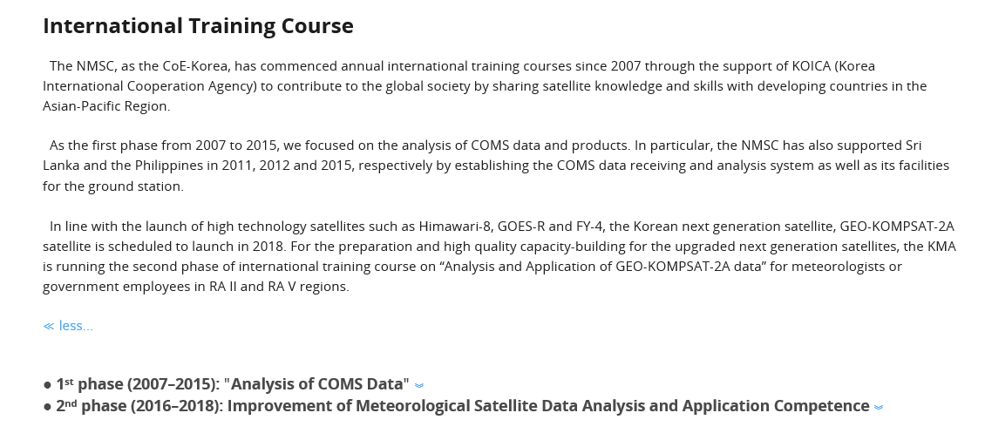
Sharing training activities and materials by WMO/VLab CoE-Korea
CoE-Korea renovated the Vlab website after operational service of GK2A data
- Education and training programme of satellite data analysis for KMA forecasters,
public users and international users
http://nmsc.kma.go.kr/enhome/html/base/cmm/selectPage.do?page=activities.VLabCoEKorea.VLabCoE-KoreaMain
Course information

Slide 11
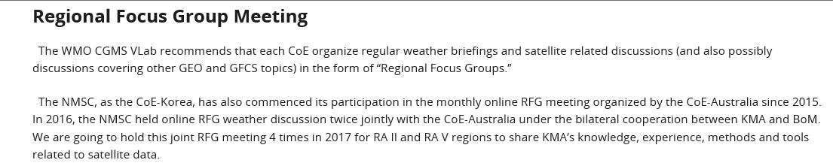
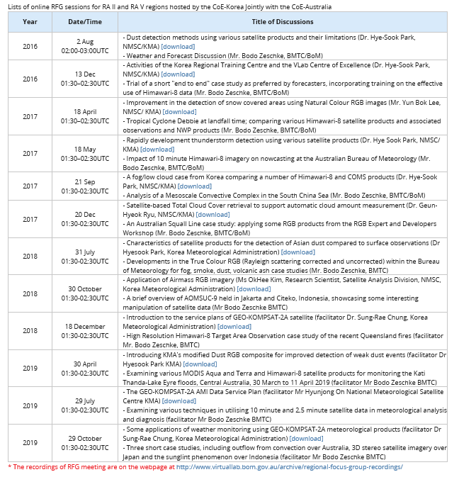
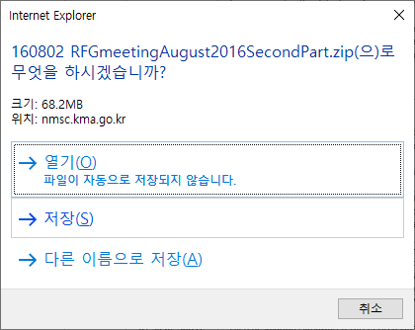
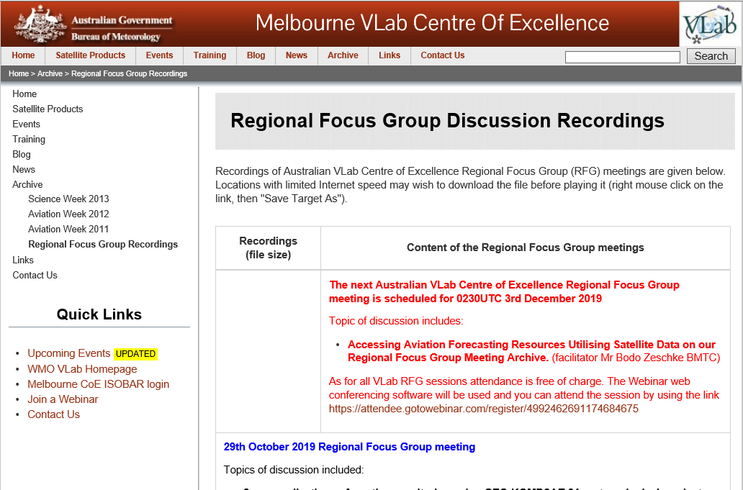
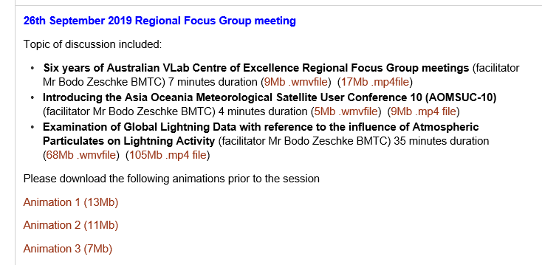
Sharing training activities and materials by WMO/VLab CoE-Korea
CoE-Korea host Regional Focus Group(RFG) weather discussion jointly with CoE-
Australia 2~4 times a year since 2016.
Download the presented pdf file
The recordings of RFG meeting can be downloaded on the CoE-Australia webpage at
http://www.virtuallab.bom.gov.au/archive/regional-focus-group-recordings/

Slide 12
Thank you!

