Slide 1
Himawari Data distribution/dissemination services
Japan Meteorological Agency

Slide 2
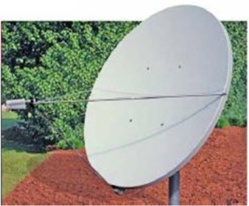
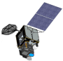

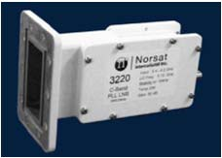
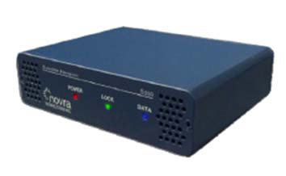

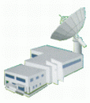
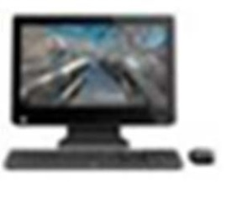
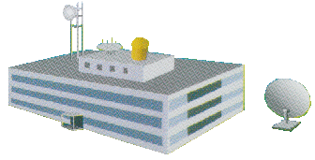


Himawari-8/9 Data Dissemination
Communication Satellite (CS)
Himawari-8/9
HimawariCast
service
C-band antenna
raw data
HRIT files,
SATAID files
LNB
CS Operator
DVB-S2 receiver
All imagery
(full data)
PC & software
JMA
HimawariCloud service
NMHSs
Archive
Server
Users
Operated by Japanese Science Group

Slide 3
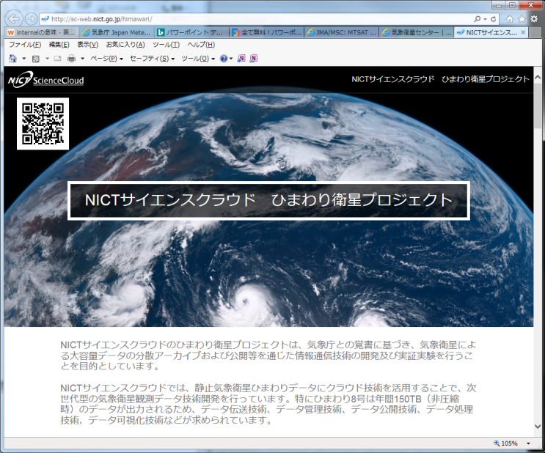
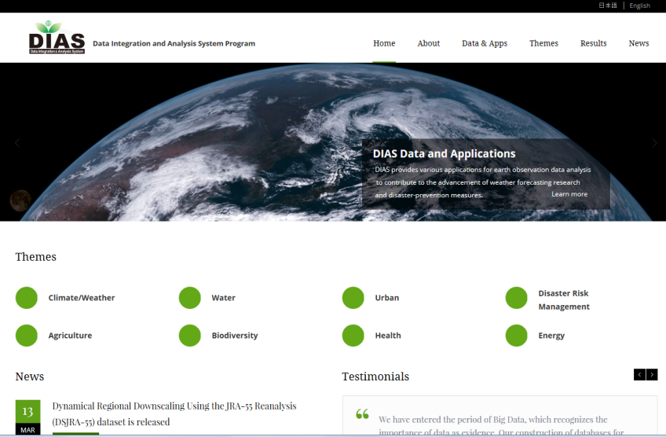
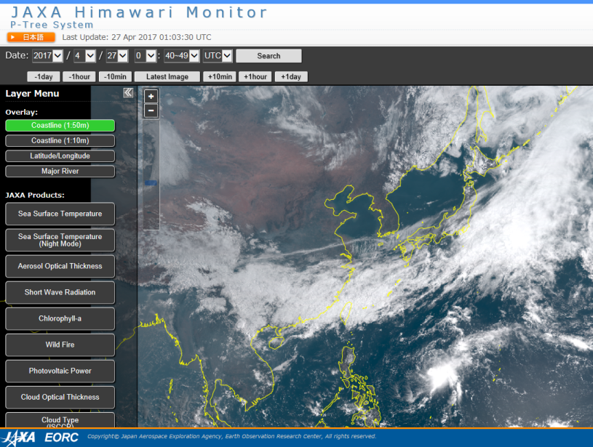
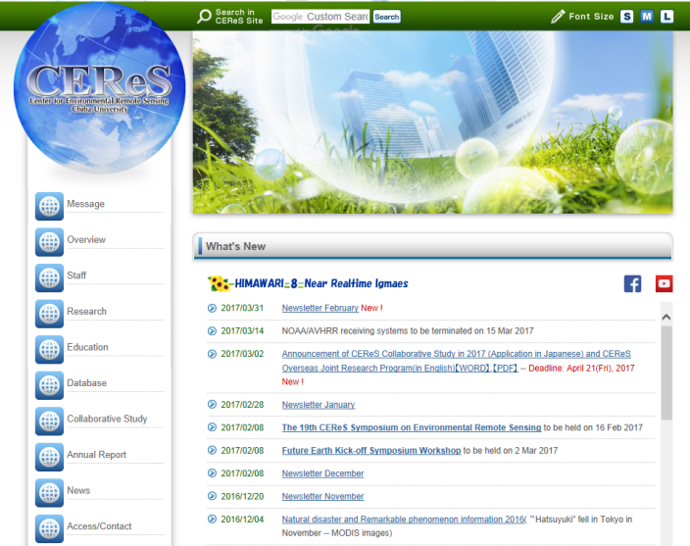
Data Distribution Services by Cooperation Institutes
Himawari-8 data are being redistributed to foreign and domestic R&D users by the following Japanese scientific institutes.
NICT* (via Science Cloud)
JAXA** (via Himawari Monitor)
University of Tokyo (via DIAS; Data Integration and Analysis System)
Chiba University CEReS***
* National Institute of information and Communications Technology
** Japan Aerospace Exploration Agency
*** Center for Environmental Remote Sensing

Slide 4
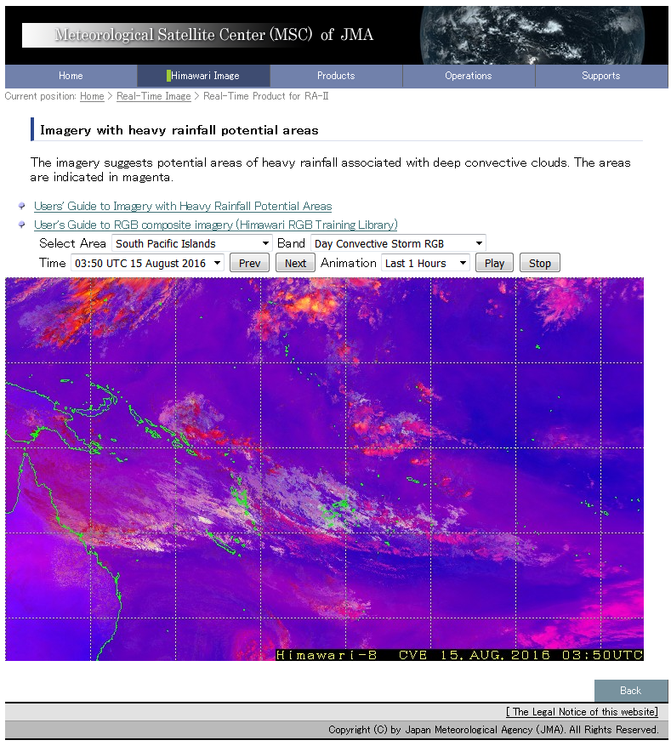
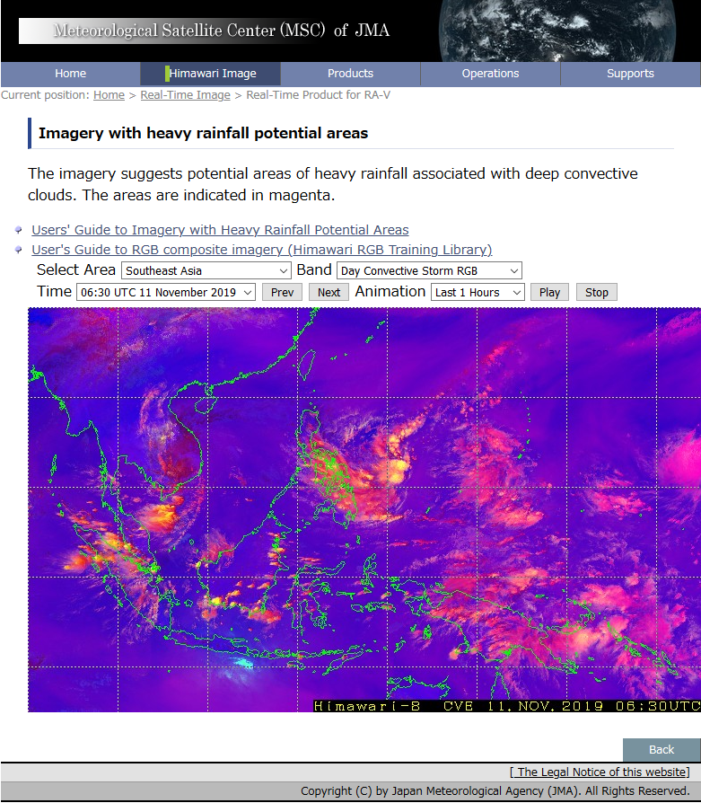
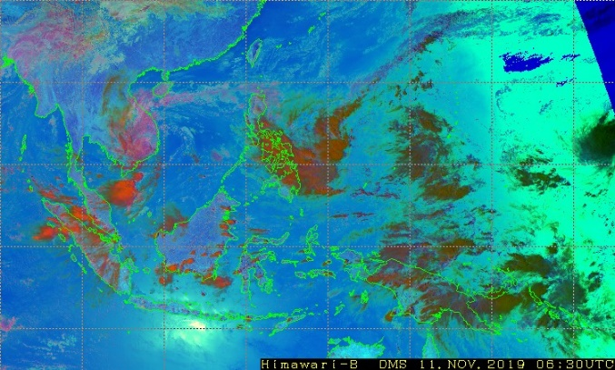
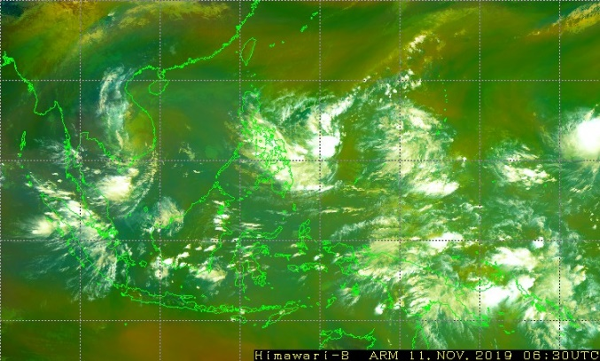
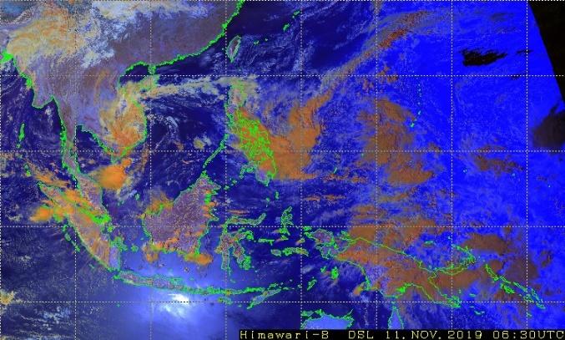
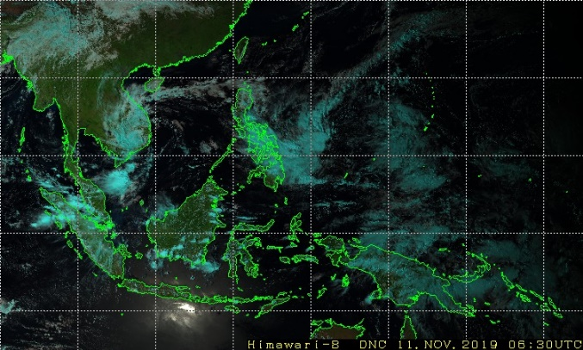
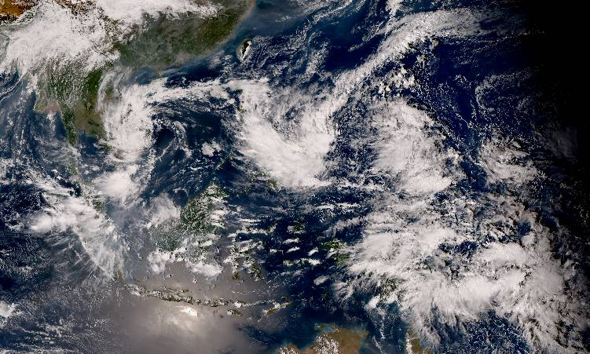
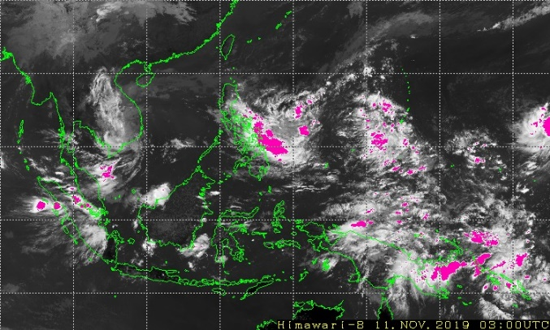
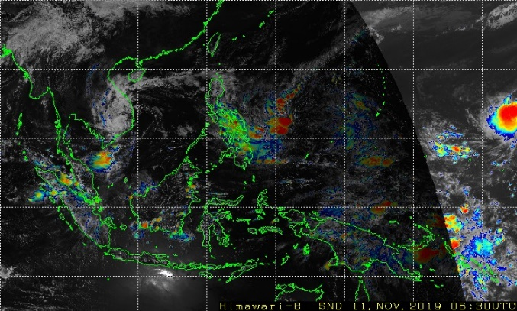
Web based Quick-Look Imagery
JMA provides the Web site and the User’s Guide documentation.
RGB composite imagery based on the WMO standard recipe are produced from Himawari-8 imagery.
Products are provided for supporting SWFDP in RA II/RA V region.
IR(10.4μm), IR(3.9μm), WV(6.2μm), VIS(0.64μm), Heavy Rainfall Potential Areas and Sandwich Imagery are also provided.
Day Microphysics RGB
Airmass RGB
Day Snow-Fog RGB
Natural Color RGB
True Color Reproduction Image
Heavy rainfall potential areas
Sandwich
http://www.data.jma.go.jp/mscweb/data/himawari/index.html
JMA, NOAA/NESDISS, CSU/CIRA
4
Notes:
Next topic is imagery service on MSC website.
MSC website provides JPEG imagery for Asia and Oceania region.
It provides imageries for Australia, Central Asia, Pacific Islands, Southeast Asia, and more.
This is easy way to access to Himawari-8 imagery on near-real time basis with animation in the last 24 hours.
This service provides not only normal observation imagery but also various RGB composite images,
and totally 15 type imageries are available on the website.
This imagery is an example of selecting central-asia.

Slide 5


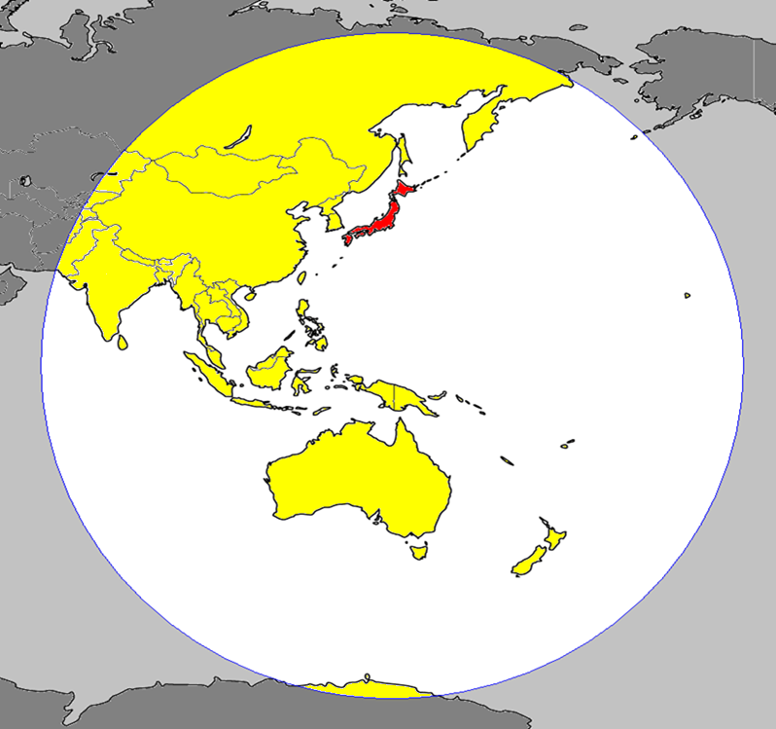

































Himawari NMHSs Users
HimawariCast Receiving Systems
HimawariCloud accounts
23 users
Including
NOAA/NESDIS and EUMETSAT
Web service covers
42 areas
including
Timor-Leste and
Cook Islands
32 users
Russia
Mongolia
Korea
China
Hong Kong, China
Macau
Nepal
Bhutan
Bangladesh
Myanmar
Laos
Sri Lanka
Thailand
Vietnam
Cambodia
Malaysia
Singapore
Indonesia
Observation Area of Himawari-8/9
Philippines
Brunei
Palau
Timor-Leste
Micronesia
Papua New Guinea
Hawaii (USA)
Solomon Islands
Kiribati
Tuvalu
Fiji
Samoa
Cook Islands
Tonga
Vanuatu
New Caledonia (Fr.)
Australia
New Zealand
(As of 1 October 2019)

Slide 6
Back up

Slide 7
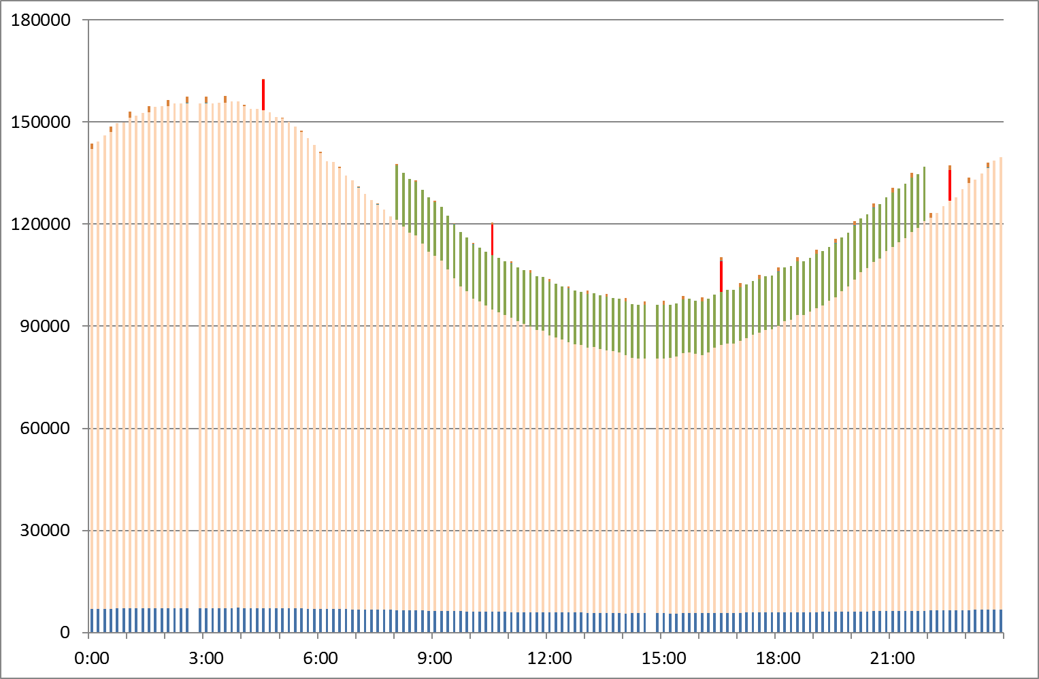
HimawariCast Dissemination data volume
[KB / 10 min]
New official limit after the update of ground system
Current official dissemination limit
NWP data
High-Res Band 7 data during night time
HRIT data
LRIT data
UTC

