Slide 1

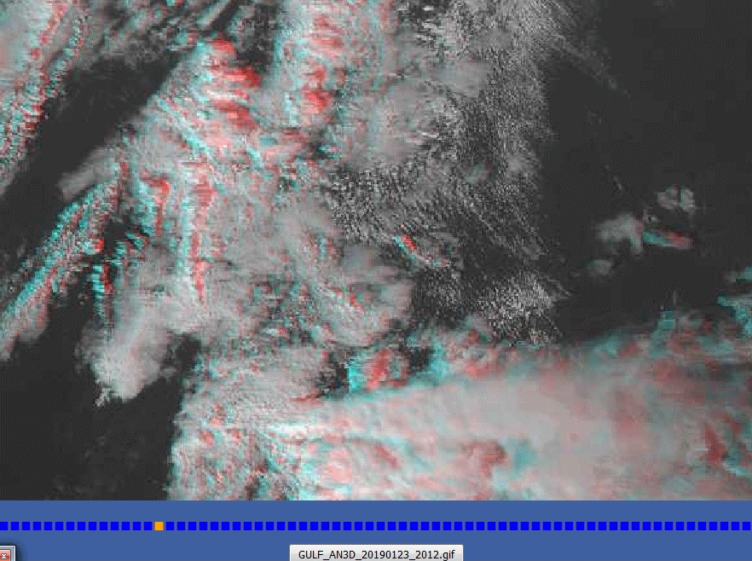
Animation: Gulf of Mexico Thunderstorms
2012UTC to 2242UTC 23rd January 2019
(5FPS rocking animation, visible to enhanced infrared transition)
image from Wikipedia
image from CONUS imagery presented by Embry-Riddle Aeronautical University

