Slide 1


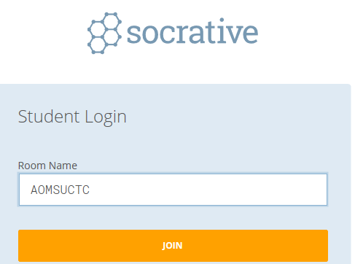
Tropical Cyclone applications of current and emerging scatterometers and radiometers
Joe Courtney
Bureau of Meteorology Perth
Socrative: b.socrative.com
Room: AOMSUCTC
Notes:
Why: more sensors now sending output in real time
Issues: access to data and presentation
Show knmi website; manati website; VisWx displays
Socrative:
Survey 1: Who are you? TC forecaster; other forecaster; manager of forecast operational; research; satellite systems; other
Survey 2: Have you heard of ASCAT; SCATSAT; Windsat; HY-2B; CFOSAT?

Slide 2

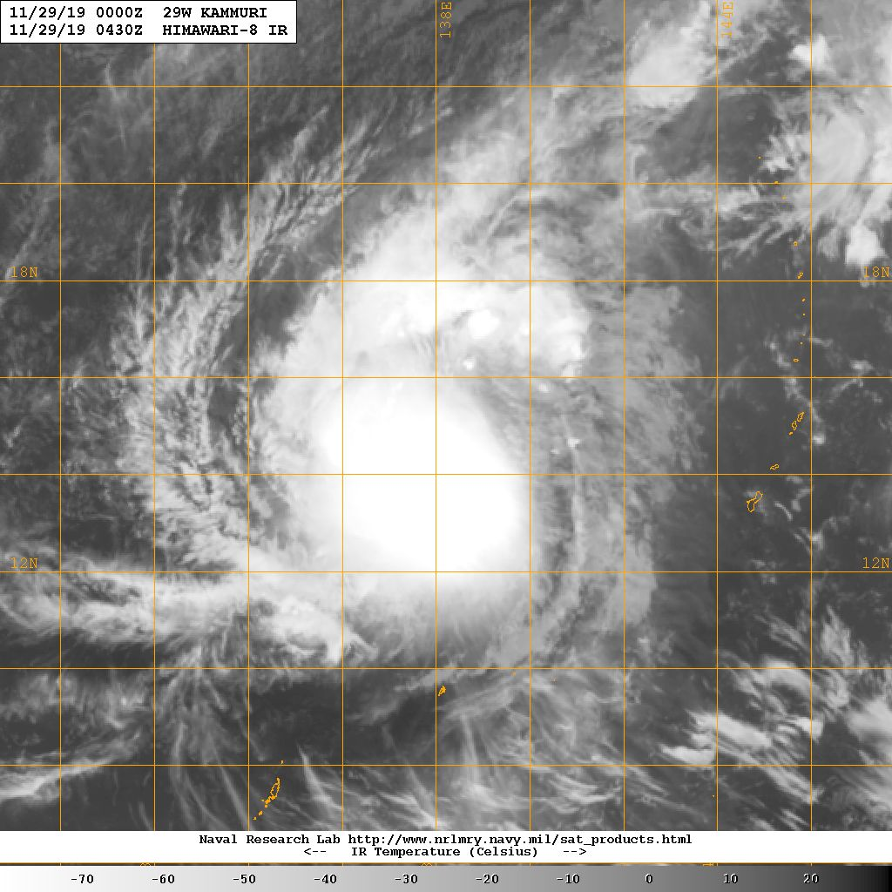
The forecasting challenge
Where is the centre?
How strong is it?
How far do gales extend?
TC Kammuri
29 November 2019
Credit: NRL https://www.nrlmry.navy.mil/TC.html
Notes:
Where is the centre?
How strong is it?
How far do gales extend?
https://www.nrlmry.navy.mil/tc-bin/tc_home2.cgi?ACTIVES=19-SHEM-01P.RITA,19-WPAC-29W.KAMMURI,19-IO-90A.INVEST,19-SHEM-91S.INVEST,19-WPAC-95W.INVEST,19-WPAC-96W.INVEST&PHOT=yes&ATCF_BASIN=wp&AGE=Latest&SIZE=full&NAV=tc&ATCF_YR=2019&ATCF_FILE=/SATPRODUCTS/kauai_data/www/atcf_web/public_html/image_archives/2019/wp292019.19112812.gif&CURRENT_ATCF_FILE=/SATPRODUCTS/kauai_data/www/atcf_web/public_html/image_archives/2019/wp292019.19112812.gif&CURRENT=20191129.0430.hm8.x.ir1km_bw.29WKAMMURI.70kts-979mb-146N-1382E.100pc.jpg&CURRENT_ATCF=wp292019.19112812.gif&ATCF_NAME=wp292019&ATCF_DIR=/SATPRODUCTS/kauai_data/www/atcf_web/public_html/image_archives/2019&MO=NOV&BASIN=WPAC&STYLE=tables&YEAR=2019&YR=19&STORM_NAME=29W.KAMMURI&ARCHIVE=active&AREA=pacific/southern_hemisphere&PRODUCT=ir&DIR=/SATPRODUCTS/TC/tc19/WPAC/29W.KAMMURI/ir/geo/1km_bw&TYPE=ir&PROD=ir&SUB_PROD=geo&SUB_SUB_PROD=1km_bw

Slide 3
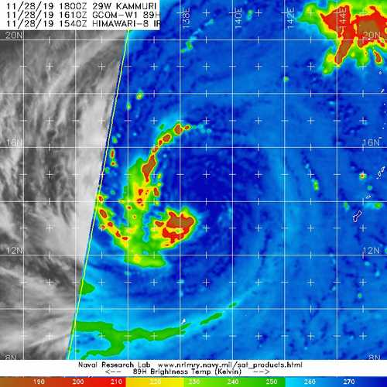
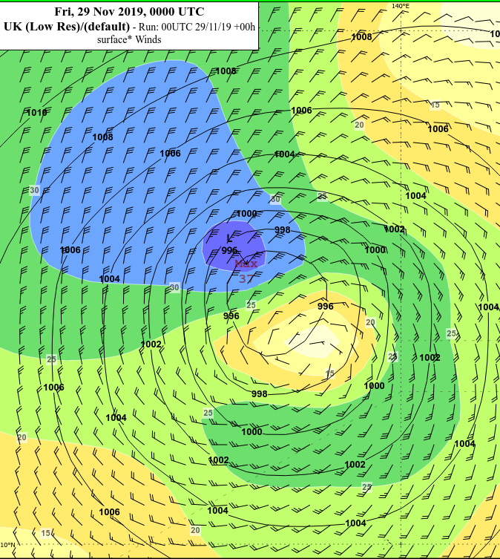
The forecasting challenge:
Where is the centre?
How strong is it?
How far do gales extend?
Tools:
IR/Vis; radar; Microwave; Observations (sfc/aircraft…), NWP/objective algorithms and scatterometers/radiometers
Credit: NRL https://www.nrlmry.navy.mil/TC.html

Slide 4

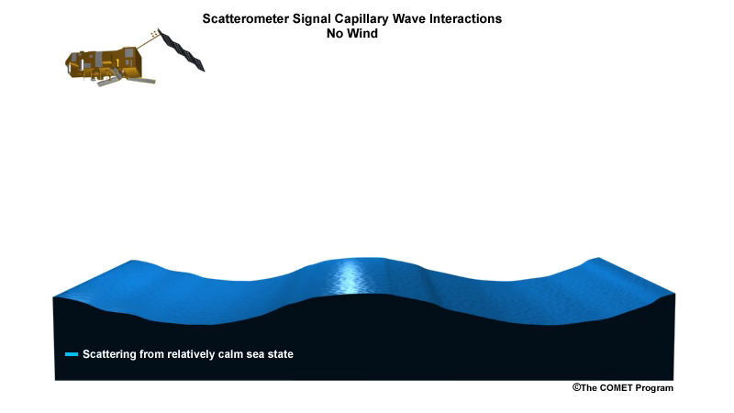
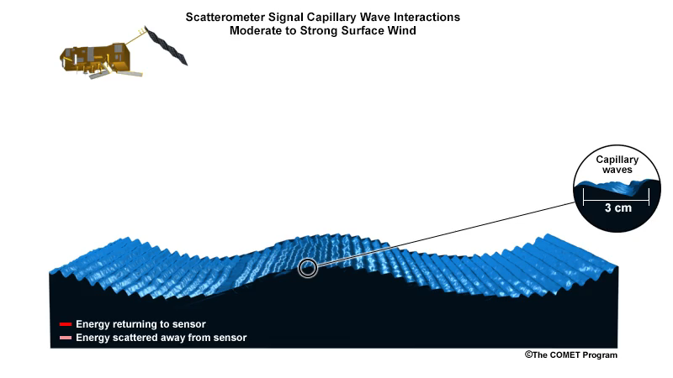
Scatterometry Theory:
active sensors measure backscatter
Bragg scattering
Sensors emit microwave energy and measure return signal
Small (2-4cm) capillary waves correspond to wind speed
Bragg scattering: energy at similar wavelengths scattered
Credit: COMET https://www.meted.ucar.edu/training_module.php?id=1093#.XElBfteWa71

Slide 5
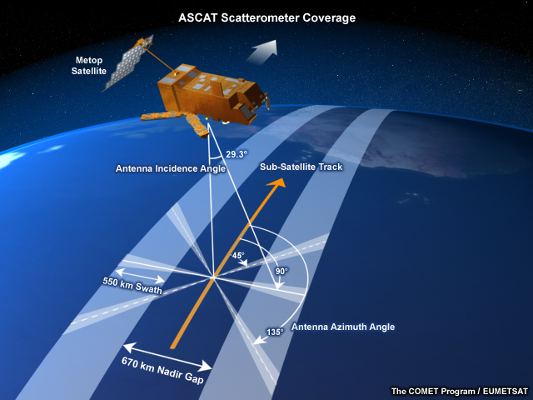
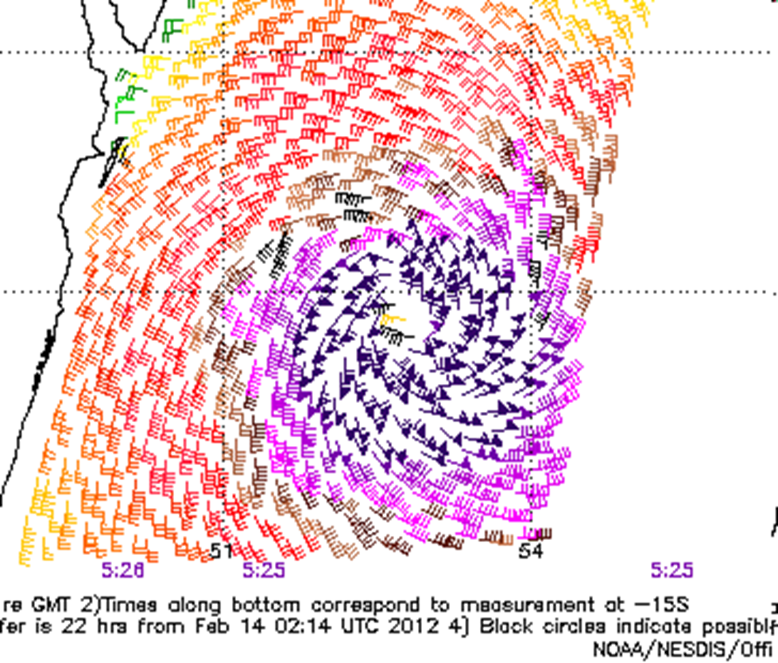
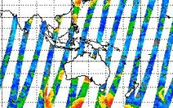
Advanced SCATterometer (ASCAT)
Satellite: MetOp-A (2007), B (2012), C (2018)
Channel: 5.25 GHz (5cm); C-Band
coverage: three antennas detecting two swathes 520km wide separated by ~600km underneath where insufficient energy comes back.
two passes per day (ascending/descending)
Resolution: 25-50km
TC applications:
Lack of coverage in tropics an issue
Excellent for gale radii and positioning
Excellent for intensity to ~50kn
NOAA http://manati.orbit.nesdis.noaa.gov/datasets/ASCATData.php
KNMI http://projects.knmi.nl/scatterometer/tile_prod/tile_app.cgi
NRL: https://www.nrlmry.navy.mil/tc-bin/tc_home2.cgi

Slide 6
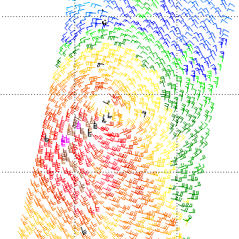
AScat - positioning
Streamline analysis
Wrong direction
  Southern Hemisphere example
Notes:
Ascat
By measuring the roughness of the ocean surface the surface winds can be estimated. There are three useful satellite instruments for estimating surfaces winds. In order of usefulness for TC operations:
1. Ascat aboard the EUMETSAT METOP-A and B satellites. Ascat uses lower frequencies (C-Band) than the QScat or OceanSat which reduces the sensitivity to heavy rain – important for TC situations. Will be available through IDV.
See: http://manati.orbit.nesdis.noaa.gov/datasets/ASCATData.php/
2. Oceansat. Similar to QScat has broader swathe then Ascat but more sensiftive to heavy rain and also suffers from degradation at the edge of the swathe. Currently only available on KNMI web site.
3. Windsat: very sensitive to heavy rain so more useful for periphery of TCs. Available through NRL TC page (and hence on local microwave viewer).
For the times when the Ascat captures the circulation, it is another tool by which to locate the centre.
To help determine the centre, trace streamlines to identify the focal point. In this case for TC Koji in 2012, the centre was reasonably well defined. However, near the centre some wind barbs were in the wrong direction even though the wind speed may be reasonable. Sometimes these are easy to identify as the direction is 180degrees out. This occurs as there are multiple possible solutions and the automated method may choose the wrong one especially near the centre. Sometimes It is easier to look further away from the centre.

Slide 7
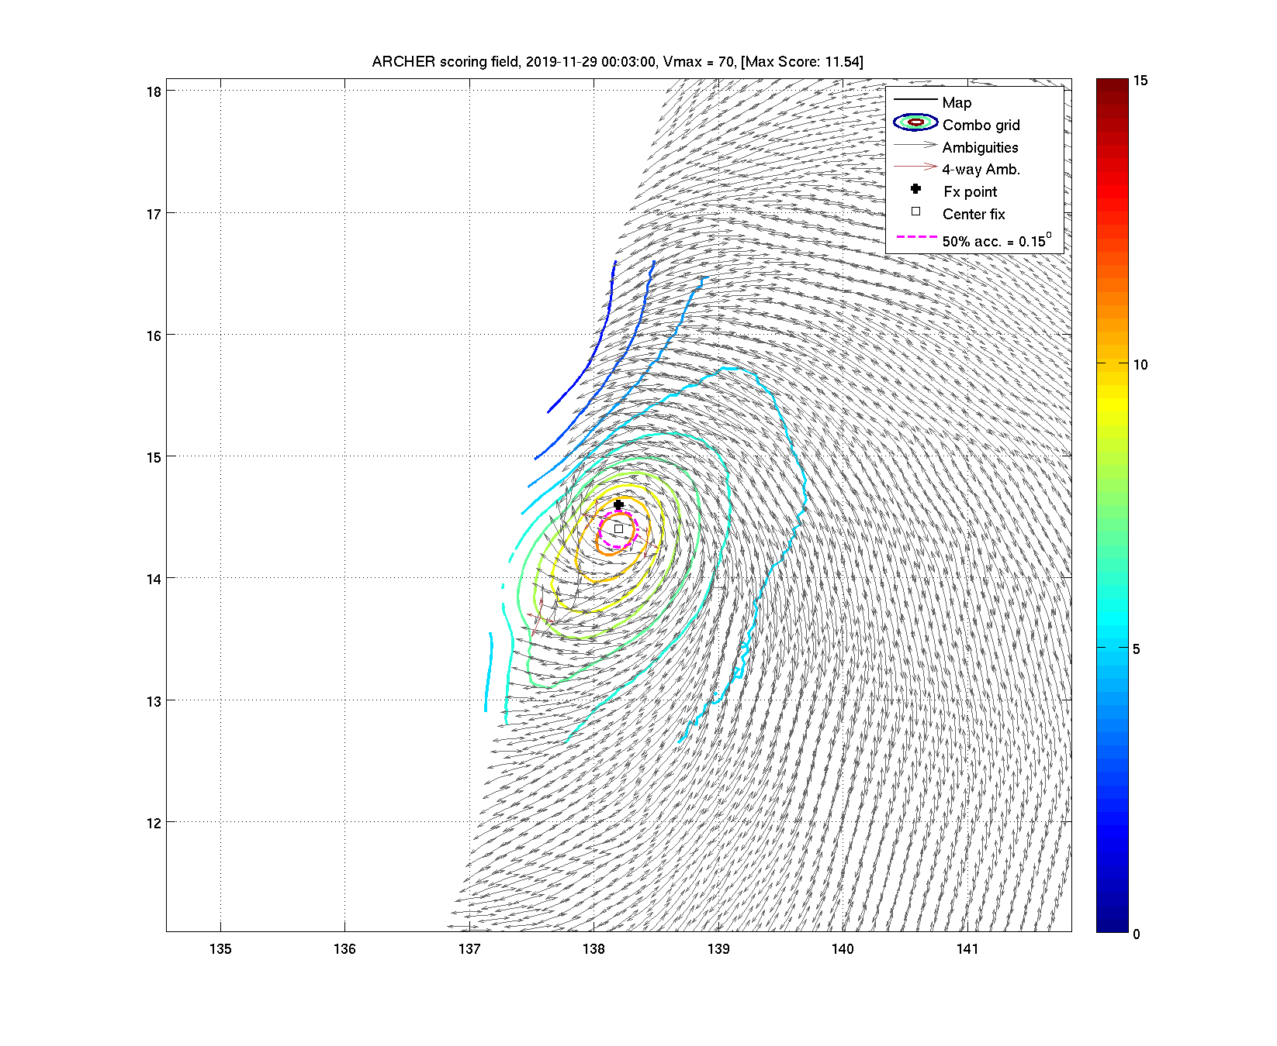
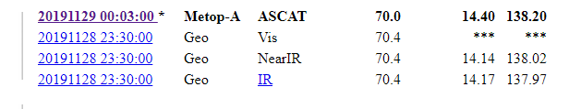
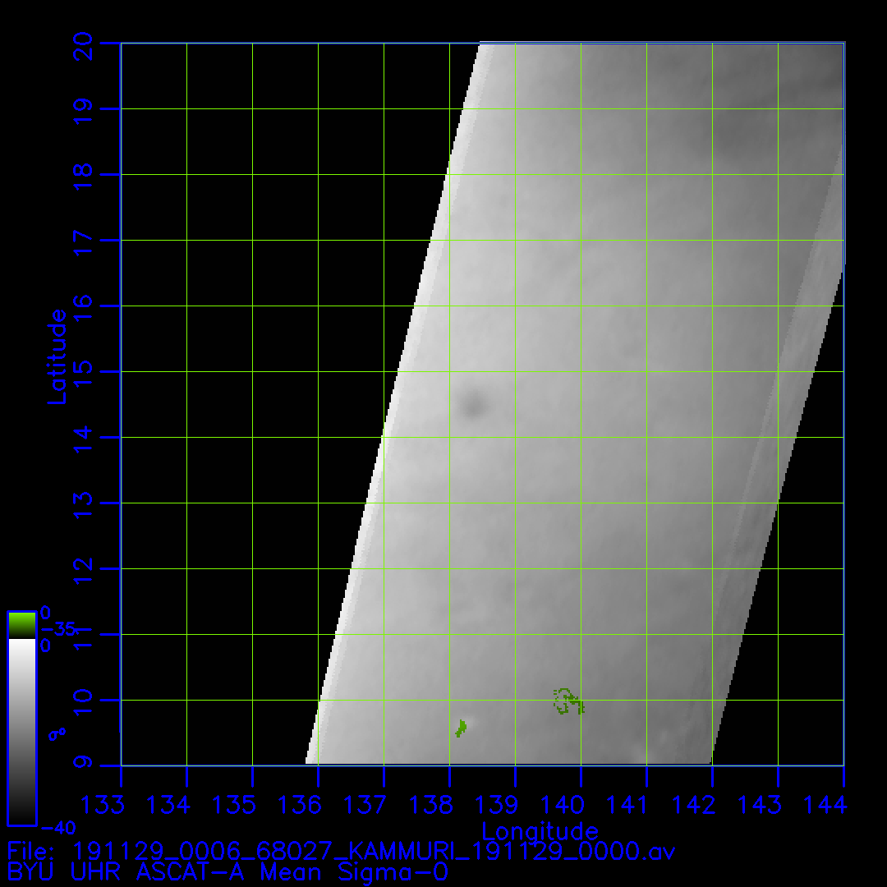
ASCAT positioning: ARCHER http://tropic.ssec.wisc.edu/real-time/archerOnline/web/index.shtml
Automatic and usually better than human eye
Kammuri 29W: 00Z 29/11/2019 ASCAT-A
http://tropic.ssec.wisc.edu/real-time/archerOnline/cyclones/2019_29W/web/summaryTable.html
NRCS: scalar wind display can be the clearest indication of centre fix in the light wind area
NRCS from NOAA 'manati' web page:
via 'storm' option
eg : Kammuri: NRCS very clear!
X

Slide 8
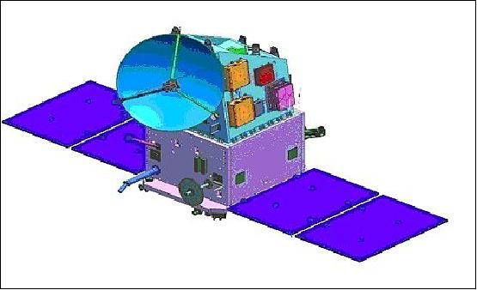
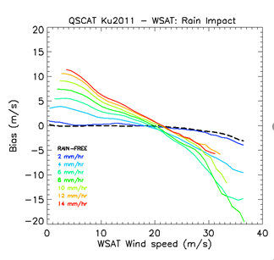
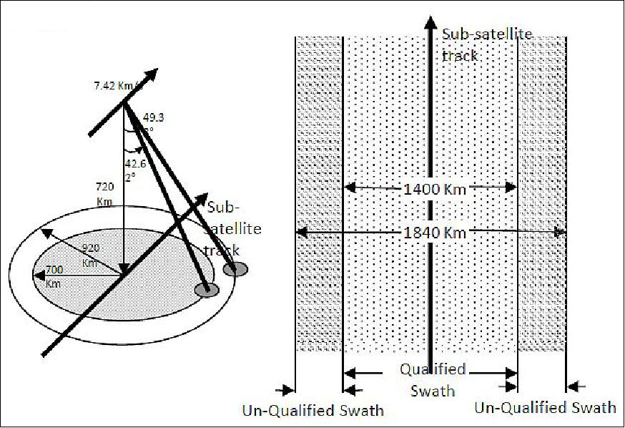
SCATSAT
SCATSAT-1 India (ISRO) continuation of OSCAT
Channel: 13.5 GHz (2cm); Ku-Band
coverage: 1800km wide (wider than ASCAT)
two passes per day(ascending/descending)
Resolution: 25-50km
Swathe 1440km
TC applications:
Good for gale radii
Issue: rain contamination for speed
Overestimates winds in mod/heavy rain (<50kn)
intensity not so great esp >~50kn
X
Images courtesy:
https://directory.eoportal.org/web/eoportal/satellite-missions/s/scatsat-1
Notes:
https://www.google.com/url?sa=i&source=imgres&cd=&cad=rja&uact=8&ved=2ahUKEwiXraaAgJXgAhVXfH0KHeKDDvYQjRx6BAgBEAU&url=https%3A%2F%2Fdirectory.eoportal.org%2Fweb%2Feoportal%2Fsatellite-missions%2Fs%2Fscatsat-1&psig=AOvVaw2EdfayTur8EabWJQLDUM3U&ust=1548920326568281
Example Kelvin
http://projects.knmi.nl/scatterometer/publications/pdf/osisaf_cdop2_ss3_pum_scatsat1_winds.pdf
ScatSat-1 is a continuity mission for the Oceansat-2 scatterometer, which provided useful ocean vector wind observations used in, among others, oceanography, Numerical Weather Prediction (NWP) and nowcasting. ScatSat-1 carries the Ku-band OSCAT scatterometer which is similar to the one flown onboard Oceansat-2, with some enhanced features based on lessons learnt. The spacecraft is in a sunsynchronous orbit of 720 km altitude with an inclination of 98.1°. ScatSat-1 was launched on September 26th, 2016. The local time of Equator crossing was 9:20. Since then, the local time of Equator crossing is slowly drifting towards a time which will be approximately 8:00 at the end. In May 2018, the local time of Equator crossing was approximately 8:45. This is still very close to that of Metop-A and Metop-B (9:30) and as such it allows cross-calibration with ASCAT. For detailed information on the OSCAT instrument and data we refer to [6] and [7]. A brief description is given below. The OSCAT instrument is a conically scanning pencil-beam scatterometer, as depicted in figure 1. It uses a 1-meter dish antenna rotating at 20 rpm with two “spot” beams of about 25 km × 55 km size on the ground, a horizontal polarisation beam (HH) and a vertical polarisation beam (VV) at incidence angles of 49º and 58º respectively. The beams sweep the surface in a circular pattern as depicted in Figure 1. Note that the egg-shaped beam footprints are divided into slices by applying a modulated chirp signal. Due to the conical scanning, a Wind Vector Cell (WVC) is generally viewed when looking forward (fore) and a second time when looking aft. As such, up to four measurement classes (called “beam” here) emerge: HH fore, HH aft, VV fore, and VV aft, in each WVC. The 1800-km-wide swath covers 90% of the ocean surface in 24 hours which is substantially higher than side-looking scatterometers like ERS, NSCAT and ASCAT.
The OSCAT scatterometer operates at a Ku-band radar frequency (13.5 GHz corresponding to ~2 cm wavelength). The atmosphere is not transparent at these wavelengths and in particular rain is detrimental for wind computation. In fact, moderate and heavy rain cause bogus wind retrievals of 15- 20 m/s wind speed which need to be eliminated by a Quality Control (QC) step. Wind-rain discrimination is easiest to manage in the sweet swath, but still performs acceptably in nadir and outer swath.

Slide 9
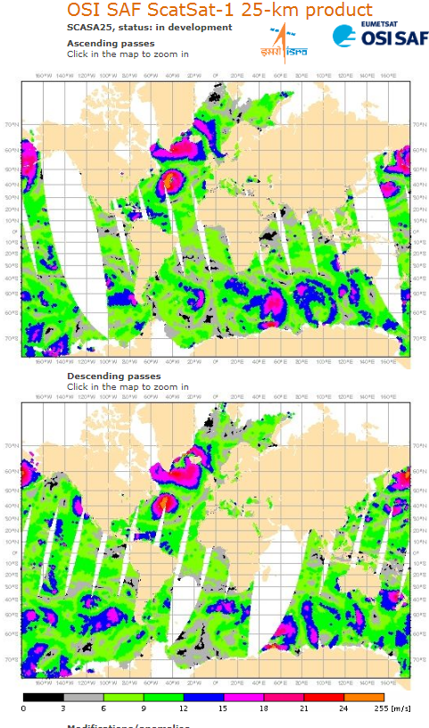
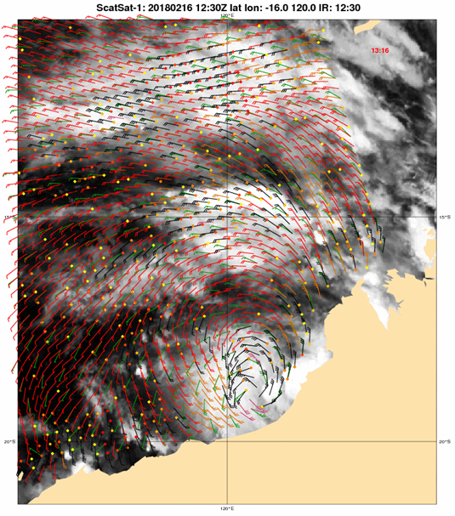
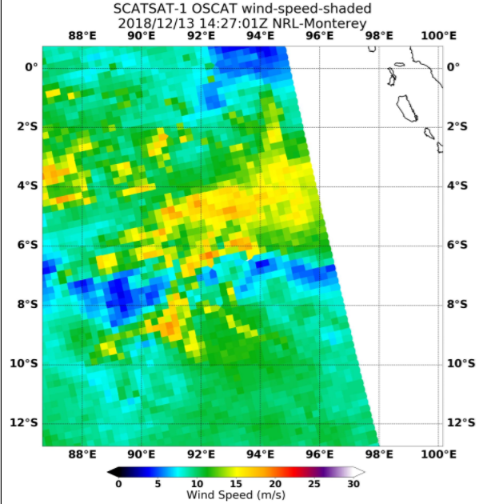
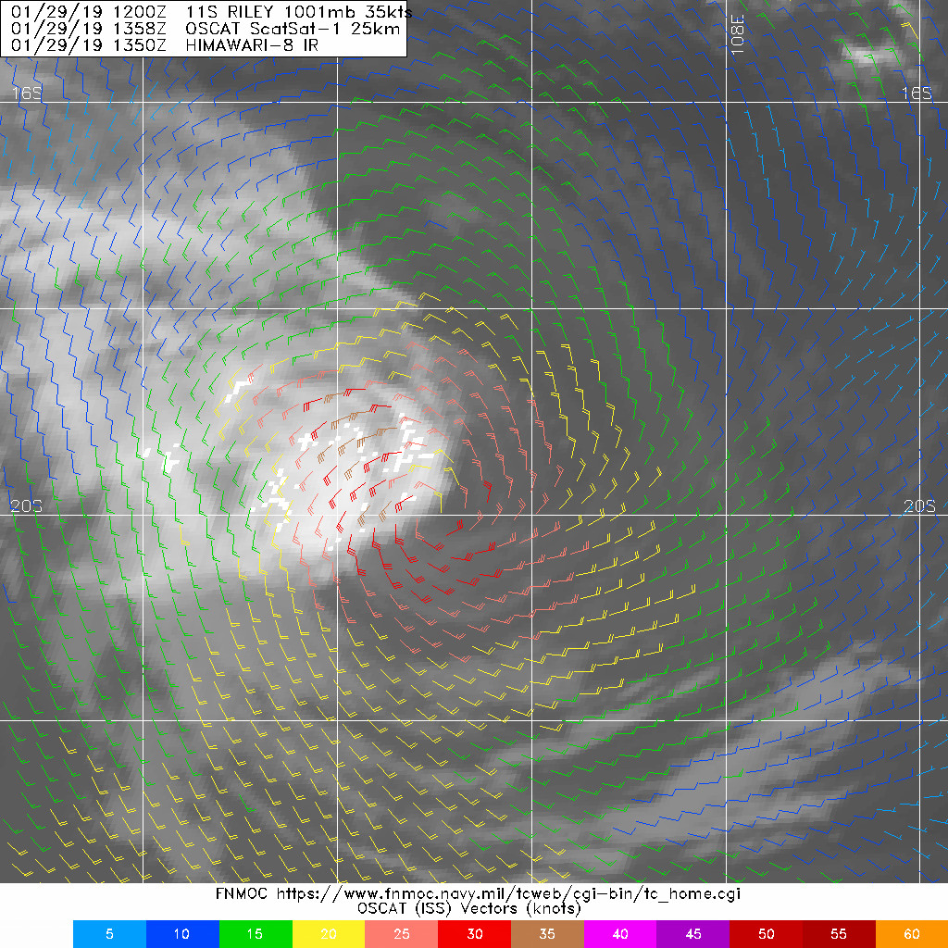
SCATSAT availability
1. KNMI http://projects.knmi.nl/scatterometer/tile_prod/tile_app.cgi
2. FNMOC: https://www.fnmoc.navy.mil/tcweb/cgi-bin/tc_home.cgi
3. NRL: speed only (irregular coverage currently)
4. Not yet NOAA-coming?
https://manati.star.nesdis.noaa.gov/datasets/ASCATData.php
X
Example: Kelvin (Southern Hemisphere)
Courtesy: KNMI
Notes:
Example Kelvin
http://projects.knmi.nl/scatterometer/publications/pdf/osisaf_cdop2_ss3_pum_scatsat1_winds.pdf
Riley SCATSAT

Slide 10
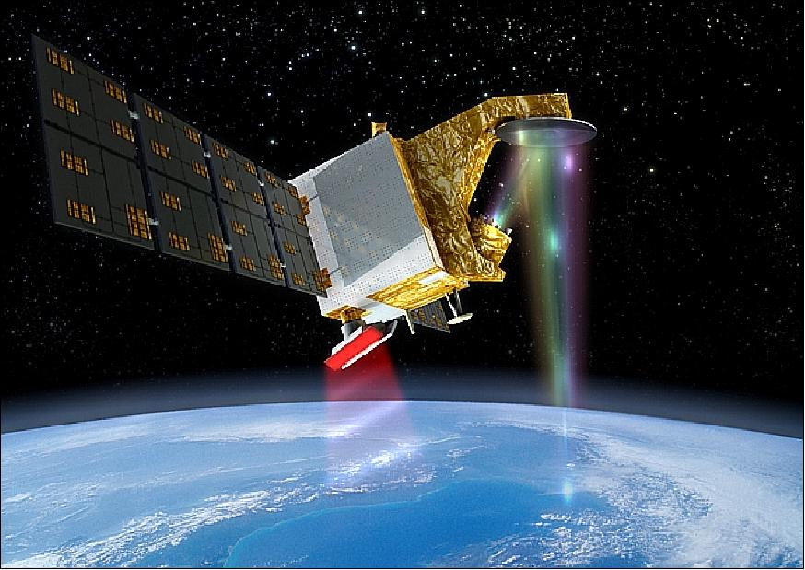

NEW CFOSAT SCATterometer
Similar characteristics to SCATSAT
Joint Chinese French Oceanography SATellite : CFOSAT (2019),
https://www.wmo-sat.info/oscar/instruments/view/918
Channel: 13.3 GHz (5cm); Ku-Band (dual-pol)
two passes per day (ascending/descending)
Swathe 1000km
Resolution: 25-50km
TC applications:
Lack of coverage in tropics an issue
Good for gale radii and positioning
intensity not so great esp >~50kn
Available:
KNMI http://projects.knmi.nl/scatterometer/tile_prod/tile_app.cgi

Slide 11
NEW HY-2B SCATterometer
Similar characteristics to SCATSAT
Satellite: HY-2B (2019),
https://www.wmo-sat.info/oscar/satellites/view/545
Channel: 13.2 GHz (5cm); Ku-Band
two passes per day (ascending/descending)
Resolution: 25-50km
Swathe 1300km
TC applications:
Lack of coverage in tropics an issue
Good for gale radii and positioning
intensity not so great esp >~50kn
Available
KNMI http://projects.knmi.nl/scatterometer/tile_prod/tile_app.cgi

Slide 12
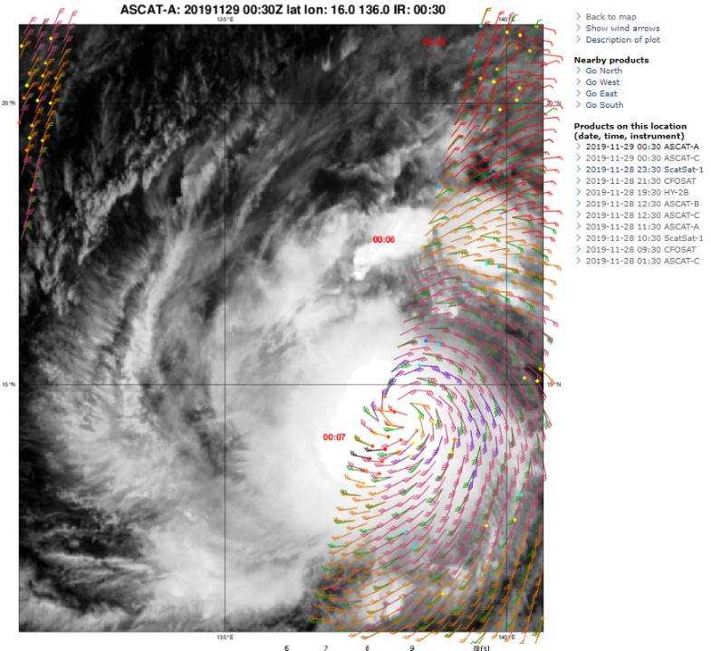
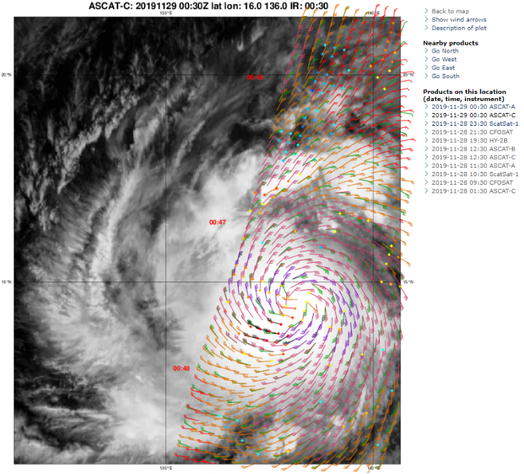
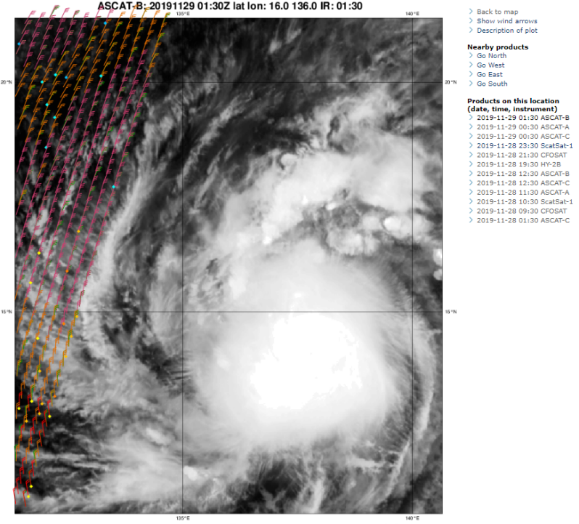
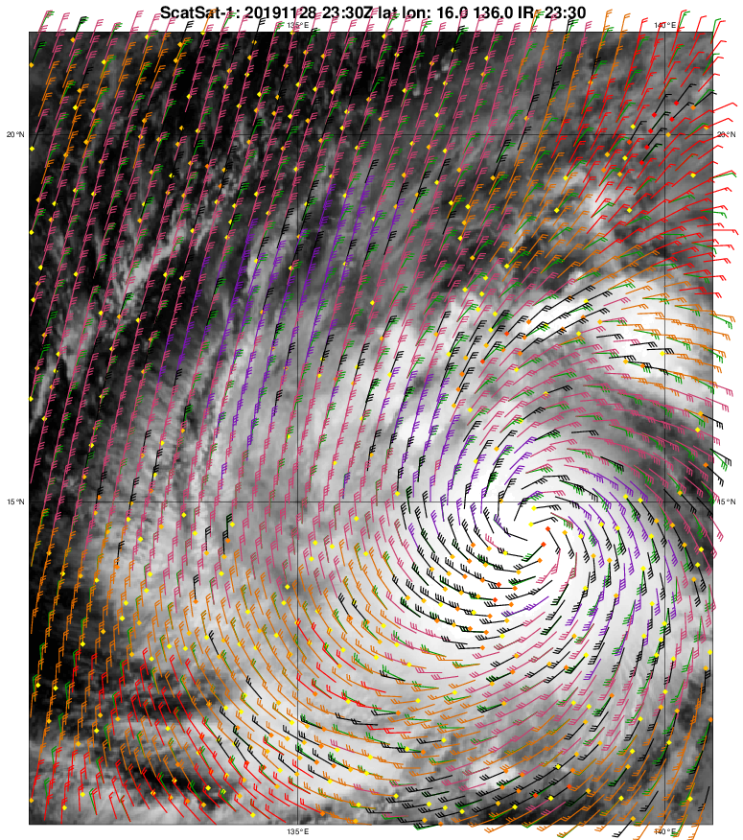
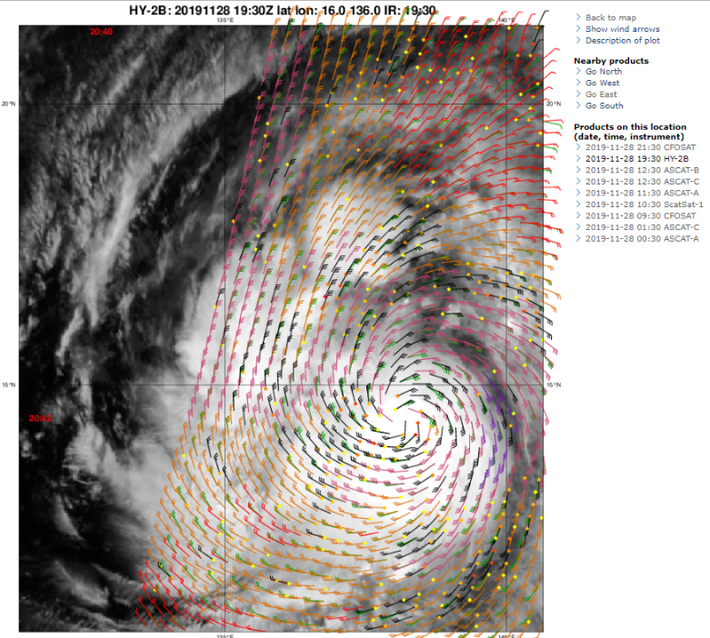
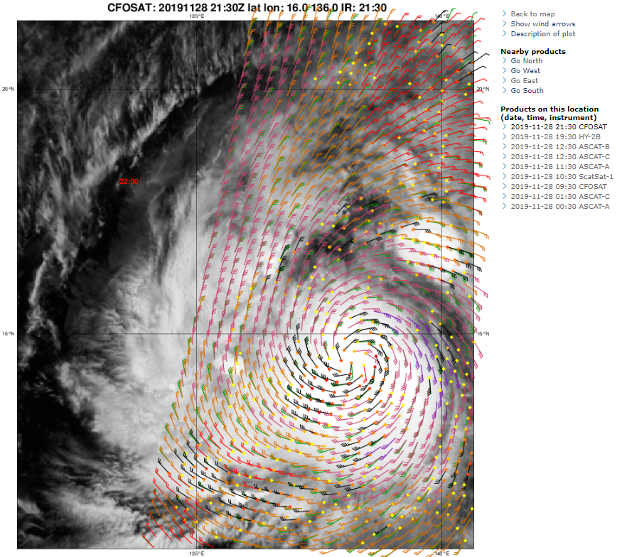
Coverage: HY-2B, CFOSAT-SCATSAT-ASCAT A, B, C
Case: Kamuri 3h window 28/22Z to 29/0120Z
NOW: coverage 95% guaranteed 2 daily!!!
ASCAT-A
ASCAT-C
ASCAT-B
SCATSAT
CFOSAT
HY-2B
Notes:
ASCATA 29 0007
ASCATB 0120
ASCATC 0047
SCATSATA 2319
CFOSAT 28/2200

Slide 13
Case: Kamuri 00 UTC 29 November
What is the intensity ?
Refer Socrative.com
ASCAT-A 40kn
ASCAT-C 40kn
ASCAT-B
SCATSAT 45kn
CFOSAT 40kn
HY-2B 40kn
Notes:
ASCATA 29 0007
ASCATB 0120
ASCATC 0047
SCATSATA 2319
CFOSAT 28/2200
ADT: 3.5 50kn
SATCON: 55kn
JMA: 80kn
JTWC 65kn

Slide 14
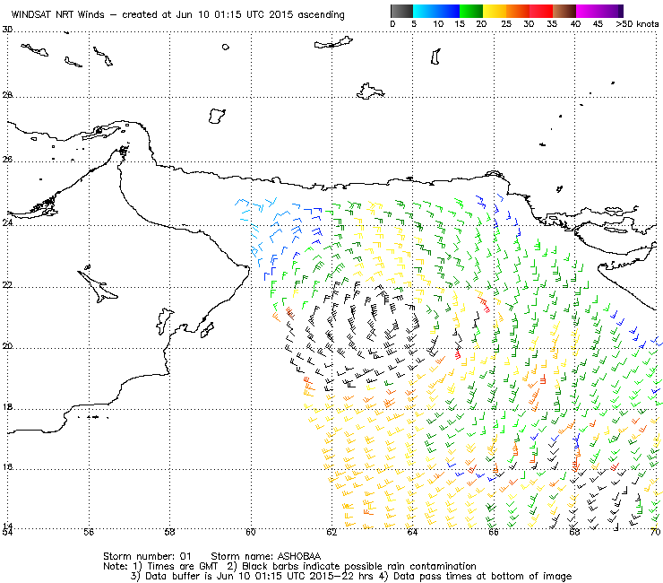
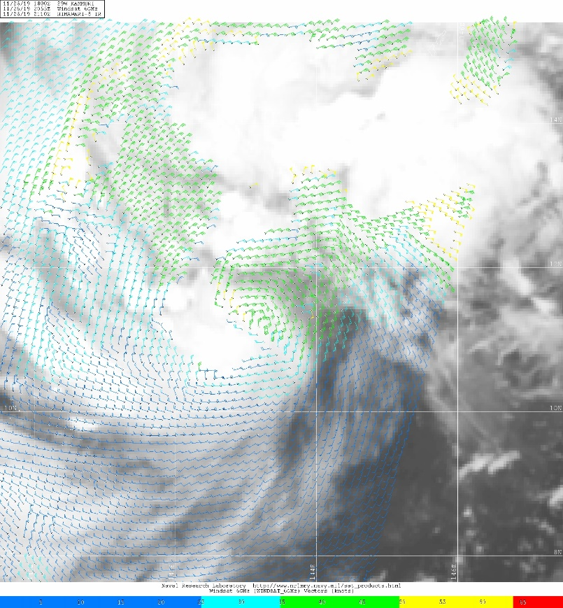
Radiometers (passive)
Windsat
https://manati.star.nesdis.noaa.gov/datasets/WindSATData.php
Satellites: Coriolis (2003 extended lifetime!)
Channel: 6.8-37 GHz
coverage: 1000km wide (>ASCAT, <SCATSAT)
two passes per day(ascending/descending)
Resolution: ~25km
TC applications:
Overestimates winds in rain, but solution to overcome speed in rainfall being worked on
Not useful for intensity
Sometimes for gale radii outside rain areas
NOAA: https://manati.star.nesdis.noaa.gov/datasets/WindSATData.php
NRL: https://www.nrlmry.navy.mil/tc-bin/tc_home2.cgi
X
Examples:1 Ashobaa Courtesy: NOAA https://manati.star.nesdis.noaa.gov/windsat_images/windsat_storm/storm_id_image_new/2015/windsat15061001_01_ASHOBAA_as.png
2. Kammuri courtesy NRL https://www.nrlmry.navy.mil/tc-bin/tc_home2.cgi?AGE=Prev&ACTIVES=19-SHEM-01P.RITA,19-WPAC-29W.KAMMURI,19-IO-90A.INVEST,19-SHEM-91S.INVEST,19-WPAC-95W.INVEST,19-WPAC-96W.INVEST&PHOT=yes&ATCF_BASIN=wp&SIZE=Full&NAV=tc&ATCF_YR=2019&ATCF_FILE=/SATPRODUCTS/kauai_data/www/atcf_web/public_html/image_archives/2019/wp292019.19112818.gif&CURRENT_ATCF_FILE=/SATPRODUCTS/kauai_data/www/atcf_web/public_html/image_archives/2019/wp292019.19112818.gif&CURRENT=20191126.2055.windsat.WINDSAT_6GHz_IRWS.wind.29WKAMMURI.3067_073pc_50kts-989mb_115N_1435E_sft20191126_1800.jpg&CURRENT_ATCF=wp292019.19112818.gif&ATCF_NAME=wp292019&ATCF_DIR=/SATPRODUCTS/kauai_data/www/atcf_web/public_html/image_archives/2019&MO=NOV&BASIN=WPAC&STYLE=tables&YEAR=2019&YR=19&STORM_NAME=29W.KAMMURI&ARCHIVE=active&AREA=pacific/southern_hemisphere&AID_DIR=/SATPRODUCTS/kauai_data/www/pacific/western/tropics/microvap/dmsp&DIR=/SATPRODUCTS/TC/tc19/WPAC/29W.KAMMURI/windsat/6ghz_wind&TYPE=windsat&PROD=6ghz_wind&SUB_PROD=2degreeticks
Notes:
https://weather.msfc.nasa.gov/sport/survey/windSat/WindSat_Reference_Guide.pdf
http://www.remss.com/missions/windsat/
The WindSat Polarimetric Radiometer was developed by the Naval Research Laboratory (NRL) Remote Sensing Division and the Naval Center for Space Technology for the U.S. Navy and the National Polar-orbiting Operational Environmental Satellite System (NPOESS) Integrated Program Office (IPO). It was launched on January 6, 2003 aboard the Department of Defense Coriolis satellite. WindSat was meant to demonstrate the capabilities of a fully polarimetric radiometer to measure the ocean surface wind vector from space. Prior to launch, the only instrument capable of measuring ocean wind vectors were scatterometers (active microwave sensors). In addition to wind speed and direction, the instrument can also measure sea surface temperature, soil moisture, ice and snow characteristics, water vapor, cloud liquid water, and rain rate.
Instrument Description
For a detailed description of the WindSat instrument, see P.Gaiser, "The WindSat Spaceborne Polarimetric Microwave Radiometer: Sensor Description and Early Orbit Performance". WindSat operates on the Coriolis satellite which is in a near-polar orbit. The local ascending node time is maintained at 6pm. This means the instrument passes over the equator at 6pm as it travels from south to north and at your location is measuring the surface near this time depending on your latitude.
The WindSat radiometer is well-calibrated and contains the lower frequency channels required for SST retrievals. The radiometer operates in 5 discrete channels: 6.8, 10.7, 18.7, 23.8 and 37.0 GHz. All are fully polarimeteric except the 6.8 and 23.8 GHz channels that have only dual polarization. Table 1 summarizes the channel details. The feedhorns of each frequency channel trace out different arcs along the scan, therefore the Earth Incidence Angles (EIA) are different for each frequency band. Unlike previous radiometers, the WindSat sensor takes observations during both the forward and aft looking scans. This makes the WindSat geometry of the earth view swath quite different and significantly more complicated to work with than the other passive microwave sensors. The RSS WindSat products are the only dataset available that uses both the fore and aft look directions. By using both directions, we obtain a wider swath and more complicated swath geometry as is visible in the browse images.
Thomas Meissner 29 Jan 2019
Radiometers (WindSat and AMSR2), slides 9/10: Thanks but as the data is not available in real time I've just mentioned that this might improve!
The standard rain-free radiometer wind speed algorithms break down quickly already in light rain, due to increased atmospheric attenuation. The wind speeds become indeed (much) too high.
However, there are All-Weather radiometer wind speed algorithms that are specifically trained in rainy conditions. They use a combination of the lowest two bands (C/X band) to mitigate the rain. Similar, than in the scatterometer case, that works to some extent (moderate rain, gale force winds). For WindSat, the All-Weather data are on our web site www.remss.com (paper reference Meissner and Wentz, IEEE TGRS 2009, https://doi.org/10.1109/TGRS.2009.2027012.)
For AMSR2, there is a Russian/French paper, Zabolotskikh, E., L. Mitnik, N. Reul, and B. Chapron, 2015, IEEE J. Sel. Top. Appl. Earth Obs. Remote Sens, doi: https://doi.org/10.1109/JSTARS.2015.2416514.) I think the data are distributed by IFREMER, but probably not in real-time.

Slide 15
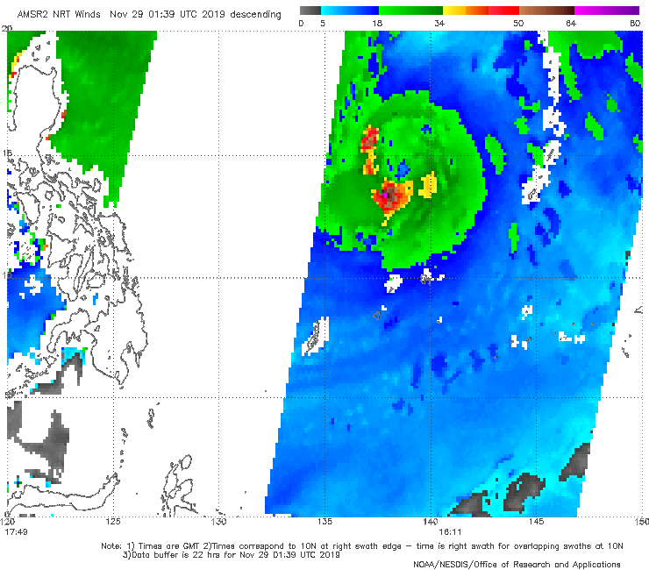
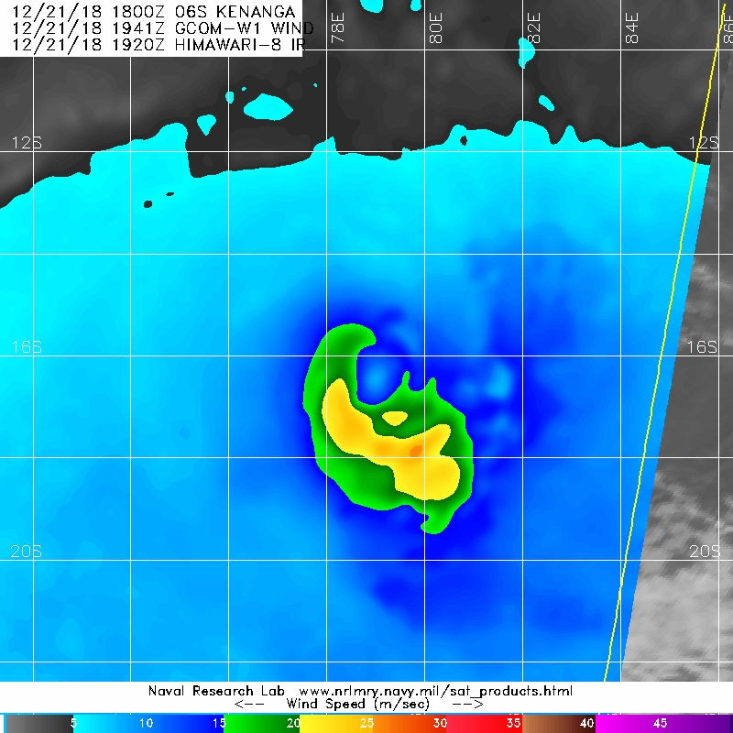
AMSR2 radiometer (passive)
https://manati.star.nesdis.noaa.gov/datasets//GCOM2Data.php
Satellite: GCOM (2012)
Channel: 10.7-36.5GHz
Coverage: 1450km (wider than ASCAT)
Two passes per day
TC applications:
Can be ok for extent of gales
Speed only
Availability same as Windsat
NOAA and NRL
Solution to overcome speed in rainfall
being worked on
ALSO SSMIS radiometer as well
X
Examples: 1. Kammuri Courtesy: NOAA https://manati.star.nesdis.noaa.gov/gcom_images/cur/wdsp/zooms/WMBds62.png
2. Kenanga 2018 NRL
Notes:
http://www.remss.com/missions/amsr/

Slide 16
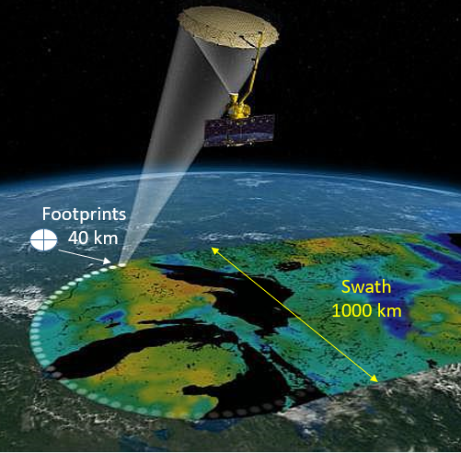
L-Band Radiometers: SMAP (Soil Moisture Active Passive) SMOS (Soil Moisture and Ocean Salinity)
http://www.remss.com/missions/smap/winds/
microwave ocean emissivity (sea foam) correlates to wind speed mostly linear at high winds, no reduced sensitivity.
at L-band (21 cm) atmosphere is almost transparent so very small impacts of rain compared to C, X and Ku bands
L-Band 1.4GHz cf ASCAT C-Band 5.3GHz & SCATSAT Ku-band 13.5GHz
So can resolve high wind speeds
Satellite: SMOS (NASA 2009); SMAP (ESA 2012)
Coverage swathe 1000km SMAP; 1500km SMOS
Resolution 40km (winds averaged over footprint)
TC applications:
Intensity as resolves high wind speeds
40km resolution constraint for small RMW
Good for gale/storm/hurricane radii
Access for real-time an issue (SMOS N/A)
SMAP coverage image courtesy Meissner et al.2018
Notes:
Soil Moisture and Ocean Salinity (SMOS) ESA launched 2009
Soil Moisture Active Passive (SMAP) NASA launched 2015
SMAP http://www.remss.com/missions/smap/winds/
http://images.remss.com/smap/smap_data_daily.html
https://journals.ametsoc.org/doi/pdf/10.1175/BAMS-D-15-00291.1
40km resolution 1000km swathe
From: Cossuth, Dr. Joshua [mailto:Joshua.Cossuth@nrlmry.navy.mil]
Sent: Tuesday, 28 November 2017 10:57 PM
To: Andrew Burton
Cc: Joe Courtney; Vikash Prasad
Subject: RE: SMAP and SCATSAT on NRL TC Page? [SEC=UNCLASSIFIED]
Hi Andrew,
Great to hear from you - hope all is going well with you, Joe, et al!
Yes, we are in the process of adding SCATSAT, SMAP, and SMOS winds to NRL TC web’s real-time stream. We are experiencing delays in transitioning new sensors since we right in the thick of shifting all our processing to a new software system. In the next year, we hope to have a parallel TC web running in open source python and a new web interface. However, for now, that means incremental progress since any new data will be only supported in our new processing.
Here are some comments on the status of these sensors:
SCATSAT:
We have a real-time feed set-up through KNMI.
A scalar wind product is generated in real-time – see the “ScatSat-1 OSCAT” option when you hover your cursor over the WindVectors button.
Here’s a sample folder if you’d like to skip the webpage:
https://www.nrlmry.navy.mil/TC/tc18/SHEM/95S.INVEST/wind-speed-shaded/oscat/1km/
We’re still debugging our new vector product (currently just a blank map), but they will replace the scalar product when ready:
https://www.nrlmry.navy.mil/TC/tc18/SHEM/95S.INVEST/windbarbs/oscat/1km/
If you have access to the FNMOC TC page (I believe it is public, but perhaps not), their SCATSAT vector products using the old processing is under the “OSCAT” link:
https://www.fnmoc.navy.mil/tcweb/cgi-bin/tc_home.cgi
SMAP:
We have a feed from REMSS, but as you noted the latency is not great.
We are also acquiring the 1.4 GHz brightness temperature feed directly from NASA JPL and may try their alternative wind product.
There are discussions between NASA/REMSS/CIRA/NRL to improve that latency to ~2-3 hours. Still a work in progress, but it is making forward movement. This depends on NASA setting up resources to improve their product processing time (I believe their data downlink is not the issue). Not sure if the timing will help your current TC season though.
SMOS:
Similar movement between NRL/CIRA/REMSS and ESA has started toward acquiring near-realtime SMOS data and creating similar analyses to SMAP (similar frequency). Preliminary for now, but promising.
Otherwise, I tried the other usual suspects for wind products (NOAA NESDIS, etc.) and couldn’t locate other alternatives at the moment.
Our SCATSAT updates should happen fairly soon. When we get better SMAP/SMOS progress, I’ll try to send an update.
Sorry for the long e-mail – hope it was useful!
-Josh

Slide 17
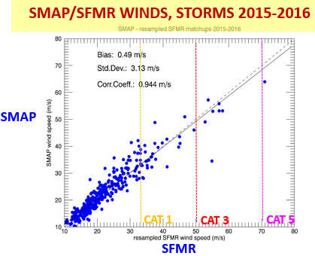
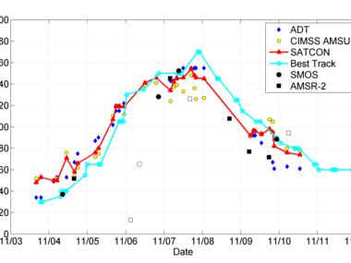
L-Band Radiometers: calibration accuracy within ~10 %
SMAP Vs SFMR calibration
SMOS Haiyan
http://www.smosstorm.org/
Acknowledgement: Meissner et al IWTC-IX
Notes:
http://www.smosstorm.org/
Soil Moisture and Ocean Salinity (SMOS) ESA launched 2009
Soil Moisture Active Passive (SMAP) NASA launched 2015
SMAP http://www.remss.com/missions/smap/winds/
http://images.remss.com/smap/smap_data_daily.html
https://journals.ametsoc.org/doi/pdf/10.1175/BAMS-D-15-00291.1
40km resolution 1000km swathe
From: Cossuth, Dr. Joshua [mailto:Joshua.Cossuth@nrlmry.navy.mil]
Sent: Tuesday, 28 November 2017 10:57 PM
To: Andrew Burton
Cc: Joe Courtney; Vikash Prasad
Subject: RE: SMAP and SCATSAT on NRL TC Page? [SEC=UNCLASSIFIED]
Hi Andrew,
Great to hear from you - hope all is going well with you, Joe, et al!
Yes, we are in the process of adding SCATSAT, SMAP, and SMOS winds to NRL TC web’s real-time stream. We are experiencing delays in transitioning new sensors since we right in the thick of shifting all our processing to a new software system. In the next year, we hope to have a parallel TC web running in open source python and a new web interface. However, for now, that means incremental progress since any new data will be only supported in our new processing.
Here are some comments on the status of these sensors:
SCATSAT:
We have a real-time feed set-up through KNMI.
A scalar wind product is generated in real-time – see the “ScatSat-1 OSCAT” option when you hover your cursor over the WindVectors button.
Here’s a sample folder if you’d like to skip the webpage:
https://www.nrlmry.navy.mil/TC/tc18/SHEM/95S.INVEST/wind-speed-shaded/oscat/1km/
We’re still debugging our new vector product (currently just a blank map), but they will replace the scalar product when ready:
https://www.nrlmry.navy.mil/TC/tc18/SHEM/95S.INVEST/windbarbs/oscat/1km/
If you have access to the FNMOC TC page (I believe it is public, but perhaps not), their SCATSAT vector products using the old processing is under the “OSCAT” link:
https://www.fnmoc.navy.mil/tcweb/cgi-bin/tc_home.cgi
SMAP:
We have a feed from REMSS, but as you noted the latency is not great.
We are also acquiring the 1.4 GHz brightness temperature feed directly from NASA JPL and may try their alternative wind product.
There are discussions between NASA/REMSS/CIRA/NRL to improve that latency to ~2-3 hours. Still a work in progress, but it is making forward movement. This depends on NASA setting up resources to improve their product processing time (I believe their data downlink is not the issue). Not sure if the timing will help your current TC season though.
SMOS:
Similar movement between NRL/CIRA/REMSS and ESA has started toward acquiring near-realtime SMOS data and creating similar analyses to SMAP (similar frequency). Preliminary for now, but promising.
Otherwise, I tried the other usual suspects for wind products (NOAA NESDIS, etc.) and couldn’t locate other alternatives at the moment.
Our SCATSAT updates should happen fairly soon. When we get better SMAP/SMOS progress, I’ll try to send an update.
Sorry for the long e-mail – hope it was useful!
-Josh

Slide 18
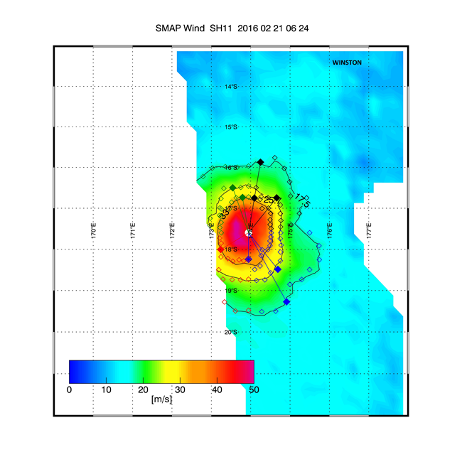
SMAP wind radii
Excellent for R34, R48 and R64 contours
Near-real time for SMAP (~3h)
JTWC collab: file 'fixes' not 'aids'
Marcus: 137 kn
Meissner, Ricciardulli and Wentz:
https://journals.ametsoc.org/doi/10.1175/BAMS-D-16-0052.1
Winston: winds of 50m/s (>90kn)
http://images.remss.com/figures/announcements/smap-wspd-v1-release/Fig5a_winston.jpg
Notes:
SMAP resolves higher winds being a L-band radiometers are sensitive to sea foam at high winds. Its signal (foam emission) keeps increasing linearly with wind speed and shows no sign of saturation even in very high winds (similar to C-band SFMR radiometer). Accuracy is ~10%.
SMAP http://www.remss.com/missions/smap/winds/
http://images.remss.com/smap/smap_data_daily.html
https://journals.ametsoc.org/doi/pdf/10.1175/BAMS-D-15-00291.1
From: Cossuth, Dr. Joshua [mailto:Joshua.Cossuth@nrlmry.navy.mil]
Sent: Tuesday, 28 November 2017 10:57 PM
To: Andrew Burton
Cc: Joe Courtney; Vikash Prasad
Subject: RE: SMAP and SCATSAT on NRL TC Page? [SEC=UNCLASSIFIED]
Hi Andrew,
Great to hear from you - hope all is going well with you, Joe, et al!
Yes, we are in the process of adding SCATSAT, SMAP, and SMOS winds to NRL TC web’s real-time stream. We are experiencing delays in transitioning new sensors since we right in the thick of shifting all our processing to a new software system. In the next year, we hope to have a parallel TC web running in open source python and a new web interface. However, for now, that means incremental progress since any new data will be only supported in our new processing.
Here are some comments on the status of these sensors:
SCATSAT:
We have a real-time feed set-up through KNMI.
A scalar wind product is generated in real-time – see the “ScatSat-1 OSCAT” option when you hover your cursor over the WindVectors button.
Here’s a sample folder if you’d like to skip the webpage:
https://www.nrlmry.navy.mil/TC/tc18/SHEM/95S.INVEST/wind-speed-shaded/oscat/1km/
We’re still debugging our new vector product (currently just a blank map), but they will replace the scalar product when ready:
https://www.nrlmry.navy.mil/TC/tc18/SHEM/95S.INVEST/windbarbs/oscat/1km/
If you have access to the FNMOC TC page (I believe it is public, but perhaps not), their SCATSAT vector products using the old processing is under the “OSCAT” link:
https://www.fnmoc.navy.mil/tcweb/cgi-bin/tc_home.cgi
SMAP:
We have a feed from REMSS, but as you noted the latency is not great.
We are also acquiring the 1.4 GHz brightness temperature feed directly from NASA JPL and may try their alternative wind product.
There are discussions between NASA/REMSS/CIRA/NRL to improve that latency to ~2-3 hours. Still a work in progress, but it is making forward movement. This depends on NASA setting up resources to improve their product processing time (I believe their data downlink is not the issue). Not sure if the timing will help your current TC season though.
SMOS:
Similar movement between NRL/CIRA/REMSS and ESA has started toward acquiring near-realtime SMOS data and creating similar analyses to SMAP (similar frequency). Preliminary for now, but promising.
Otherwise, I tried the other usual suspects for wind products (NOAA NESDIS, etc.) and couldn’t locate other alternatives at the moment.
Our SCATSAT updates should happen fairly soon. When we get better SMAP/SMOS progress, I’ll try to send an update.
Sorry for the long e-mail – hope it was useful!
-Josh

Slide 19
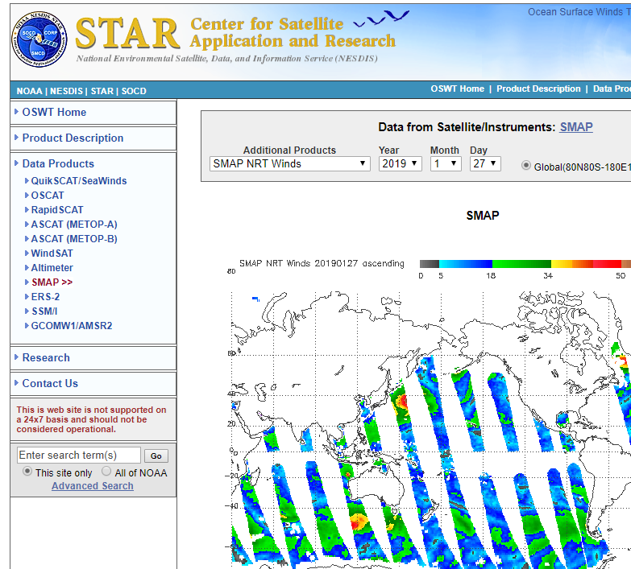
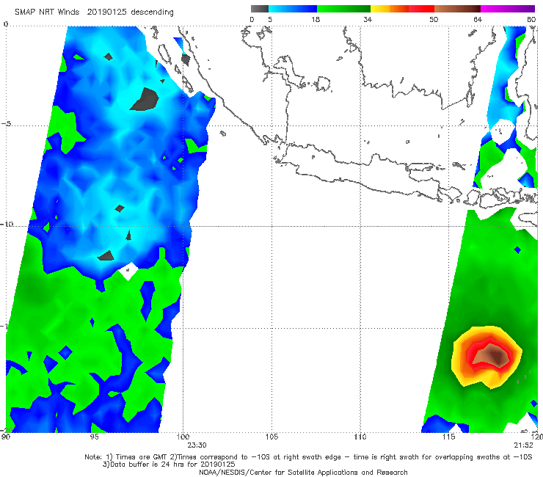
SMAP availability:
NOAA manati https://manati.star.nesdis.noaa.gov/datasets/SMAPData.php
NRL https://www.nrlmry.navy.mil/tc-bin/tc_home2.cgi
REMSS (not real time though) http://images.remss.com/smap/
Example: Riley 2330Z, 25 January 2019

Slide 20
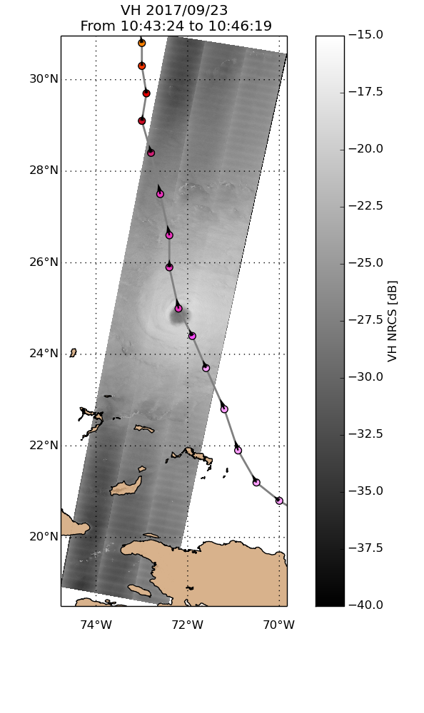
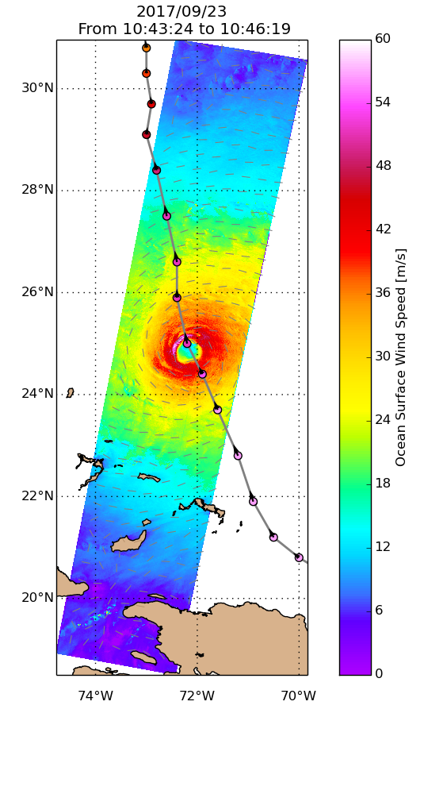
SAR C-Band
Synthetic Aperture Radar
https://www.wmo.int/pages/prog/arep/wwrp/tmr/documents/IWTC-9_Subtopic_5-1.pdf
Satellites: Sentinel 1A, 1B (C,D coming) (ESA Copernicus program)
RadarSat-2 (Canada); Gaofeng-3 (China)
Coverage: ~400km
Resolution: <150m !!
Co-polarization: similar to ASCAT good <65kn
Cross-polarization: good for high winds like L-Band. No sensitivity to direction.
Skill: high (~SFMR)
Technique will be added to second generation (SG) scatterometers (EUMETSAT)
Issue: research mode only so not operational !
C-band SAR
VH backscatter
C-band SAR
Wind retrieval
2017/09/23, Maria
Mouche et al. 2017, IEEE TGRS
Notes:
SAR potential operational use
There is no international strategy to maximize acquisitions over TCs.
Requires international efforts to go from “experiments” to “operational services”.
C-Band Synthetic Aperture Radar The C-Band Synthetic Aperture Radar (SAR) systems are the only active microwave sensors able to observe ocean surface night and day and through clouds at high resolution (50 m) with a wide coverage (400 km swath). This unique combination opens perspectives to characterize the inner core storm structures, such as, the eye-wall and radius of maximum wind speed, and the rain band locations. High resolution also allows measurements in coastal areas without any land contamination. Since the launch of the first satellite SAR mission SEASAT in 1978, the application of SAR for ocean surface wind retrieval has become mature for moderate wind speeds (Monaldo et al., 2003; Dagestad et al., 2012), with noticeable efforts for hurricane monitoring (Gonzales et al. 1982; Katsaros et al., 2000). Up to very recently, and as for scatterometer missions, most of the SAR were only operating in co-polarization (antenna emits in V or H polarization and receives in H or V polarization). SAR wind measurement principle is thus very similar to scatterometers. It relies on the sensitivity of the backscattered intensity from the ocean sea surface to the ocean surface wind speed and direction. Consequently, SAR suffers from the same limitation for extreme winds: a decrease in sensitivity for winds higher than 35 ms-1 . Yet, several improvements and new methodologies have been seen in recent years. Radarsat-2 (launched in 2007 by the Canadian Space Agency) pioneered the capabilities to measure the signal both in co-polarization and crosspolarization (antenna emits in V polarization and receives in H; or vice versa). In particular, the 5.1.7 higher sensitivity (with no apparent saturation) of the cross-polarization (w.r.t. to co-polarization) to the ocean surface wind speed for extreme winds enables to improve the wind speed accuracy in TCs (Zhang et al., 2012; Horstmann et al., 2015; Hwang et al., 2015). Thanks to the space component of Copernicus (the European Union's Earth Observation Programme), a constellation mission consisting of two SARs is now operational since April 2014 for Sentinel-1A and April 2016 for Sentinel-1B. The extension of Sentinel-1 mission is already planned and agreed by the European Commission and the ESA with Sentinel-1C and -1D. They will ensure the continuity of Copernicus service at least until the end of 2030. As it was the case with Radarsat-2, the Sentinel-1 SARs can acquire simultaneously over the same area in both coand cross- polarizations. Mouche et al. (2017) focused on the quality assessment of the new cross-polarization channel and its possible benefits for extreme wind measurements. They propose to combine both co- and cross- polarizations to measure ocean surface wind vector at 3-km resolution over TCs. When compared to SMAP radiometer measurements, very consistent results have been obtained with bias and RMS respectively lower than 3.5 and 5.0 ms-1 for wind speeds larger than 30 ms-1 (Mouche et al. 2017). At the same resolution (40 km), the linear relationship found between L-band ocean surface roughness brightness temperature and C-band cross-polarized backscattering over extreme winds explains the similar performances of the two different sensors (Zhao et al. 2018). Figure 5.1.4. shows a comparison between Sentinel-1 SAR and SMAP radiometer ocean surface wind speed retrieved in the case of Typhoon Lionrock (2016/08/27) as obtained (a) with SAR using the two polarization channels at 3-km resolution and (b) SMAP radiometer wind speed from the RSS algorithm (Meissner et al., 2017). As observed, typical parameters such as TC eye diameter or radius of maximum wind can only be accurately derived from high resolution products. Recent work has also shown the capability of Sentinel-1 to measure wind speeds up to 75 ms-1 over Irma the 7th of September 2017 in close agreement with SFMR (Stepped Frequency Microwave Radiometer) airborne measurements (Mouche et al. 2018). Finally, the analysis of backscattered signal can also provide information on the wind rolls alignments in the TC (Foster et al., 2004). The differing sensitivity between contemporaneous co- and cross-polarized SAR signals is thus the main advantage of new SAR missions to infer local information about the TC structure. To first order and because of its high-resolution capabilities, SAR measurements can thus accurately document the ocean surface response in and around TC eyes. However, at C-Band and at high resolution, the impact of rain in case of extreme wind is still uncertain with possible increase or decrease of the backscattered signal. 5.1.8 Figure 5.1.1: Wind speed as obtained (a) with SAR using the two polarization channels at 3-km resolution, (b) at 40 km re

Slide 21
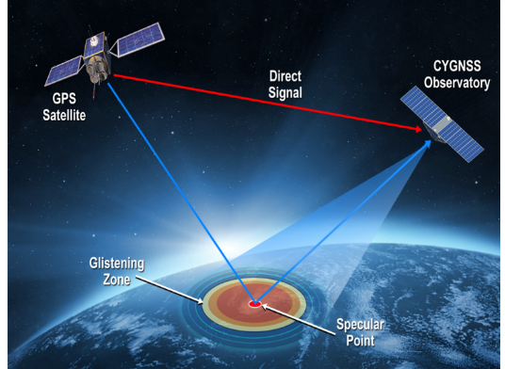
FUTURE
(CY)GNSS Cyclone Global Navigation Satellite System Reflectometry
navigation signals reflected from sfc using constellation of 8 micro-satellites (LOE 35deg.inclination), carrying a bi-static scatterometer receiver of GPS signals scattered by ocean.
'TROPICS' Time-Resolved Observations of Precipitation structure and storm Intensity with a Constellation of Smallsats
MetOp-SG (second generation)
CIMR: Copernicus Imaging Microwave Radiometer
L & C-band radiometer follow-on project in EU
Notes:
https://journals.ametsoc.org/doi/full/10.1175/JAMC-D-16-0375.1
Global Navigation Satellite System-reflectometry (GNSS-R) is a remote sensing technique that uses navigation signals—specifically, those that reflect from a surface—opportunistically for science applications (Zavorotny et al. 2014). The Cyclone Global Navigation Satellite System (CYGNSS) mission employs a constellation of eight microsatellites, each with a 4-channel GNSSR radar receiver capable of measuring Global Positioning System (GPS) L1 signals scattered from the surface (Ruf et al. 2016a,b; 2018). CYGNSS provides frequent observations of nearsurface ocean wind speed in all precipitating conditions and represents the first science-driven GNSS-R satellite mission. 5.1.9 Figure 5.1.2: A CYGNSS overpass of Hurricane Florence on 11 September 2018. Left: In color, CYGNSS young seas limited fetch (YSLF) wind speed. A dashed-cross line denotes the best track center location, with the red dots denoting the interpolated center position at the CYGNSS coverage time for this plot. Middle: CYGNSS YSLF wind speed, again in knots, but projected in storm centric coordinates, with the closest-in-time best track wind radii estimates visualized for comparison. Right: An example of a CYGNSS parametric model retrieval in the SE quadrant. Contrasting the large swaths provided from scatterometers and radiometers, CYGNSS delivers wind speed observations via collections of tracks across the ocean surface (See Figure 5.1.5) (CYGNSS, 2017; Ruf and Balasubramaniam, 2018; Ruf et al., 2018) The sampling properties of the CYGNSS constellation are a function of the orbit properties of the spacecraft and GPS satellites, and are therefore a function of latitude, and time and space window choices (BussyVirat et al., 2018). Morris and Ruf (2017a,b) developed methods that objectively estimate TC intensity, wind radii, radius of maximum wind speed, and integrated kinetic energy from simulated CYGNSS level-2 wind speed estimates. Morris and Ruf’s parametric model algorithm smartly interpolates across tracks of CYGNSS observations through a storm, leading to objective estimates of TC metrics. Using the best-track datasets as validation, these methods are applied and validated using the first set of CYGNSS TC observations (Morris, 2018; Chu et al., 2002; Landsea and Franklin, 2013). Figure 5.1.5 shows a preliminary example of a CYGNSS storm overpass, with the resulting parametric model retrieval. In the example shown in Figure 5.1.5, Hurricane Florence is not completely sampled, but where there are observations, objective estimates of TC metrics are possible. Notably, CYGNSS wind speed estimates capture the storm structure asymmetry documented in the closest best-track analysis. The methods developed in Morris and Ruf (2017b) are currently being applied to on-orbit data, with one retrieval example shown in Figure 5.

Slide 22
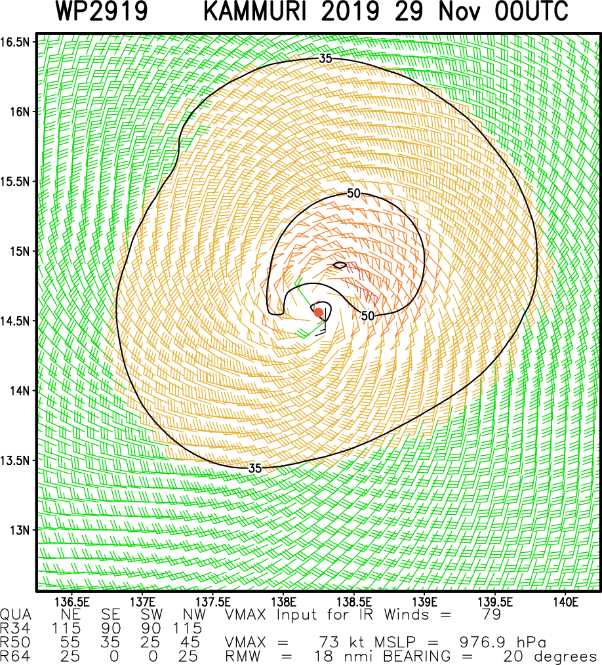
Challenges
Forecasters: integrate all of this information into the forecast process – time is the killer.
Satellite people: share this data in real-time
Systems people: get the data into viewing software – current 'nightmare' for forecasters (need navigation for measuring!)
Researchers: include this info into methods/techniques (SATCON, ARCHER, CIRA MSSWA …)
NWP people: assimilate this information into NWP

Slide 23
Summary & Questions
Sensor | Band | Best | Challenge | Useful in ops
ASCAT (A, B, C) | C-band |  | Coverage tropics | YES YES YES
 |  | Gale radii; Intensity <55kn
SCATSAT | Ku-band | Gale radii; | rain contamination | YES
HY-2B
CFOSAT
SMAP | L-Band | Resolves high winds; Wind radii | Availability; 40km resolution | When avialable
Windsat/ AMSRE2/SSMIS | Passive radiometers | Gale radii | useful outside convection | somewhat
SAR | C-band | 150m res; high skill <65kn | 400km swathe; | NOT YET
 |  |  | <65kn for now.
CyGNSS | GPS scatter | 8 satellites | Small footprint; noisy | NOT YET
TROPICS | Passive radiometers | constellation | Into future; low quality | NOT YET
CIMR; MetOp-SG | combined | Skill at all intensity | Into future | After 2022/25

Slide 24
EXTRA SLIDES

Slide 25
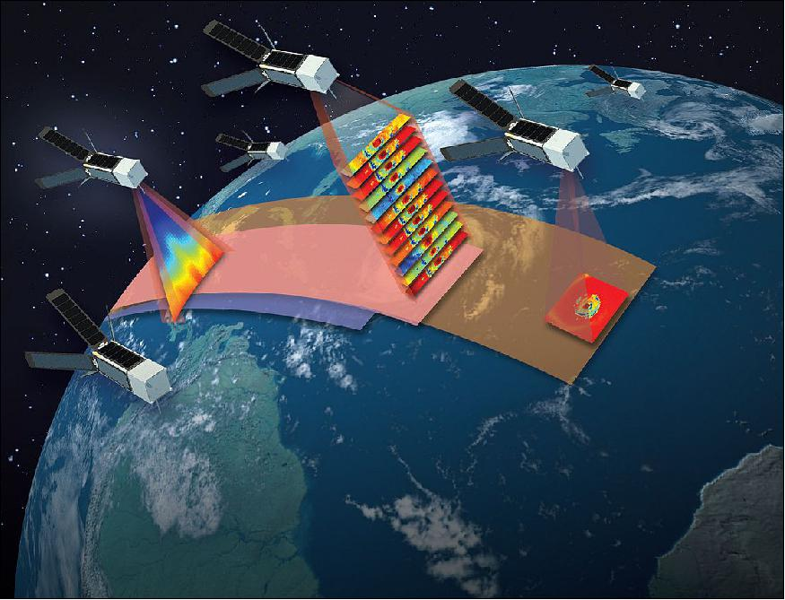
Future: 'TROPICS'
Time-Resolved Observations of Precipitation structure and storm Intensity with a Constellation of Smallsats
CUBESAT constellation: small satellites (<4kg) and cheap (short lifecycle)
12 channels 90-206GHz
Consortium approach NASA/MIT etc
First launch
Lower quality sensors but higher
frequency when many deployed
https://directory.eoportal.org/web/eoportal/satellite-missions/content/-/article/tropics
Notes:
https://directory.eoportal.org/web/eoportal/satellite-missions/content/-/article/tropics
A constellation of identical 3U CubeSats provide sounding (left CubeSat has a temperature profile of a simulated TC (Tropical Cyclone) from a NWP (Numerical Weather Prediction) model and 12-channel radiometric imagery (center CubeSat has simulated radiances from NWP model and radiative transfer model and the near right CubeSat has a single channel radiance image of a TC) with 30-minute median revisit rate to meet most PATH requirements

Slide 26
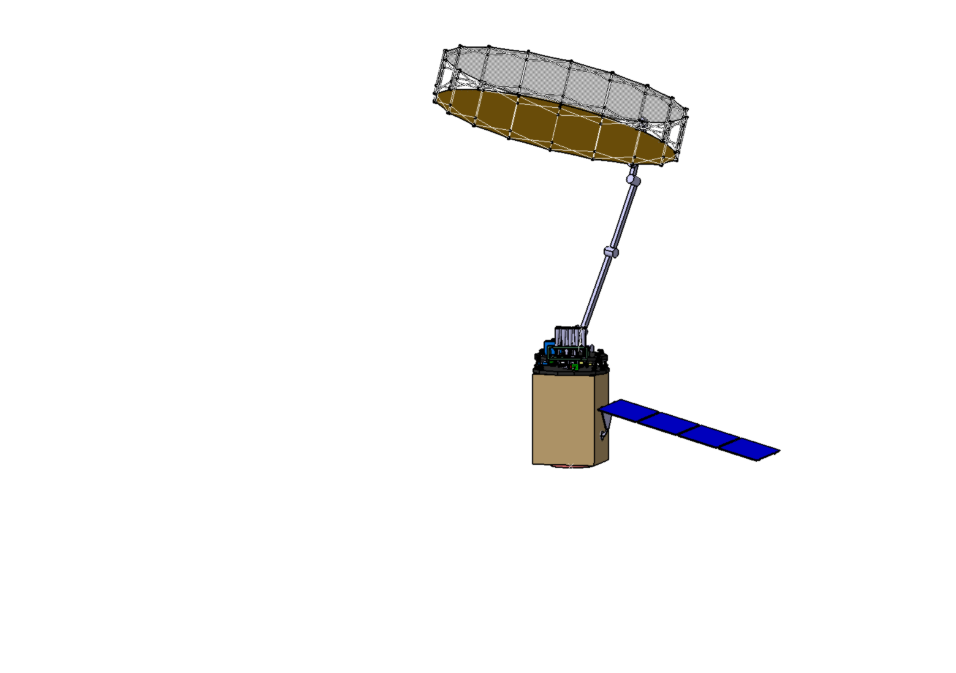
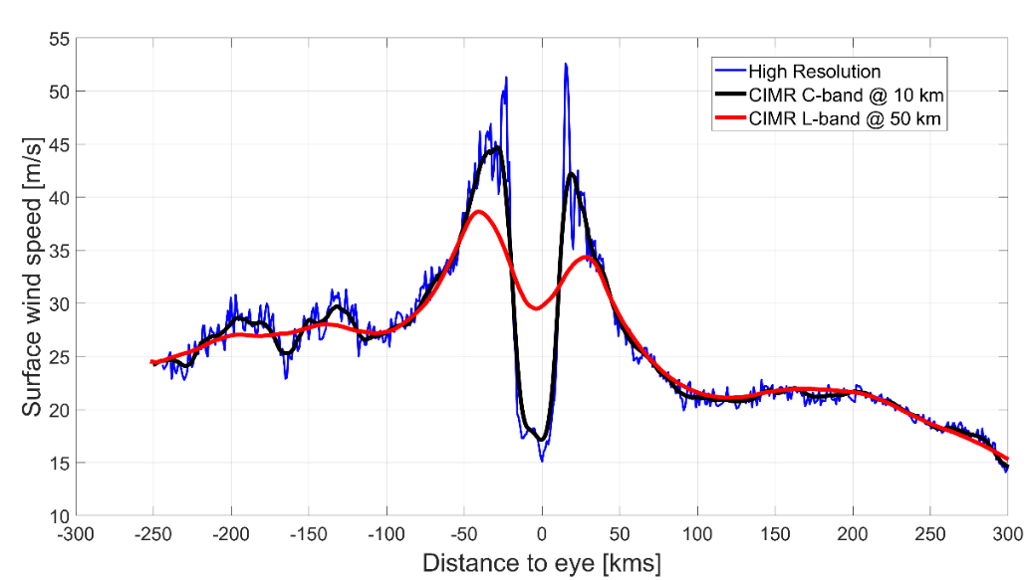
Longer term 2022+
MetOp-SG (second generation)
CIMR: Copernicus Imaging Microwave Radiometer
L & C-band radiometer follow-on project in EU
CIMR is one of the 6 High Priority Candidate Mission (HPCM) for the Expansion of the Copernicus Space Component (adding to the Sentinels 1-6).
Combined L and C bands provides extra capabilities
~Ø7m
Characteristics (To be Confirmed)
Conically scanning multi-frequency microwave radiometer
~95% global coverage every day; - swath 1800 km
Launch: 2025+ timeframe if selected by EU
Channels (GHz, all H&V):1.4, 6.9, 10.65, 18.7 36.5
Resolution (km): ≤55 10 ≤10 ≤5 ≤5
NEΔT (K @150K): ≤0.3 ≤0.2 ≤0.3 ≤0.3 ≤0.7
Notes:
With combined L -(50 km)+ C- (10km) CIMR shall have excellent capabilities for high surface wind speed retrievals of both the outer and inner core TC wind structure

Slide 27
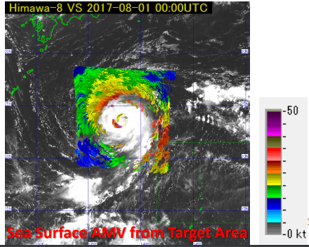
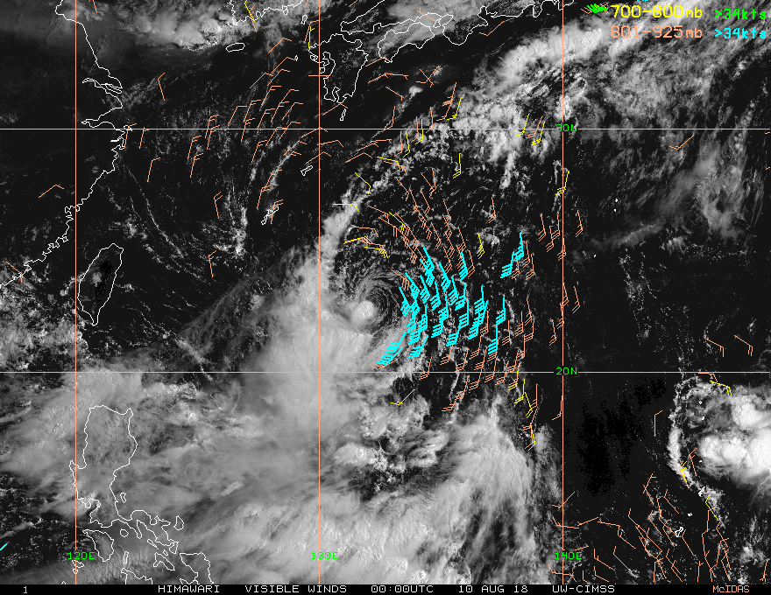
Geostationary satellites
AMV (Cloud drift winds) derived to surface
Rapid scan mode
Latest Geostationary:
Himawari-9: 10min; rapidscan 2.5min for target*;
GOES-R: 10-15min; rapidscan 1-5min;
FY-4: 15min rapidscan 2.5min;
KOMPSAT-2A 10min rapidscan 2.0min east Asia soon
Meteosat: 10min rapidscan 2.5min Europe
Rapidscan best for surface winds
Requires low level cloud exposed so not for central cloudy regions near TC;
Useful for environmental flow and gale extent.
CIMSS: Surface Adjusted Vis/SWIR Winds
Acknowledgement: Bessho et al 2018 (IWTC-9)
https://www.wmo.int/pages/prog/arep/wwrp/tmr/documents/T5.2_ppt.pdf
Notes:
*target in SH upon request

Slide 28

Reflectometry (CY)GNSS
Cyclone Global Navigation Satellite System Reflectometry
AIM: To Measure ocean surface wind speed in all precipitating conditions
How: navigation signals reflected from surface using constellation
Design: 8 micro-satellites in low-earth orbit (35deg.inclination), each carrying a bi-static scatterometer receiver of GPS signals scattered by the ocean surface.
Challenges: noisy observations and resolution
Requires modelling to connect to TC tracks
Small footprint
Not operational but data on :
https://worldview.earthdata.nasa.gov
Advantages: more frequent temporally
(8 satellites)
Resolution 25km
Morris and Ruf 2017, J. Appl. Meteor. Climat.
Notes:
https://journals.ametsoc.org/doi/full/10.1175/JAMC-D-16-0375.1
Global Navigation Satellite System-reflectometry (GNSS-R) is a remote sensing technique that uses navigation signals—specifically, those that reflect from a surface—opportunistically for science applications (Zavorotny et al. 2014). The Cyclone Global Navigation Satellite System (CYGNSS) mission employs a constellation of eight microsatellites, each with a 4-channel GNSSR radar receiver capable of measuring Global Positioning System (GPS) L1 signals scattered from the surface (Ruf et al. 2016a,b; 2018). CYGNSS provides frequent observations of nearsurface ocean wind speed in all precipitating conditions and represents the first science-driven GNSS-R satellite mission. 5.1.9 Figure 5.1.2: A CYGNSS overpass of Hurricane Florence on 11 September 2018. Left: In color, CYGNSS young seas limited fetch (YSLF) wind speed. A dashed-cross line denotes the best track center location, with the red dots denoting the interpolated center position at the CYGNSS coverage time for this plot. Middle: CYGNSS YSLF wind speed, again in knots, but projected in storm centric coordinates, with the closest-in-time best track wind radii estimates visualized for comparison. Right: An example of a CYGNSS parametric model retrieval in the SE quadrant. Contrasting the large swaths provided from scatterometers and radiometers, CYGNSS delivers wind speed observations via collections of tracks across the ocean surface (See Figure 5.1.5) (CYGNSS, 2017; Ruf and Balasubramaniam, 2018; Ruf et al., 2018) The sampling properties of the CYGNSS constellation are a function of the orbit properties of the spacecraft and GPS satellites, and are therefore a function of latitude, and time and space window choices (BussyVirat et al., 2018). Morris and Ruf (2017a,b) developed methods that objectively estimate TC intensity, wind radii, radius of maximum wind speed, and integrated kinetic energy from simulated CYGNSS level-2 wind speed estimates. Morris and Ruf’s parametric model algorithm smartly interpolates across tracks of CYGNSS observations through a storm, leading to objective estimates of TC metrics. Using the best-track datasets as validation, these methods are applied and validated using the first set of CYGNSS TC observations (Morris, 2018; Chu et al., 2002; Landsea and Franklin, 2013). Figure 5.1.5 shows a preliminary example of a CYGNSS storm overpass, with the resulting parametric model retrieval. In the example shown in Figure 5.1.5, Hurricane Florence is not completely sampled, but where there are observations, objective estimates of TC metrics are possible. Notably, CYGNSS wind speed estimates capture the storm structure asymmetry documented in the closest best-track analysis. The methods developed in Morris and Ruf (2017b) are currently being applied to on-orbit data, with one retrieval example shown in Figure 5.

Slide 29
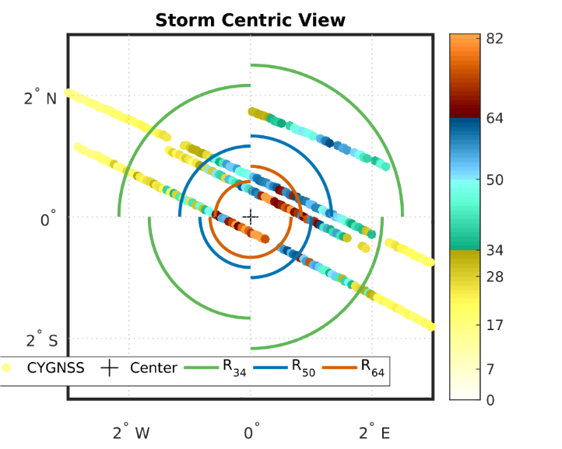
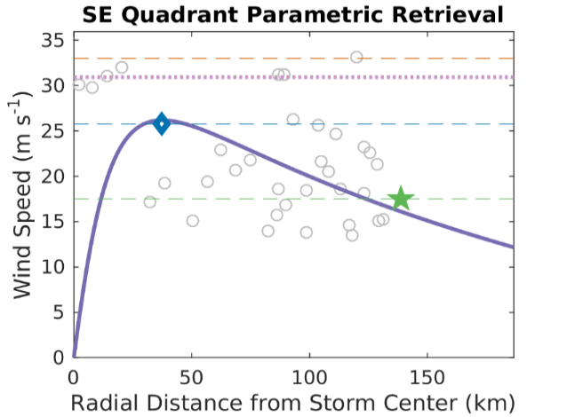
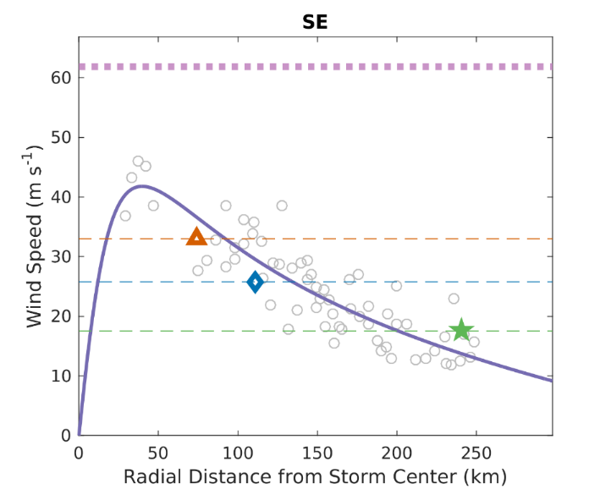
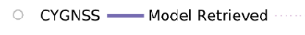


CyGNSS
CYGNSS Wind Speed (knots), Storm Centric View
Small footprint
Florence,11/9/2018, ~ 21UTC
Courtesy: Mary Morris mary.g.morris@jpl.nasa.gov.
Notes:
Preliminary Example: Hurricane Florence, 11-Sep-2018, ~ 21 UTC
https://www.nasa.gov/larc/eight-little-satellites-to-take-a-new-look-into-hurricanes

Slide 30


CyGNSS data on NASA JPL site worldview.earthdata.nasa.gov
Currently ~3day latency and uncertainty on quality, no time stamp
Riley, 28 Jan 2019 yellow ~ gales
Courtesy: NASA

