Slide 1
Singapore Flooding Case Study, 14th October 2024
Eng Hong ANG
Justin HENG
with some input from Bodo Zeschke
Notes:
Accessibility information – delete after reading
We're all responsible for producing accessible documents. Use the accessibility checker to make sure your content is accessible to everyone.

Slide 2
Content
What happened
Impact of the event
Observations
Climatology
Why did the event occur?
Climate Drivers and Tropical Waves
Satellite imagery and identifying the Drivers of the Weather
Evolution of the event (satellite imagery, RADAR and lightning data, surface and upper air observations).
Performance of NWP in anticipating the event.
Eng Hong and Justin to provide input
Summary
The Bureau of Meteorology
Notes:
This is the outline of our presentation

Slide 3
Content
What happened
Impact of the event
Observations
Climatology
Why did the event occur?
Climate Drivers and Tropical Waves
Satellite imagery and identifying the Drivers of the Weather
Evolution of the event (satellite imagery, RADAR and lightning data, surface and upper air observations).
Performance of NWP in anticipating the event.
Eng Hong and Justin to provide input
Summary
The Bureau of Meteorology
Notes:
This is the outline of our presentation

Slide 4
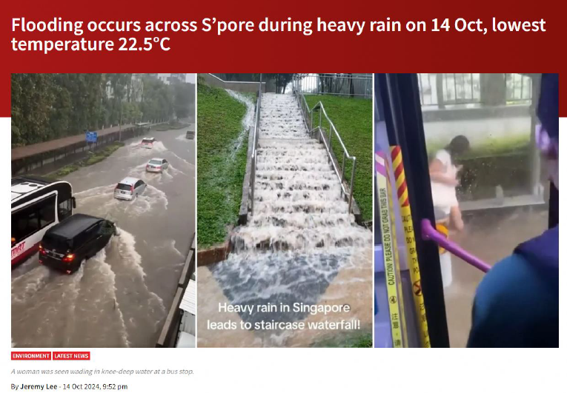
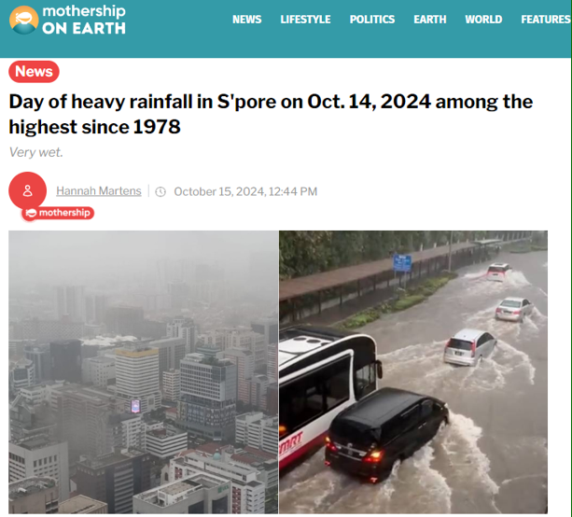
i. Impact of the Event
1. What happened?
"According to PUB (Singapore National Water Agency), 134.8mm of rainfall was recorded in western Singapore from 8:15am to 1:50pm (0015UTC and 0550UTC 14th October 2024)"
"Due to high water levels in the adjacent drains and Bukit Timah Canal, the pedestrian sidewalks and bus stops along Dunearn Road were flooded. However, PUB stated the floodwaters subsided within 20 minutes."
"The road markings on all lanes could not be seen due to the knee-deep waters at times."
"Pedestrians had to stand on the benches at the bus stop."
Top Article - courtesy MSNews
Top Article - courtesy "mothership ON EARTH"

Slide 5
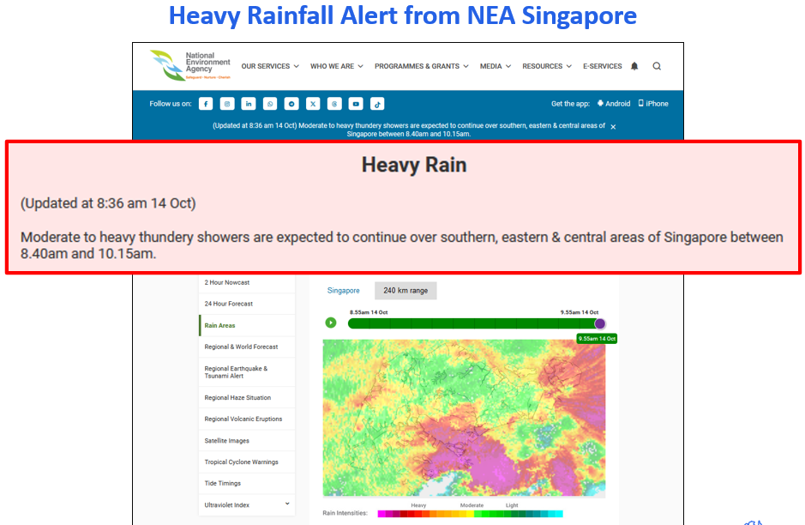
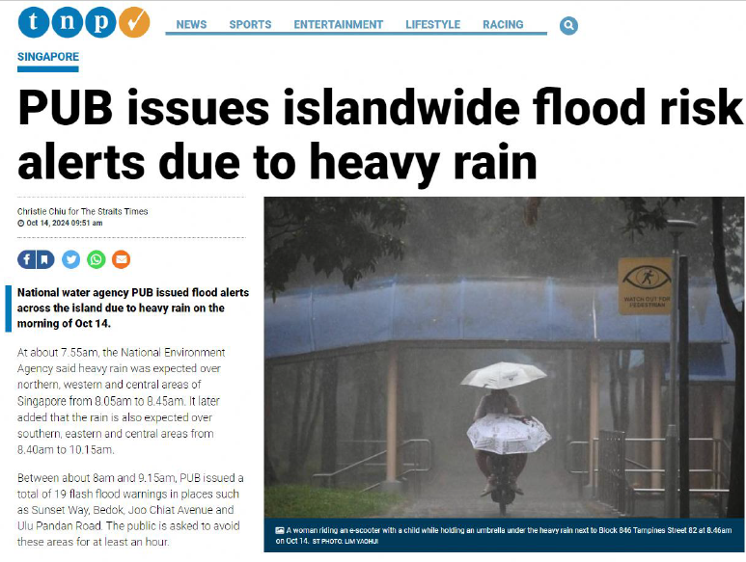
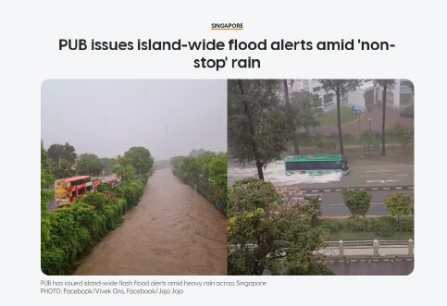
i. Impact of the Event
1. What happened?
Top image - courtesy NEA Singapore
Top Article – courtesy The New Paper
"Between about 8am and 9.15am, PUB issued a total of 19 flash flood warnings in places such as Sunset Way, Bedok, Joo Chiat Avenue and Ulu Pandan Road. The public is asked to avoid these areas for at least an hour"
Top Article – courtesy AsiaOne

Slide 6
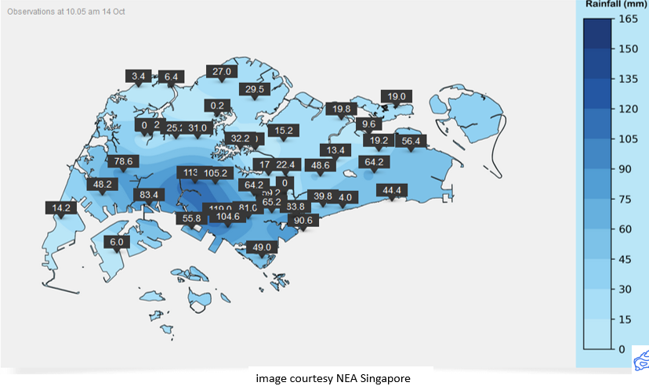
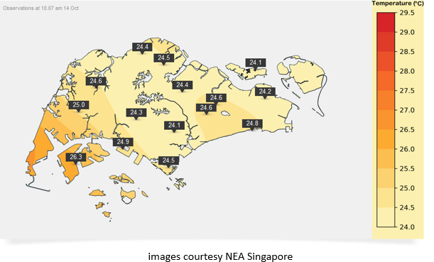
ii. Observations – Automated Weather Stations (AWS)
1. What happened?
Rainfall observations from 1600UTC 13th October to 0205UTC 14th October
i.e., midnight to 10.05am 14th October 2024
Temperature observations at 10.07am 14th Oct
Singapore City Fringe.
Precipitation more than 100mm
Changi Airport.
Precipitation 56.4mm
24.1C

Slide 7
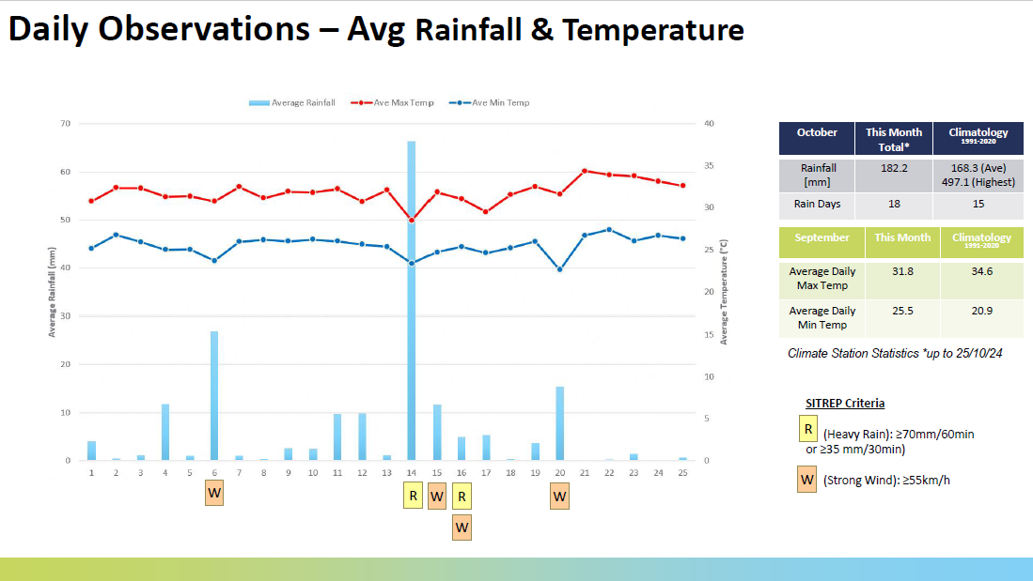
iii. Climatology
1. What happened?
"According to PUB, 134.8mm of rainfall was recorded in western Singapore from 8:15am to 1:50pm, which is among the highest recorded in over 40 years."
"This corresponds to 80 per cent of Singapore's average monthly rainfall in October and is within the top one per cent of maximum daily rainfall records since 1978."
QUESTION TO ENG HONG AND JUSTIN
How does the ~60mm precipitation on the graph relate to the 138mm of rainfall over western Singapore?
Data courtesy NEA Singapore

Slide 8
Content
What happened
Impact of the event
Observations
Climatology
Why did the event occur?
Climate Drivers and Tropical Waves
Satellite imagery and identifying the Drivers of the Weather
Evolution of the event (satellite imagery, RADAR and lightning data, surface and upper air observations).
Performance of NWP in anticipating the event.
Eng Hong and Justin to provide input
Summary
The Bureau of Meteorology
Notes:
This is the outline of our presentation

Slide 9
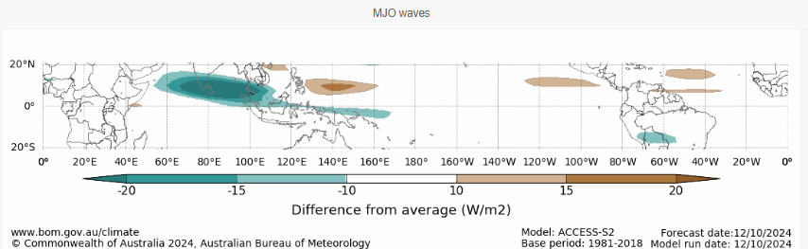
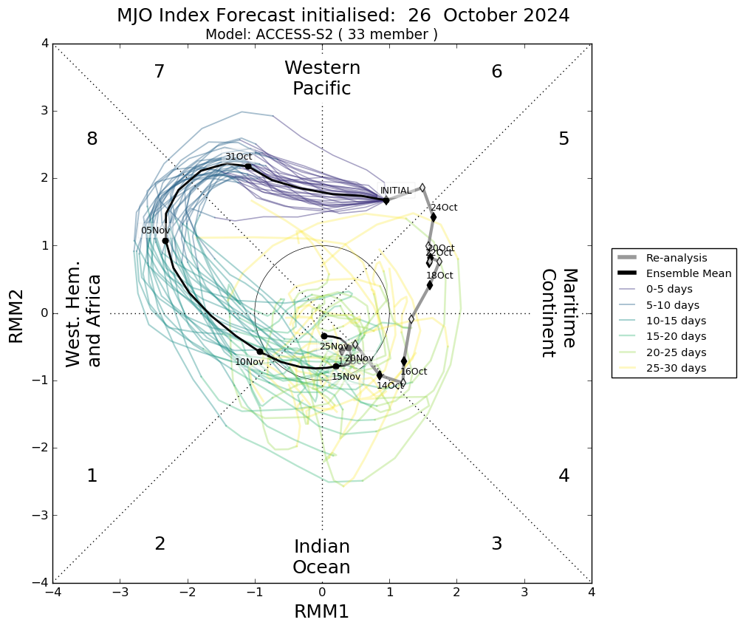
Climate Driver: Madden-Julien Oscillation (MJO)
MJO OLR anomaly signature
Very Strong –OLR Anomaly to West of Maritime region
MJO Index was just outside the Unit Circle on the 14th October 2024
14th Oct 2024
Taken from: https://www.bom.gov.au/climate/enso/wrap-up/archive/20241015.archive.shtml#tabs=Tropics

Slide 10
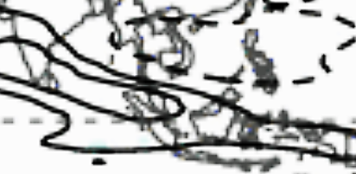
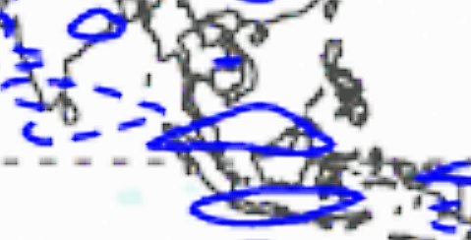
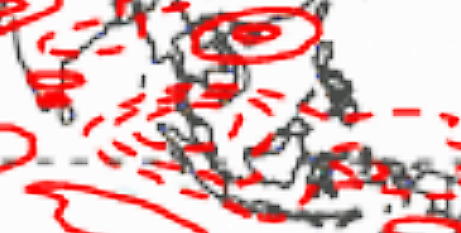

Tropical Wave Summary, 14th October 2024 (information from North Carolina Institute for Climate Studies and NOAA MJO update)
images from https://ncics.org/pub/mjo/archive/2024/2024-10-15/v2/
MJO (OLR contribution)
Weakened MJO over Indian Ocean. Competing interference with higher frequency variability in the tropics. (positive reinforcement from Kelvin waves, negative from ER waves)
Equatorial Kelvin wave
Equatorial Kelvin wave moving ahead and separating from main MJO convective envelope.
Equatorial Rossby wave
In a suppressed phase (dashed OLR anomaly contours)
S
S
S
S = Location of Singapore

Slide 11
Notes: MJO and Equatorial Wave update
(from https://www.cpc.ncep.noaa.gov/products/precip/CWlink/MJO/ARCHIVE/PDF/ )
Weakened MJO over Indian Ocean. Competing interference with higher frequency variability in the tropics.
850hPa – anomalous westerlies shift eastwards in the western Indian Ocean.
Equatorial Kelvin wave moving ahead and separating from main MJO convective envelope.
REFERENCE

Slide 12
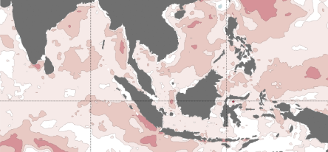
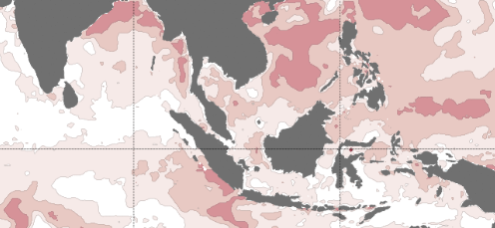
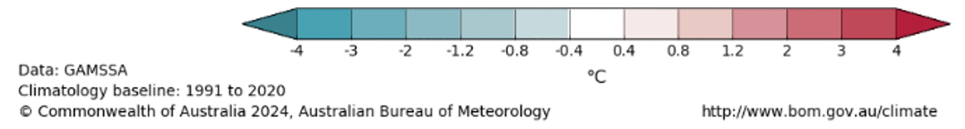
Weekly SST Anomaly (7 Oct – 13 Oct, 14 Oct – 20 Oct)
Taken from: https://www.bom.gov.au/climate/ocean/sst/#/anom/asia/weekly
Sea Surface Temperature Anomalies, 7-13th October 2024
Location of Singapore as "S"
S
About 1℃ higher SST Anomaly West of Borneo
Sea Surface Temperature Anomalies, 14-20th October 2024
Favourable region for convection
S
REFERENCE

Slide 13
Content
What happened
Impact of the event
Observations
Climatology
Why did the event occur?
Climate Drivers and Tropical Waves
Satellite imagery and identifying the Drivers of the Weather
Evolution of the event (satellite imagery, RADAR and lightning data, surface and upper air observations).
Performance of NWP in anticipating the event.
Eng Hong and Justin to provide input
Summary
The Bureau of Meteorology
Notes:
This is the outline of our presentation

Slide 14
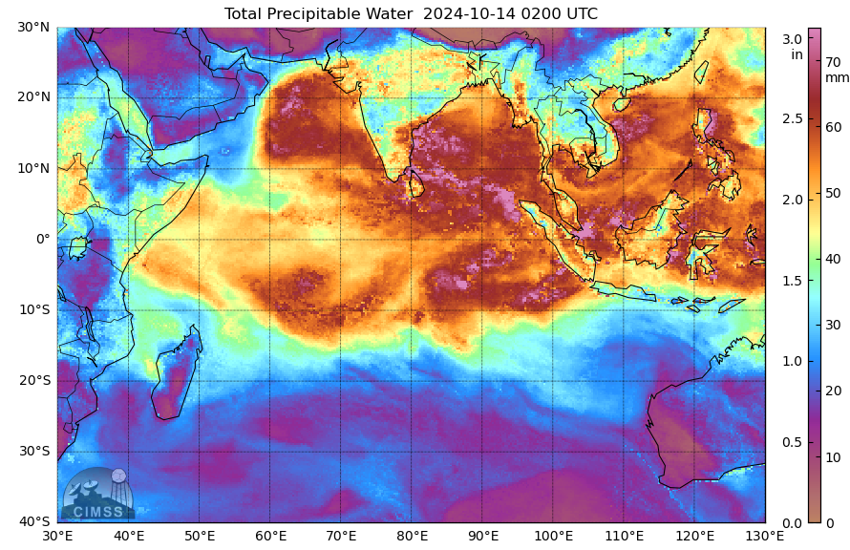
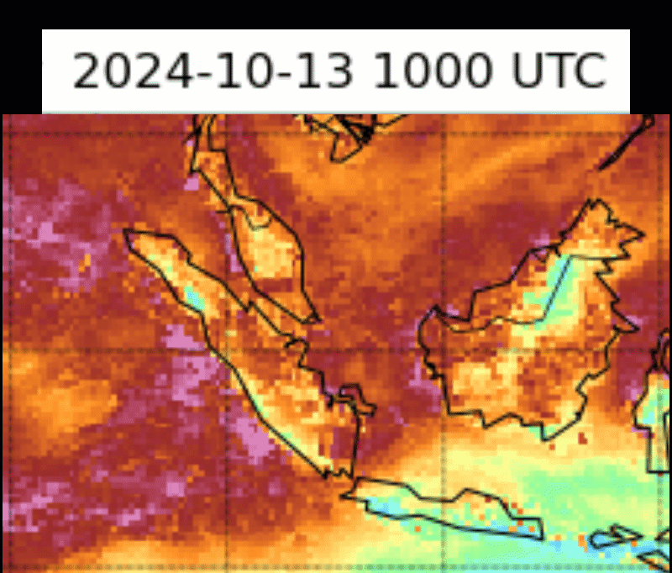
ii. Observations – Satellite derived products
1. What happened?
Animation 1
MIMIC Total Precipitable Water,
1000UTC 13th to 0200UTC 14th October 2024
S
Easterly wave moving from Borneo towards Singapore seen from pink flow of PW > 70mm at 13th Oct 19Z
Confluent flow
Clockwise rotation through here
animation courtesy SSEC / CIMSS

Slide 15
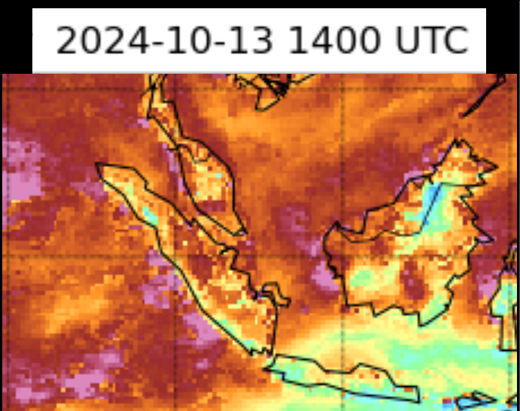
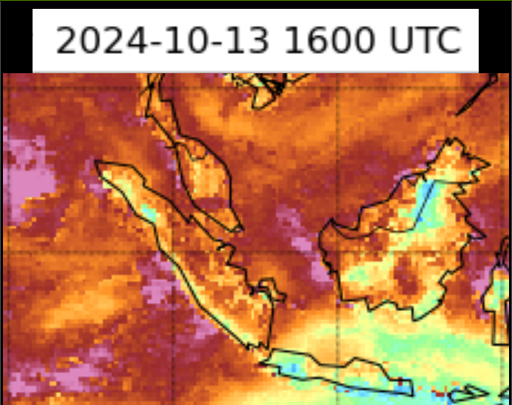
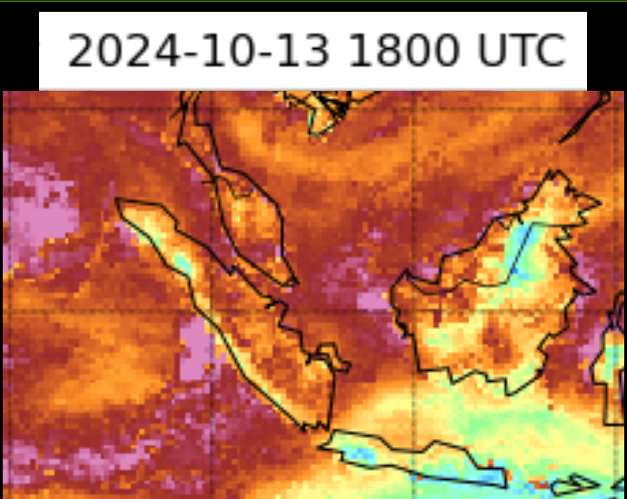

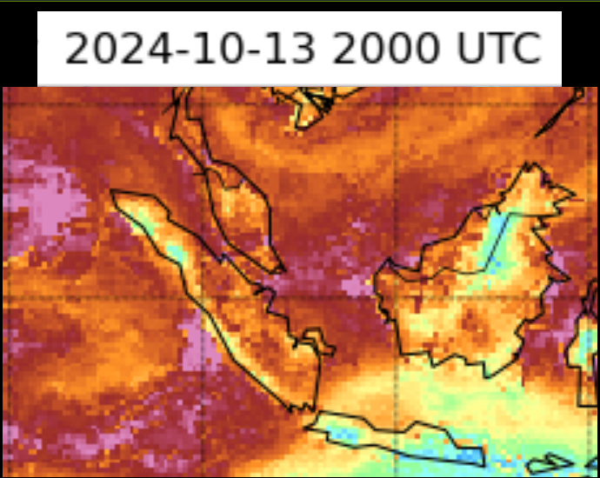
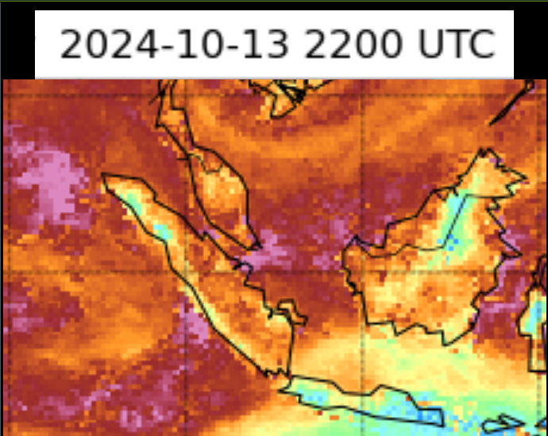
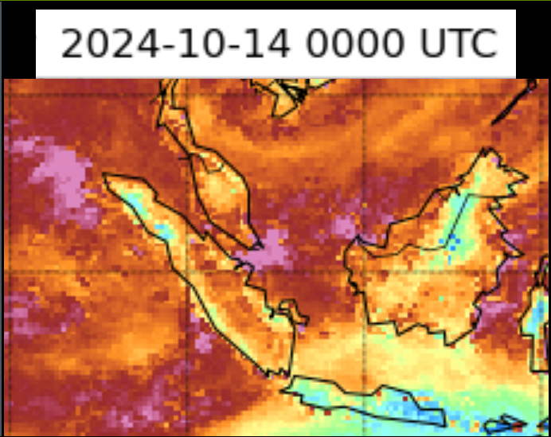
ii. Observations – Satellite derived products
1. What happened?
MIMIC Total Precipitable Water,
Two hourly images 14UTC 13th to 00UTC 14th October 2024. Singapore as "S"
S
High Precipitable Water region moving towards Singapore "S"
C
S
Confluent flow
Clockwise rotation through here
images courtesy SSEC / CIMSS

Slide 16
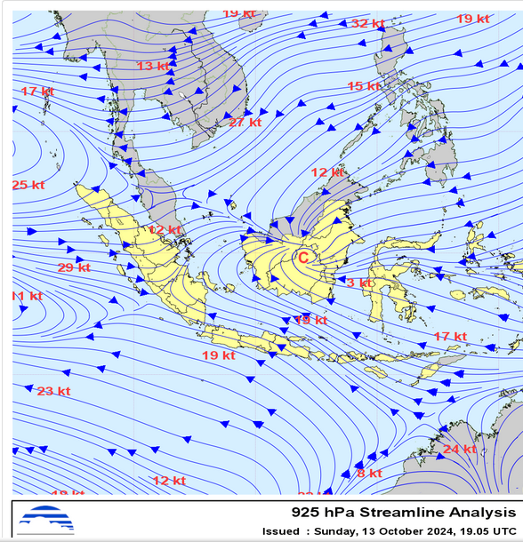
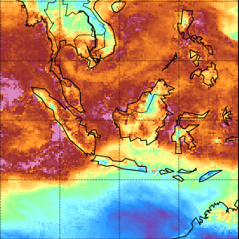
Identifying the drivers of the Weather. Streamline chart and MIMIC TPW, ~19UTC 13th October 2024.
Weak surface winds in Malaysia
supported by Col
Convergence line at North-East of Singapore
S
S
image courtesy BMKG Indonesia
image courtesy SSEC / CIMSS
Location of Singapore as "S"
Notes:
https://web-meteo.bmkg.go.id/id/pengamatan/streamline

Slide 17
Identifying the drivers of the Weather. Streamline chart and MIMIC TPW, ~19UTC 13th October 2024.
Outlines of highest precipitable water (>60mm)
S
S
Confluent flow
Clockwise rotation through here
image courtesy BMKG Indonesia
image courtesy SSEC / CIMSS
Location of Singapore as "S"
Notes:
https://web-meteo.bmkg.go.id/id/pengamatan/streamline

Slide 18
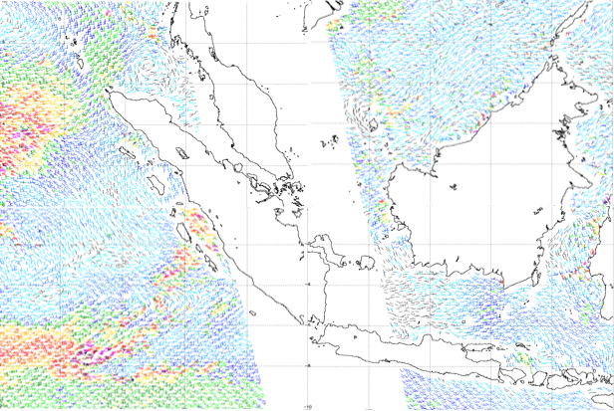
Identifying the drivers of the Weather. Streamline chart, MIMIC TPW ~19UTC 13th October 2024. OSCAT winds ~16-18UTC.
Westerly winds > 30kts
Outlines of highest precipitable water (>60mm)
S
S
Confluent flow
Clockwise rotation through here
image courtesy BMKG Indonesia
image courtesy SSEC / CIMSS
Easterly winds > 30kts
Location of Singapore as "S"
OSCAT image courtesy NOAA NESDIS STAR
Notes:
https://web-meteo.bmkg.go.id/id/pengamatan/streamline

Slide 19
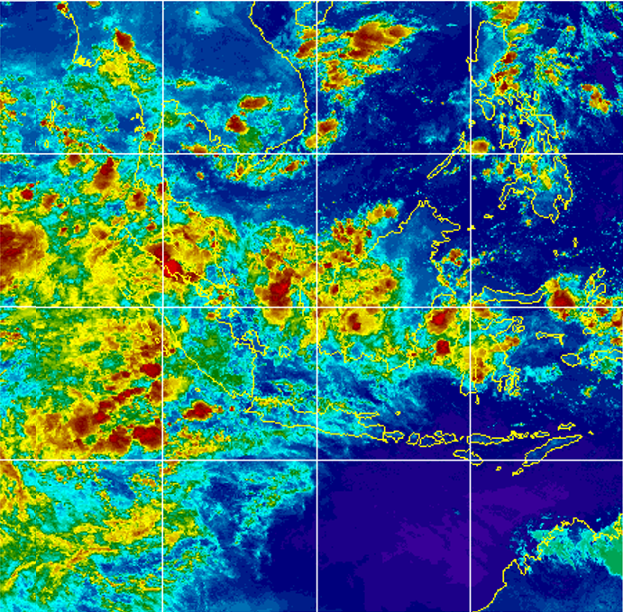

Identifying the drivers of the Weather. Streamline chart 1915UTC 13th October. Enhanced IR image 2020UTC 13th October 2024.
Location of Singapore as "S"
S
S
Himawari IR 2020UTC 13 October 2024
image courtesy BMKG Indonesia
image courtesy CIMSS University of Wisconsin-Madison
Notes:
https://web-meteo.bmkg.go.id/id/pengamatan/streamline

Slide 20
Streamline chart and enhanced IR satellite imagery. Identifying the drivers of the Weather. (highlighting areas of Tb <-50C near Singapore)
Location of Singapore as "S"
Regions of very cold cloud tops near Singapore
S
S
Himawari IR 2020UTC 13 October 2024
image courtesy BMKG Indonesia
image courtesy CIMSS University of Wisconsin-Madison
Notes:
https://web-meteo.bmkg.go.id/id/pengamatan/streamline

Slide 21
Notes: Satellite imagery and identifying the Drivers of the Weather
Animation of MIMIC-TPW imagery showed an area of high precipitable water moving towards Singapore from the east, near Kalimantan.
Animation of this imagery also showed synoptic scale confluent northeast-southeast flow to the east of Singapore, around Kalimantan island. This involved very moist airmasses (> 60mm PPW)
925hPa streamline analysis shows a WNW – ESE oriented line of confluence over the South China Sea and to the east of Singapore.
2020UTC 13th October enhanced IR satellite image shows a region of very cold cloud tops to the east of Singapore and in the abovementioned region of streamline confluence.
OSCAT data supports the streamline analysis in revealing westerly winds >30knots to the west of Sumatra, related to the MJO. These winds are in a region of very high PPW (> 70mm)
REFERENCE

Slide 22
Content
What happened
Impact of the event
Observations
Climatology
Why did the event occur?
Climate Drivers and Tropical Waves
Satellite imagery and identifying the Drivers of the Weather
Evolution of the event (satellite imagery, RADAR and lightning data, surface and upper air observations).
Performance of NWP in anticipating the event.
Eng Hong and Justin to provide input
Summary
The Bureau of Meteorology
Notes:
This is the outline of our presentation

Slide 23
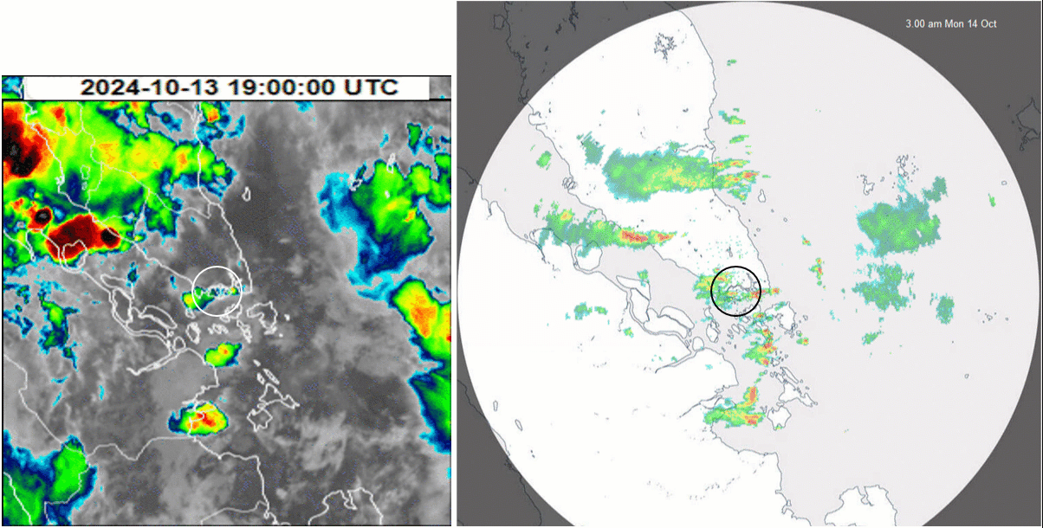


Animation 2: Singapore Heavy Rainfall Event 14th October 2024 Enhanced Himawari-9 Band 13 and Singapore RADAR 1900UTC 13th to 0630UTC 14th October
Singapore Island in the circled area
animation courtesy CIRA / RAMMB and JMA animation courtesy NEA Singapore
Notes:
Provide reasons on land breeze from Sumatra is stronger. Convergence happen inland

Slide 24
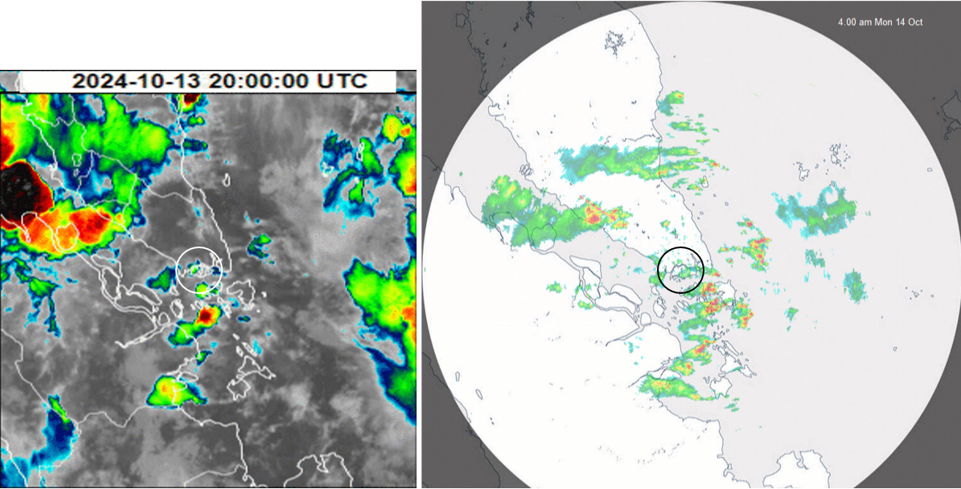
Singapore Heavy Rainfall Event 14th October 2024 Enhanced Himawari-9 Band 13 and Singapore RADAR 2000UTC 13th October
Singapore Island in the circled area
image courtesy CIRA / RAMMB and JMA image courtesy NEA Singapore

Slide 25
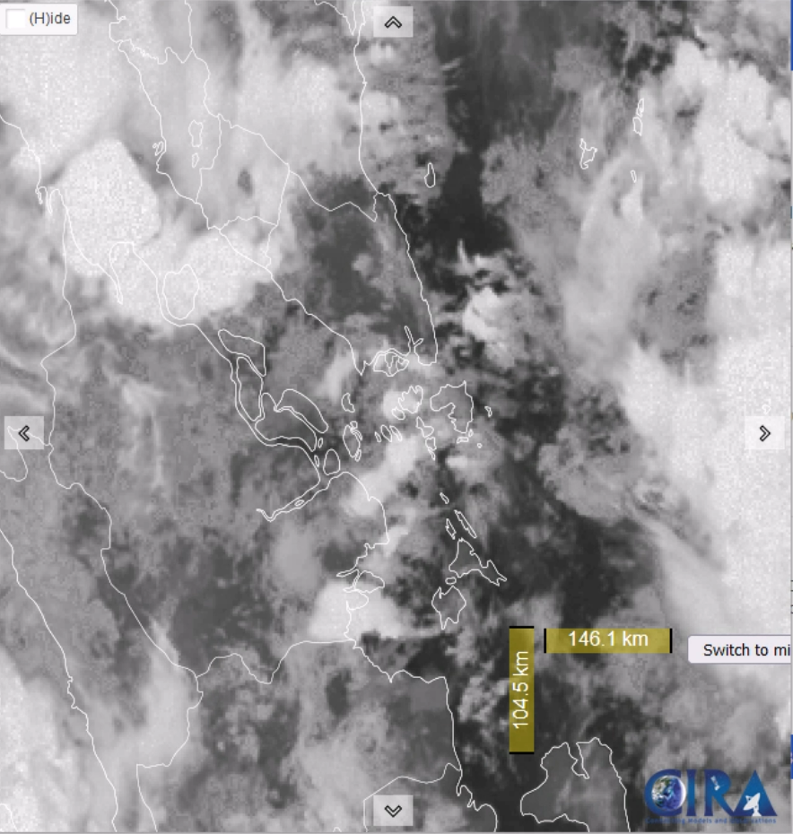
Singapore Heavy Rainfall Event 14th October 2024 CIRA ProxyVis and Singapore RADAR 2000UTC 13th October
Singapore Island in the circled area
image courtesy CIRA / RAMMB and JMA image courtesy NEA Singapore

Slide 26
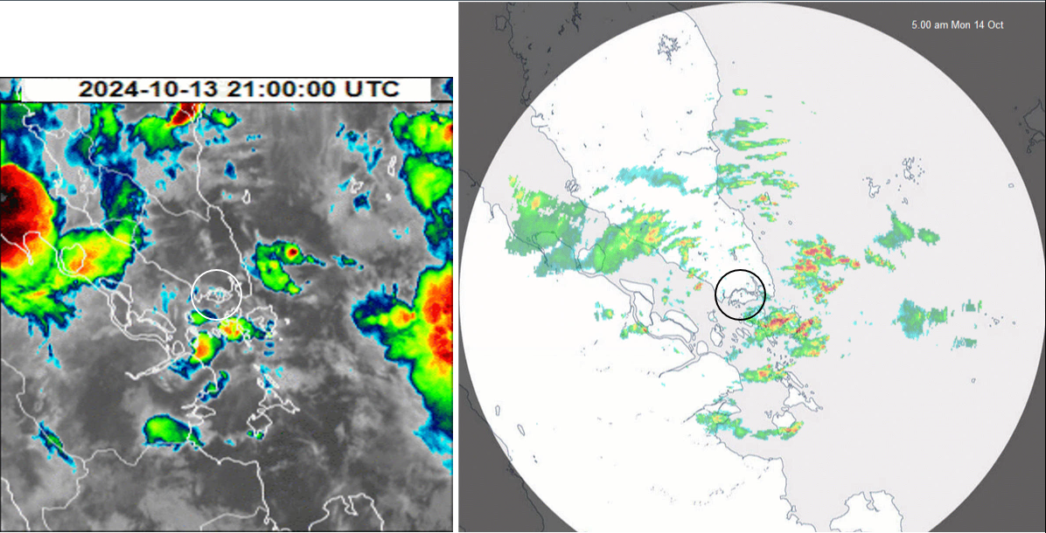
Singapore Heavy Rainfall Event 14th October 2024 Enhanced Himawari-9 Band 13 and Singapore RADAR 2100UTC 13th October
Westward propagating pptn. feature
image courtesy CIRA / RAMMB and JMA image courtesy NEA Singapore

Slide 27
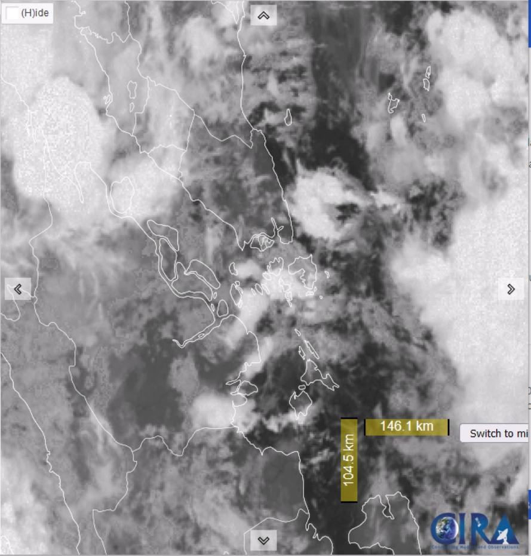
Singapore Heavy Rainfall Event 14th October 2024 CIRA ProxyVis and Singapore RADAR 2100UTC 13th October
Westward propagating pptn. feature
Linear cloud feature
image courtesy CIRA / RAMMB and JMA image courtesy NEA Singapore

Slide 28
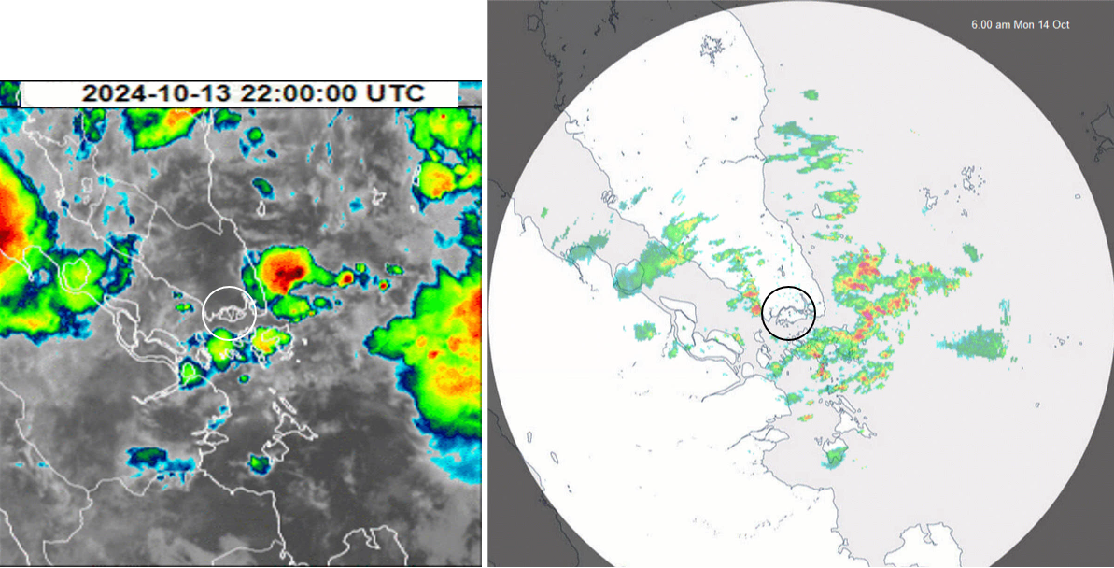
Singapore Heavy Rainfall Event 14th October 2024 Enhanced Himawari-9 Band 13 and Singapore RADAR 2200UTC 13th October
Westward propagating pptn. feature
Linear pptn. feature
image courtesy CIRA / RAMMB and JMA image courtesy NEA Singapore

Slide 29
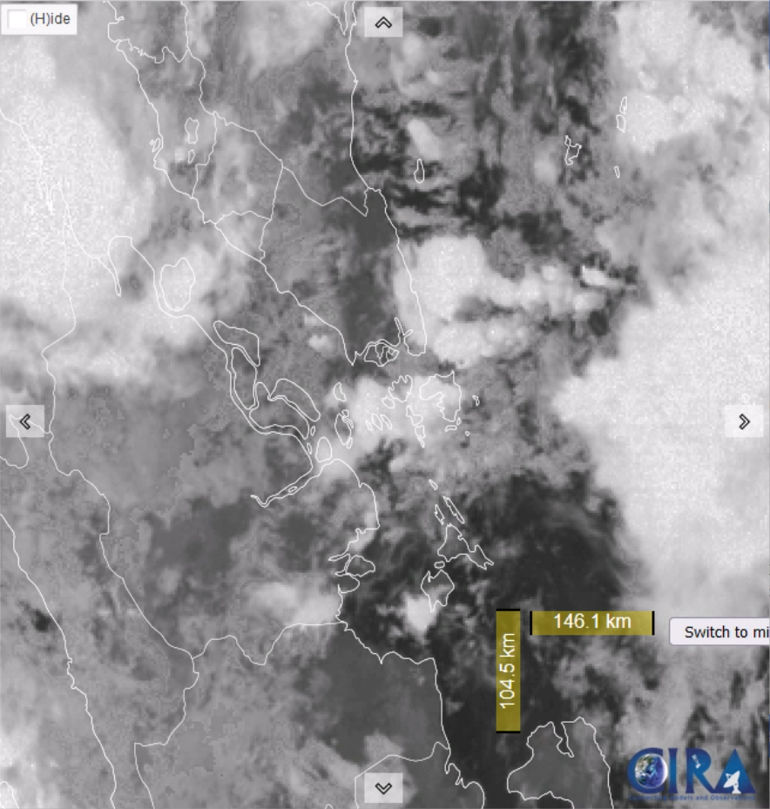
Singapore Heavy Rainfall Event 14th October 2024 CIRA ProxyVis and Singapore RADAR 2200UTC 13th October
Westward propagating pptn. feature
Linear cloud feature
Linear pptn. feature
image courtesy CIRA / RAMMB and JMA image courtesy NEA Singapore

Slide 30
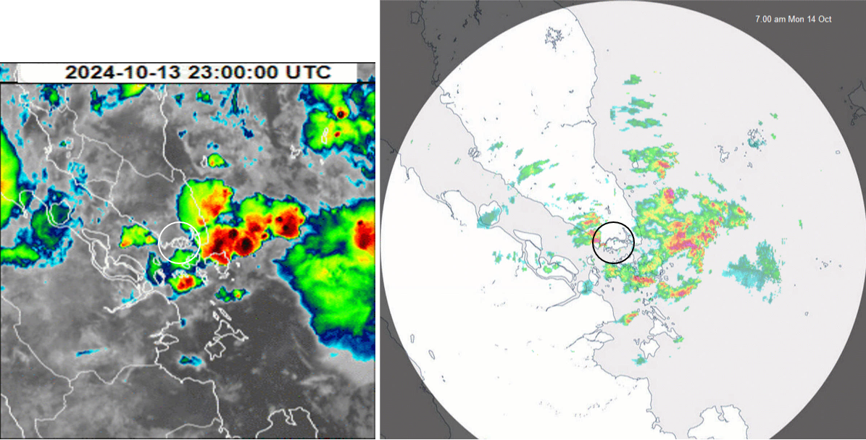
Singapore Heavy Rainfall Event 14th October 2024 Enhanced Himawari-9 Band 13 and Singapore RADAR 2300UTC 13th October
Westward propagating pptn. feature
Linear pptn. feature
image courtesy CIRA / RAMMB and JMA image courtesy NEA Singapore

Slide 31
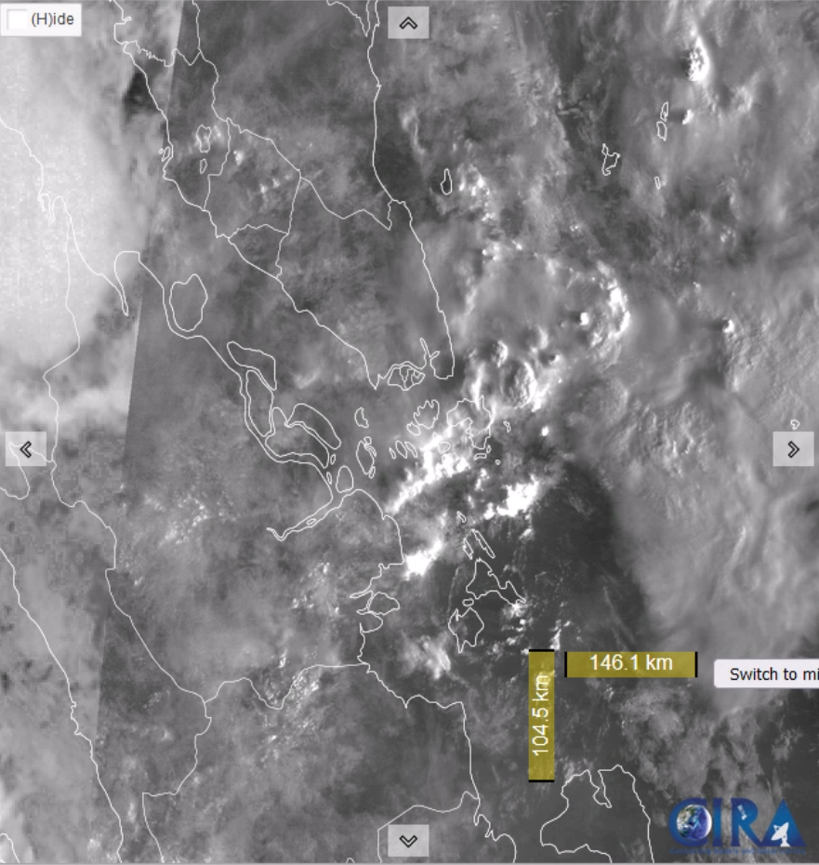
Singapore Heavy Rainfall Event 14th October 2024 CIRA ProxyVis and Singapore RADAR 2300UTC 13th October
Westward propagating pptn. feature
Linear pptn. feature
image courtesy CIRA / RAMMB and JMA image courtesy NEA Singapore

Slide 32
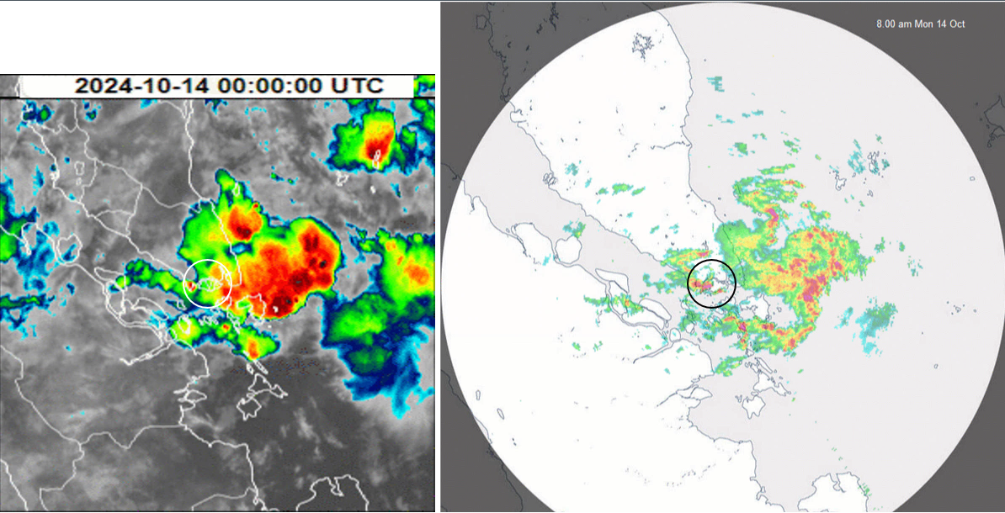
Singapore Heavy Rainfall Event 14th October 2024 Enhanced Himawari-9 Band 13 and Singapore RADAR 0000UTC 14th October
Eastward propagating pptn. feature
Westward propagating pptn. feature
Cold cloud top temp.*
Heavy pptn. event
image courtesy CIRA / RAMMB and JMA image courtesy NEA Singapore
*consider Parallax error

Slide 33
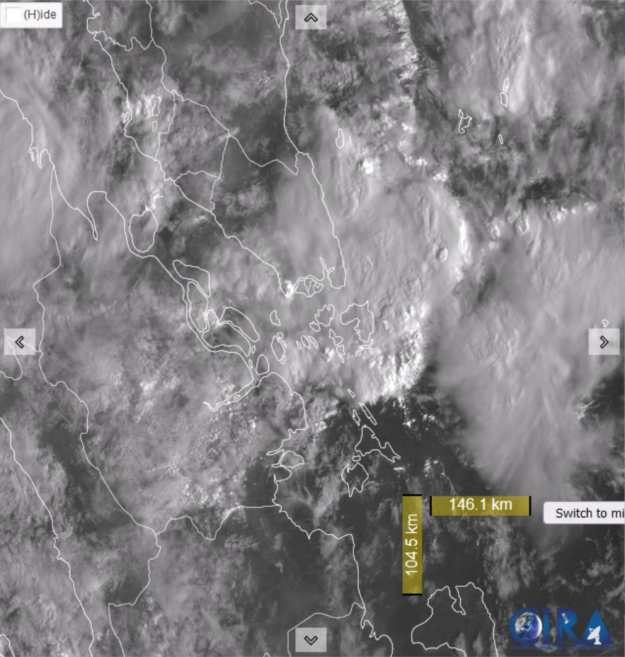
Singapore Heavy Rainfall Event 14th October 2024 CIRA ProxyVis and Singapore RADAR 0000UTC 14th October
Eastward propagating pptn. feature
Westward propagating pptn. feature
Heavy pptn event
Projecting cloud top.*
Heavy pptn. event
image courtesy CIRA / RAMMB and JMA image courtesy NEA Singapore
*consider Parallax error

Slide 34
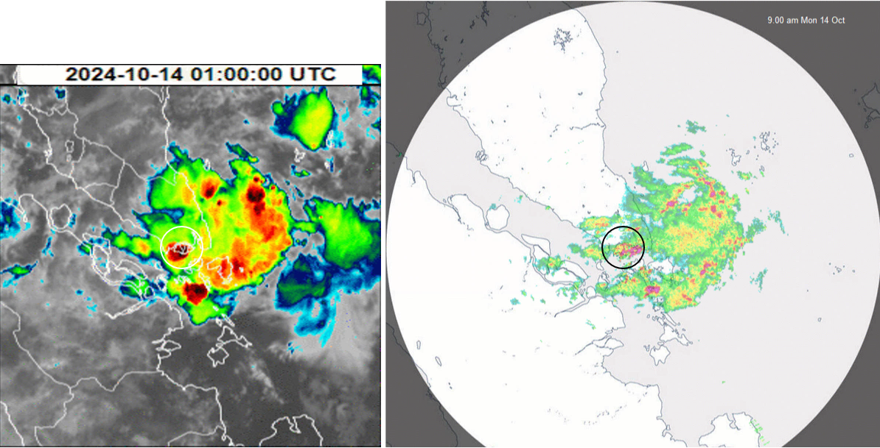
Singapore Heavy Rainfall Event 14th October 2024 Enhanced Himawari-9 Band 13 and Singapore RADAR 0100UTC 14th October
Merging of eastward and westward propagating pptn. features
Cold cloud top temp.*
Heavy pptn. event
image courtesy CIRA / RAMMB and JMA image courtesy NEA Singapore
*consider Parallax error

Slide 35
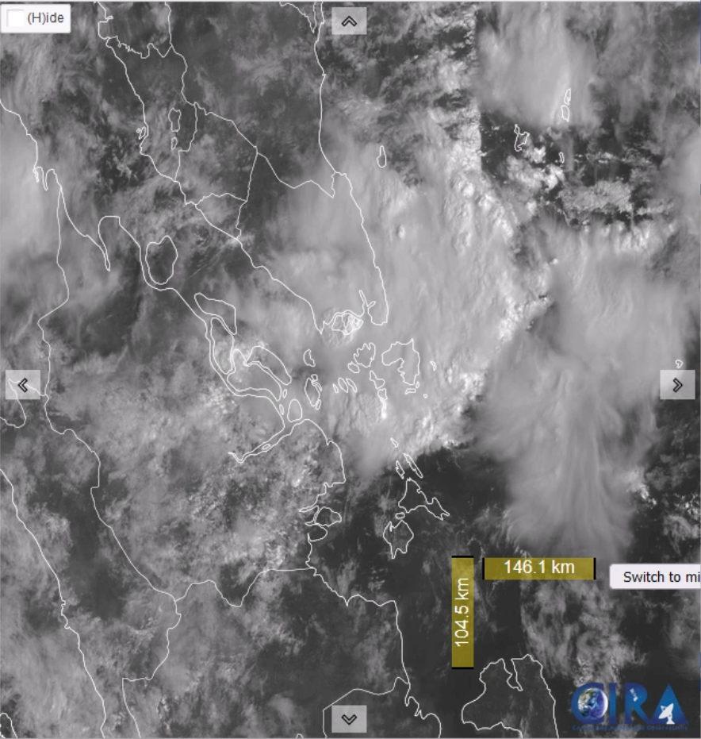
Singapore Heavy Rainfall Event 14th October 2024 CIRA ProxyVis and Singapore RADAR 0100UTC 14th October
Merging of eastward and westward propagating pptn. features
Projecting cloud top.*
Heavy pptn. event
image courtesy CIRA / RAMMB and JMA image courtesy NEA Singapore
*consider Parallax error

Slide 36
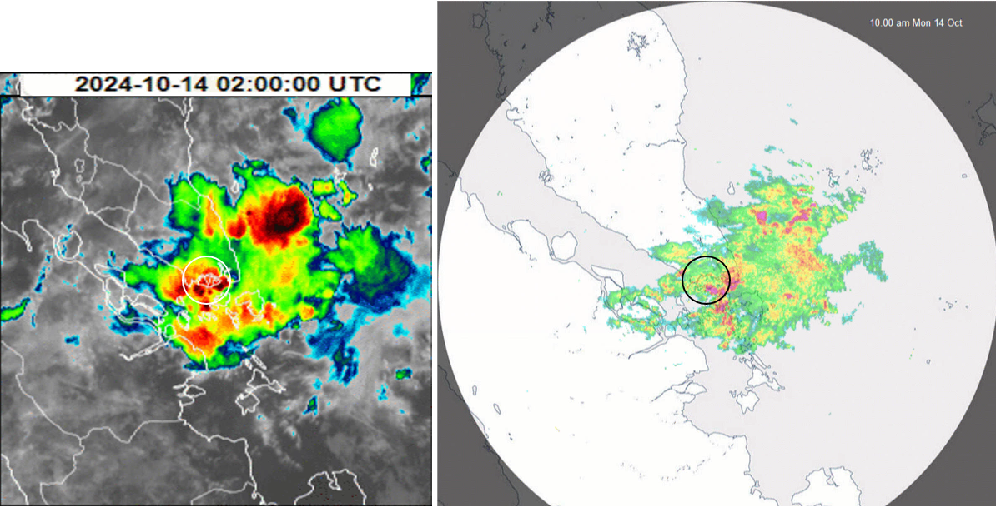
Singapore Heavy Rainfall Event 14th October 2024 Enhanced Himawari-9 Band 13 and Singapore RADAR 0200UTC 14th October
Cold cloud top temp.
(eastern and southern Singapore*)
Heavy pptn. event (E. and S. Singapore)
image courtesy CIRA / RAMMB and JMA image courtesy NEA Singapore
*consider Parallax error

Slide 37
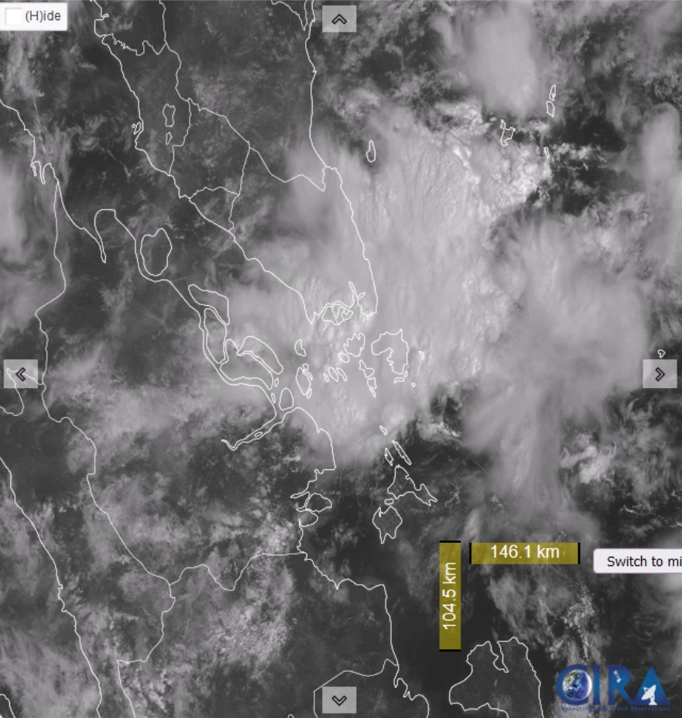
Singapore Heavy Rainfall Event 14th October 2024 CIRA ProxyVis and Singapore RADAR 0200UTC 14th October
Projecting cloud tops.
(eastern and southern Singapore*)
Heavy pptn. event (E. and S. Singapore)
image courtesy CIRA / RAMMB and JMA image courtesy NEA Singapore
*consider Parallax error

Slide 38
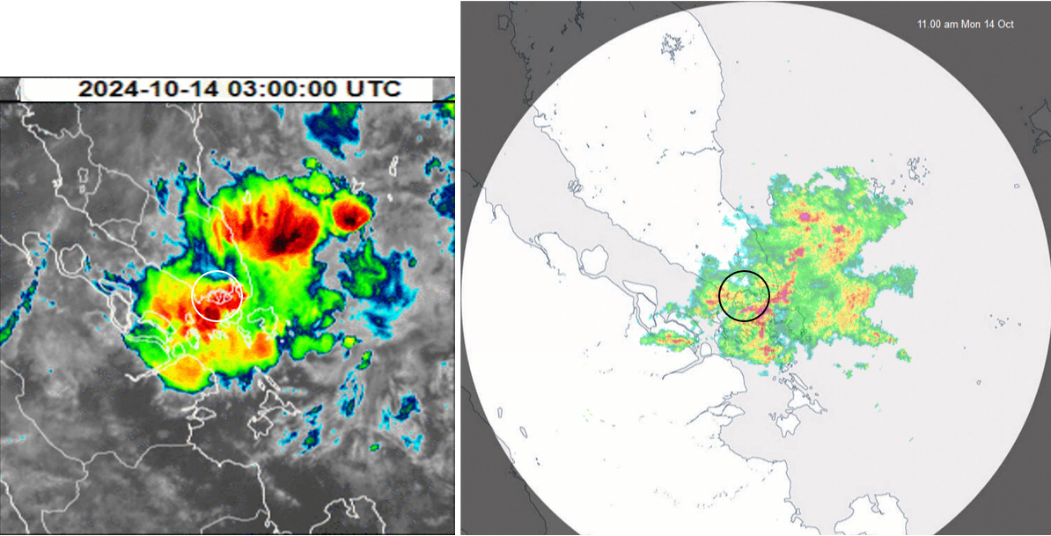
Singapore Heavy Rainfall Event 14th October 2024 Enhanced Himawari-9 Band 13 and Singapore RADAR 0300UTC 14th October
Heavy pptn. event (W. and S. Singapore)
image courtesy CIRA / RAMMB and JMA image courtesy NEA Singapore

Slide 39
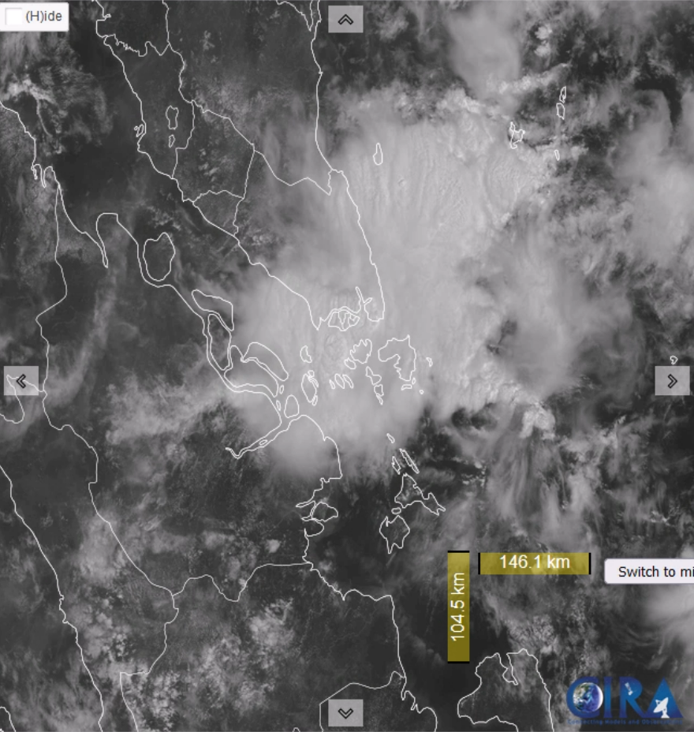
Singapore Heavy Rainfall Event 14th October 2024 CIRA ProxyVis and Singapore RADAR 0300UTC 14th October
Heavy pptn. event (W. and S. Singapore)
image courtesy CIRA / RAMMB and JMA image courtesy NEA Singapore

Slide 40
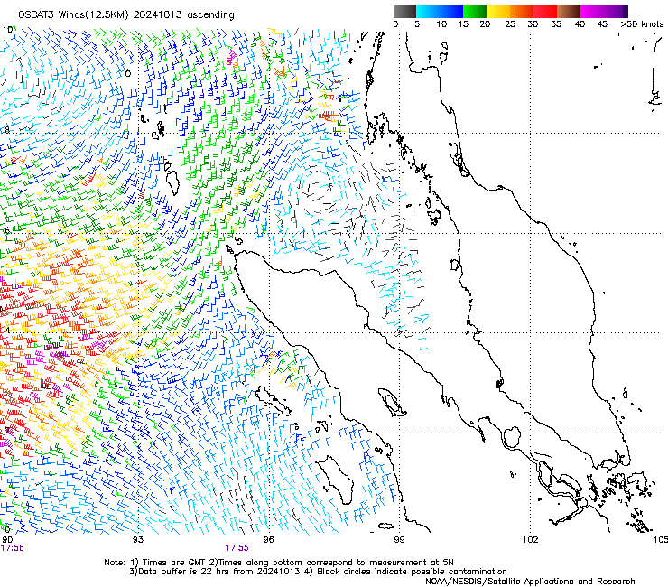
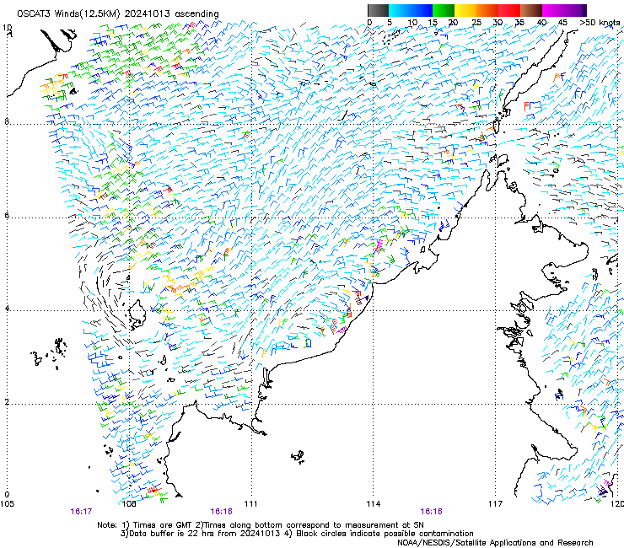
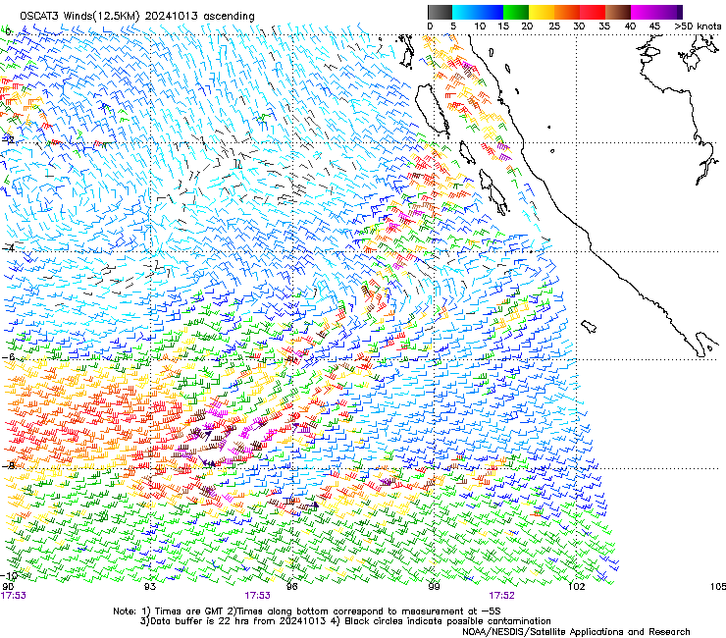
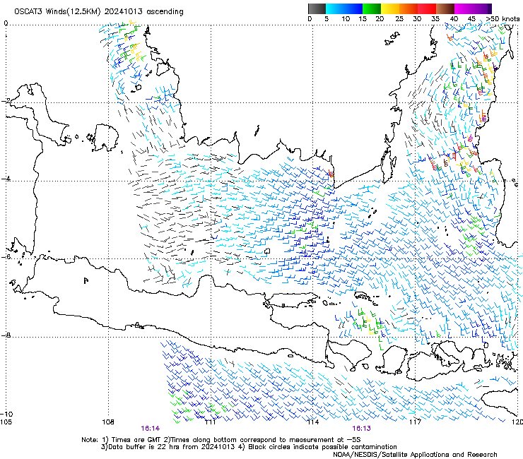
The surge in westerly winds: OSCAT data ~16-18UTC 13 Oct 2024
images courtesy NOAA NESDIS STAR
S

Slide 41
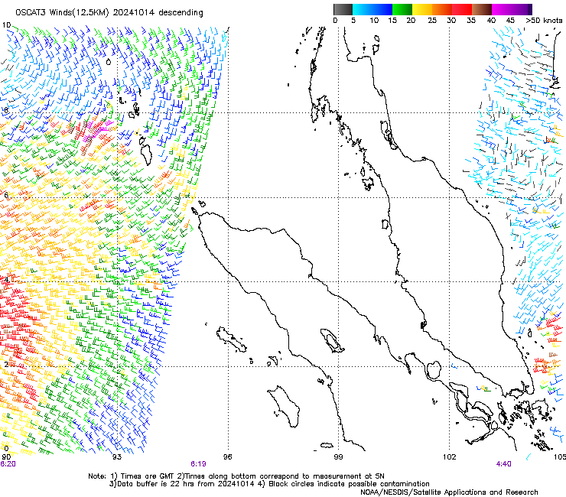





OSCAT and ASCAT-B and C data ~02-05UTC 14 Oct 2024
images courtesy NOAA NESDIS STAR
Surge in surface westerlies
Around 04UTC 14th October
S

Slide 42




GFS NWP 850hPa wind direction and speed. 21UTC 13th October to 06UTC 14th October 2024
images courtesy Cameon Beccario Nullschool Technologies Inc. https://earth.nullschool.net/
S
S
S
S
21UTC 13th October 00UTC 14th October 03UTC 14th October 06UTC 14th October
Location of Singapore as "S"
Progression of 850hPa westerly winds in red ellipse

Slide 43


ii. Observations – Satellite imageries
2. What happened?
Animation 3
Sandwich Product and Weatherzone Lightning,
00UTC to 02UTC 14th October 2024 (8am – 10am LT)
Deep convection moving westward
Slow eastward movement of the lightning signal in the animation here
animation courtesy JMA / Bureau of Meteorology. Lighting data courtesy Weatherzone

Slide 44












Comparison of Singapore Radar with Sandwich Product
satellite images courtesy JMA / Bureau of Meteorology. Lighting data courtesy Weatherzone. RADAR data courtesy NEA Singapore
Consider parallax of storm tops in relation to RADAR
0000UTC
0030UTC
0100UTC
8am SGT
8.30am SGT
9am SGT

Slide 45








Comparison of Singapore Radar with Sandwich Product
satellite images courtesy JMA / Bureau of Meteorology. Lighting data courtesy Weatherzone. RADAR data courtesy NEA Singapore
Consider parallax of storm tops in relation to RADAR
0100UTC
0130UTC
0200UTC
9am SGT
9.30am SGT
10am SGT

Slide 46

Lightning data, 0130-0200UTC 14th October 2024
image courtesy NEA Singapore

Slide 47
Notes: RADAR, Satellite Imagery and Lightning Data (part 1)
Inspection of RADAR data indicates eastward and westward propagating mesoscale lines of precipitation moving towards Singapore. First identified between 21UTC and 23UTC 13th October:
The eastward propagating line is first revealed near the Malacca Straits. This appears to be best defined in the CIRA Proxy VIS imagery and in the RADAR data, as it is largely composed of low cloud. It appears to be an outflow feature from storms over the Malacca Straits around 19UTC, or a cloud ahead of a low-level westerly wind surge.
The westward propagating line is first revealed over the South China Sea. This appears to be associated with deep convection. It can easily be followed in the animation of the Himawari-9 enhanced IR imagery.
The collision of these linear disturbances over Singapore around 01UTC appears to play a role in the heavy precipitation event.
REFERENCE

Slide 48
Notes: RADAR, Satellite Imagery and Lightning Data (part 2)
Some interaction of the eastward moving line with Singapore island may also have contributed (deep convection appearing there around 2330UTC 13th and 0000UTC 14th October)
The surge in the low surface westerly winds detected in OSCAT data over South China Sea waters to the north of Singapore around 04UTC is also of interest. GFS NWP archived data from the Nullschool website indicates that this low-level westerly wind surge propagated across Sumatra before impacting the Singapore region. This surge of winds could have contributed to the shallow cloud line that formed near the Malacca Straits and moved towards eastwards toward Singapore.
Deep convective activity and associated lightning progressed from western Singapore (around 00UTC, 14th October) across the island, markedly increasing in intensity from 01UTC.
REFERENCE

Slide 49


Singapore Sounding, 00UTC 14th October 2024 (as derived from the Sondehub website)
image from https://sondehub.org/#!mt=Mapnik&mz=11&qm=6h&mc=1.31996,103.84415&f=3105217&q=3105217

Slide 50

Singapore Sounding, 00UTC 14th October 2024 (as derived from the Sondehub website)
Very moist trace.
High precipitable water.
Variable steering winds (850-600hPa)
Low level (SFC to 800hPa westerly winds)
image from https://sondehub.org/#!mt=Mapnik&mz=11&qm=6h&mc=1.31996,103.84415&f=3105217&q=3105217

Slide 51


iii. Archived NWP outputs – ACCESS-G and Heavy Rainfall Threshold
2. Why did it occur?
Note: Outputs from ACCESS-G compiled for post-event analysis and not used during operations
ACCESS-G Heavy Rainfall Diagnostics, 00UTC 14th October 2024
Bureau of Meteorology Criteria
Heavy Rain indicated when:
DLM Winds (800-600hpa) =<10knots,
Warm Cloud depth >=3km
Average RH (SFC-600hPa) >=70%
Precipitable Water >=25mm
Higher values of 850hPa Moisture Transport
Strong anticlockwise turning of winds
ACCESS-G Singapore sounding
00UTC 14th October 2024
Images courtesy Bureau of Meteorology (BoM)
Analysis by Bodo Zeschke, BoM

Slide 52

iii. Archived NWP outputs – ACCESS-G and Heavy Rainfall Threshold
2. Why did it occur?
Note: Outputs from ACCESS-G compiled for post-event analysis and not used during operations
This event
ACCESS-G Heavy Rainfall Diagnostics, 00UTC 14th October 2024
6th October
Bureau of Meteorology Criteria
Heavy Rain indicated when:
DLM Winds (800-600hpa) =<10knots,
Warm Cloud depth >=3km
Average RH (SFC-600hPa) >=70%
Precipitable Water >=25mm
Higher values of 850hPa Moisture Transport
Strong anticlockwise turning of winds
ACCESS-G Singapore sounding
00UTC 14th October 2024
Images courtesy Bureau of Meteorology (BoM)
Analysis by Bodo Zeschke, BoM

Slide 53

Changi Airport SYNOPS and precipitation 12UTC 13th to 06UTC 14th Oct
data courtesy OGIMET https://www.ogimet.com/
Still need to check that I have decoded the SYNOPS correctly.
Will check this with a Bureau expert soon.
69907 = Trace in 3 hours
69905 = Trace in 1 hr
69985 = 0.8mm in 1 hr
60017 = 1mm in 3 hours
60225 = 22mm in 1 hr
60335 = 33mm in 1 hr
60587 = 58mm in 3 hours
60035 = 3mm 1 hour
60045 = 4mm in 1 hour
60077 = 7mm in 3 hours

Slide 54


Changi Airport observations and TAF, 12-18UTC 13th October 2024
data courtesy OGIMET https://www.ogimet.com/
Wind direction

Slide 55


Changi Airport observations and TAF, 18UTC 13th - 00UTC 14th October 2024
data courtesy OGIMET https://www.ogimet.com/
Wind direction

Slide 56


Changi Airport observations and TAF, 00-06UTC 14th October 2024
data courtesy OGIMET https://www.ogimet.com/
Wind direction

Slide 57
Notes: Soundings, SYNOPS, METARs and TAF's (part 1)
Singapore soundings (observed and ACCESS NWP):
Indicate low level easterlies, below 800hPa. This corresponds to the observed low-level cloud line and associated precipitation approaching Singapore from the west . Observed steering winds (850-600hPa) are variable. Very high precipitable water (NWP has 63.4mm).
Notable anticyclonic turning of winds with height could indicate warm air advection (southern hemisphere).
Changi Airport SYNOP observations indicate that the main precipitation event occurred between 00UTC and 03UTC with 58mm falling in the three hours.
REFERENCE

Slide 58
Notes: Soundings, SYNOPS, METARs and TAF's (part 2)
Changi Airport METAR and SPECI observations indicated:
Light NW winds from 1330-1744UTC 13th October
Light SW/SE winds from 1744-2030UTC 13th October
Calm winds from 2030UTC 13th October to 00UTC 14th October.
Generally light SW/SE winds from 00UTC – 0430UTC 14th October.
QUESTION TO ENG HONG AND JUSTIN
Input from you and from other NEA Singapore forecasters regarding the observations of these two slides would be great.
REFERENCE

Slide 59
Content
What happened
Impact of the event
Observations
Climatology
Why did the event occur?
Climate Drivers and Tropical Waves
Satellite imagery and identifying the Drivers of the Weather
Evolution of the event (satellite imagery, RADAR and lightning data, surface and upper air observations).
Performance of NWP in anticipating the event.
Eng Hong and Justin to provide input
Summary
QUESTION TO ENG HONG AND JUSTIN
It would be great if you could select 3-5 slides from the following slides and compose a brief summary of the performance of NWP prior to the event
The Bureau of Meteorology
Notes:
This is the outline of our presentation

Slide 60

iii. Archived NWP outputs – ECMWF Deterministic
2. Why did it occur?
Images courtesy ECMWF
Analysis by Ma Ka Kui, NEA Singapore

Slide 61

iii. Archived NWP outputs – ECMWF Deterministic
2. Why did it occur?
Images courtesy ECMWF
Analysis by Ma Ka Kui, NEA Singapore

Slide 62

iii. Archived NWP outputs – ECMWF Deterministic
2. Why did it occur?
Images courtesy ECMWF
Analysis by Ma Ka Kui, NEA Singapore

Slide 63

iii. Archived NWP outputs – ECMWF Deterministic
2. Why did it occur?
ECMWF 700hPa Streamline Analysis
image courtesy EUMETRAIN; Collected by Bodo Zeschke, BoM

Slide 64

iii. Archived NWP outputs – ECMWF Deterministic
2. Why did it occur?
Images courtesy ECMWF
Analysis by Ma Ka Kui, NEA Singapore

Slide 65

iii. Archived NWP outputs – ECMWF Deterministic
2. Why did it occur?
Images courtesy ECMWF/NEA Singapore
Compiled by Ma Ka Kui, NEA Singapore

Slide 66

iii. Archived NWP outputs – SINGV Deterministic
2. Why did it occur?
Surge in westerlies
Images courtesy NEA Singapore
Analysis by Ma Ka Kui, NEA Singapore

Slide 67

iii. Archived NWP outputs – SINGV Deterministic
2. Why did it occur?
Surge in westerlies
Images courtesy NEA Singapore
Analysis by Ma Ka Kui, NEA Singapore

Slide 68

iii. Archived NWP outputs – SINGV Deterministic
2. Why did it occur?
Images courtesy NEA Singapore
Compiled by Ma Ka Kui, NEA Singapore
GOOD COMPARISON. MODEL TOP, RADAR BOTTOM

Slide 69

iii. Archived NWP outputs – SINGV Deterministic
2. Why did it occur?
WHICH MODEL DOES NEA SINGAPORE USE THE MOST?
Images courtesy NEA Singapore
Compiled by Ma Ka Kui, NEA Singapore
GOOD COMPARISON ACROSS NWP RUNS

Slide 70

iii. Archived NWP outputs – EC Ensemble
2. Why did it occur?
Images courtesy ECMWF
Compiled by Ma Ka Kui, NEA Singapore

Slide 71

iii. Archived NWP outputs – EC Ensemble
2. Why did it occur?
Images courtesy ECMWF
Compiled by Ma Ka Kui, NEA Singapore

Slide 72

iii. Archived NWP outputs – EC Ensemble
2. Why did it occur?
Images courtesy ECMWF
Compiled by Ma Ka Kui, NEA Singapore

Slide 73

iii. Archived NWP outputs – SINGV Ens
2. Why did it occur?
Images courtesy ECMWF
Analysis by Ma Ka Kui, NEA Singapore

Slide 74

iii. Archived NWP outputs – SINGV Ens
2. Why did it occur?
Images courtesy ECMWF
Analysis by Ma Ka Kui, NEA Singapore

Slide 75
Summary
What happened
Impact of the event
Observations
Climatology
Why did the event occur?
Active phases of the MJO and Kelvin wave in the area.
Satellite imagery and identifying the Drivers of the Weather
Evolution of the event (satellite imagery, RADAR and lightning data, surface and upper air observations). Collision of west and east moving precipitating lines over the Singapore area.
Performance of NWP in anticipating the event.
Eng Hong and Justin to provide input
Summary
The Bureau of Meteorology
Notes:
This is the outline of our presentation

Slide 76
Thank You ☺
Eng Hong ANG
Justin HENG
Notes:
Accessibility information – delete after reading
We're all responsible for producing accessible documents. Use the accessibility checker to make sure your content is accessible to everyone.

